Slide 1
SlideFusion Surrogacy Wheelchair with Implicit Eyegaze Modality Sharing
Wong, Shing Ming 19 Oct. 2021

Slide 2
Info of the paper
Contributions:
To propose the design of a remote surrogacy wheelchair system
To explore the use of eye gaze modality for implicit communication and vision awareness sharing
Research by Keio University
Graduate School of Media Design
ACM SIGGRAPH 2020 - Emerging Technologies
Times Cited: 0 (from Google Scholar at Oct 18, 2021)
Keywords
Accessibility wheelchairs, Collaborative Systems, Eye gaze, Telepresence

Slide 3
Overview

Slide 4
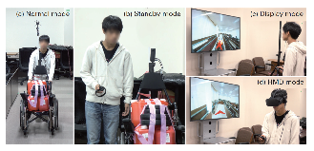
Related Work - Surrogacy Wheelchair
Audio and omni-visual feedback to the remote nursing operator
Focusing on the navigation and verbal guidance to the wheelchair patient
Cons
Needed maintain constant verbal communication with the remote operator
Lacked physical support
Satoshi Hashizume, Ippei Suzuki, Kazuki Takazawa, Ryuichiro Sasaki, and Yoichi Ochiai. 2018. Telewheelchair: The remote controllable electric wheelchair system combined human and machine intelligence. In Proceedings of the 9th Augmented Human International Conference. 1–9.

Slide 5
Related Work - Physical collaborative
Proposing a shared point of view collaboration
extends the limbs mobility and actions of the operator using two robotic arms mounted on the surrogate body
Cons
the remote operator does not have a clear understanding of the user’s visual awareness and attention
MHD Yamen Saraiji, Tomoya Sasaki, Reo Matsumura, Kouta Minamizawa, and Masahiko Inami. 2018. Fusion: Full Body Surrogacy for Collaborative Communication. In ACM SIGGRAPH 2018 Emerging Technologies (Vancouver, British Columbia, Canada) (SIGGRAPH ’18). Association for Computing Machinery, New York, NY, USA, Article 7, 2 pages. https://doi.org/10.1145/3214907.3214912
Notes:
A) 使用手勢和指示的直接動作
B) 通過強制”代理”身體到某些位置來強制其姿勢
C) 通過改變對身體姿勢的感知來誘發運動（紅色箭頭代表誘發運動）

Slide 6
Related Work - remotely located pairs of people to collaborate during visual search, using shared gaze and speech
Pairs of searchers performed better than solitary searchers
Conclusion
shared gaze affords a highly efficient method of coordinating parallel activity in a time-critical spatial task
Susan E. Brennan, Xin Chen, Christopher A. Dickinson, Mark B. Neider, and Gregory J. Zelinsky. 2008. Coordinating cognition: The costs and benefits of shared gaze during collaborative search. Cognition 106, 3 (2008), 1465 – 1477. https://doi.org/10.1016/j.cognition.2007.05.012
Notes:
展示了與口頭交流相比，在搜索任務中共享眼睛注視模式的有效性，因為它需要用戶 interest of visual 和注意力。
共享注視提供了一種在時間緊迫的空間任務中協調並行活動的高效方法

Slide 7
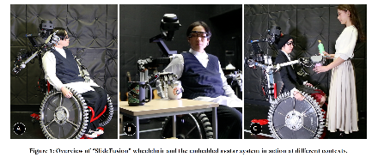
SlideFusion - surrogacy wheelchair system
Adding implicit eye gaze modality shared by the wheelchair user to the remote operator
Providing indirect communication with the remote operator
Sharing implicit intentions
Expanding the visual awareness of the user
Notes:
用於提取用戶的顯著性信息和視覺感知: 提供與遠程操作員的間接通信, 共享隱含info, 擴展用戶視覺感知

Slide 8
Avatar system
Stereoscopic vision, binaural auditory, and motion mapping
Remote user operates it using a head-mounted display
Datagloves to measure hands posture
Latency < 100ms

Slide 9
Safety considerations
The torque is limited
The software limits are set to avoid reaching the user’s body

Slide 10
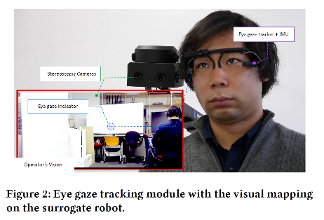
Eye-tracking module
Eye gaze info is overlaid into the visual feedback stream allowing the remote user to visually understand the real-time attention of the wheelchair user
Notes:
For example, the remote operator can directly understand the object of interest without verbal communication or physical pointing by the user

Slide 11
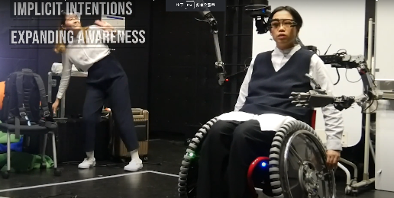
User experience
When the operator is viewing a completely different perspective
Extending the user’s visual awareness
Notes:
the operator would be aware that it is not what the wheelchair is seeing

Slide 12
Operation
Using head-mounted display and hand tracking devices to control the surrogacy robot
User sits on the wheelchair and operate it. This user is equipped with an eye-gaze tracking device to capture their eye movement and share it implicitly with the remote operator.

Slide 13
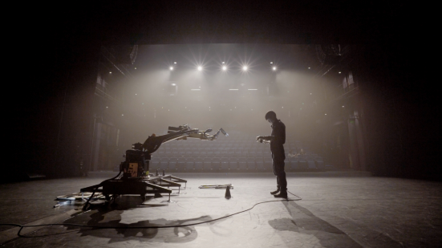
P.S.: A human-robot dance duet

