Slide 1
First Impression: AI Understands Personality TechArt Seminar, National Tsing Hua University
Wong, Shing Ming
Week 16 - Dec 28, 2021

Slide 2
Info. Of paper
Introduction
System Pipeline and Method
Results and Conclusion
Other resources/materials

Slide 3
Info. of the paper
Research by University of Science and Technology Beijing
Xiaohui Wang, Xia Liang, Miao Lu and Jingyan Qin
Conference: MM ‘2020 (Interactive Art)
CCS Concept: Media arts, Interactive systems and tools, Applied computing, Human-centered computing
Keywords: Personality, Beijing opera, Facial makeup, Morphing

Slide 4
Introduction
Purpose: Discussing the first impression. Letting AI understand human personality at first glance.
How:
Detects faces
Recognizes personality from facial appearance
Finds the matching Beijing opera facial makeup
Representation:
Using Beijing opera facial makeup to representation the human personalities

Slide 5
Why Beijing opera facial makeup
Using words to describe the people personality for the first encounter is not very accurate
Abstract patterns and images can be more accurate to describe because it is specific
Beijing opera facial makeup combination of realism and symbolism to exaggerate the appearance of certain characters
Representation the personality of characters
Suitable for visualizing personality

Slide 6
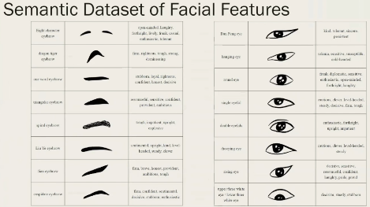
Beijing opera facial makeup dataset
Notes:
Each character contains one or two facial makeups, name, opera source, period of the character and a few personality words

Slide 7
System Pipeline
Notes:
The camera captures images in real time -> 68 landmark points.
The facial feature classification is to classify eyebrow, eye, nose and mouth to specific semantic categories respectively.
The matching makeup is founded by the semantic tree matching algorithm.
The morphing process shows the abstract process from real face to facial makeup

Slide 8
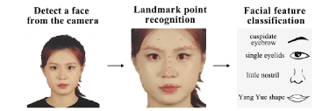
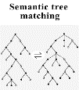
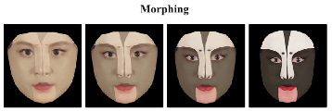
Method
Landmark point recognition -> 68 landmark points
Real face to four specific categories (semantic facial features)
Eyebrow
Eye
Nose
Mouth
Semantic facial features
WordNet
Notes:
Node: personality words and the numbers of their occurrence
Real face -> four features -> tree
Mask->tree

Slide 9
Results and Conclusion
Users can find the facial makeup and be aware of the personality according to their facial features. During the processing, users can see the process of AI understanding personality and the morphing from real face to the matching facial makeup.

Slide 10
Discuss and Other Resources/Materials
This artwork find the user personality according to the user facial feature -> low diversity
Consider adding the user emotion for model reference
Mind, 2019
Notes:
Facial expression affects people product first impression more

