Slide 1
MACHINE AUGURIES TechArt Seminar, National Tsing Hua University
Wong, Shing Ming
Week 18 - Jan 11, 2021

Slide 2
Info. Of the projects
Project's purpose and background
Method and representation
Other resources/materials

Slide 3
Info. of the paper
Research by
Research/Design: Dr. Alexandra Daisy Ginsberg, Johanna Just, Ness Lafoy, Ana Maria Nicolaescu
Conference: ARS Electronica Festival 2020 (Interactive Art)
Keywords: Environment, Light and sound pollution, Artificial sound, Machine Learning

Slide 4
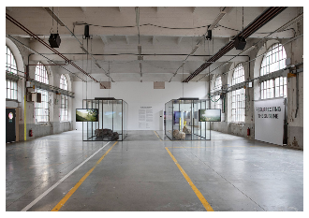
Dr. Alexandra Daisy Ginsberg
- Cambridge University
- Royal College of Art
Creating artworks, writings, and curatorial projects she made usually focuses on the relationship between humans, technology, and nature.
Past works

Slide 5
Project's purpose and background
Purpose: To highlight the light and sound pollution from our 24-hour urban lifestyle affects birds
Affect: singing earlier, louder, for longer, or at a higher pitch to communicate
Machine Auguries questions how the city might sound with changing, homogenizing, or diminishing bird populations
Warning of an apocalyptic world where bird population has been allowed to diminish

Slide 6
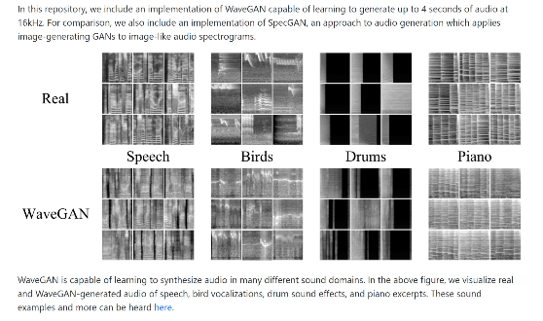
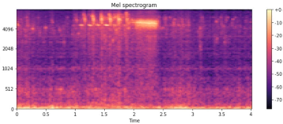
Method and representation
A natural dawn chorus is taken over by artificial birds, their calls generated using machine learning
The first work that uses GAN to generate the bird song and interact/apply it in the artwork

Slide 7
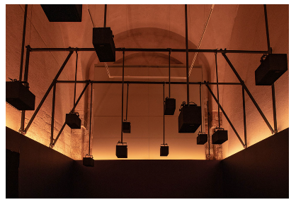
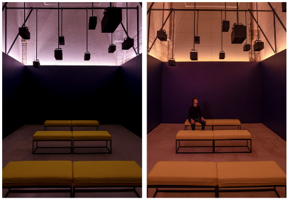
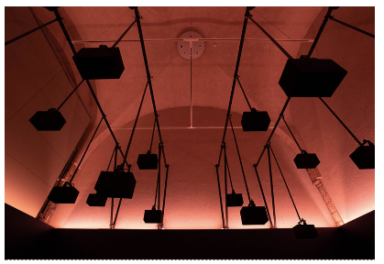
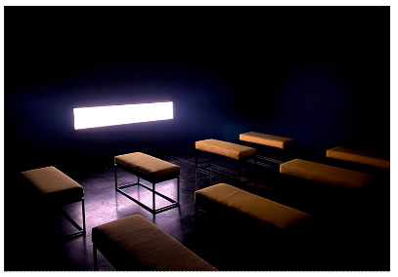

Slide 9
Thank you for your listening
Q & A

