Slide 1
Seminar of Technology & Arts 20211116
授課教師:許素朱教授 報告學生: 翁政弘 iPhD109003815
Notes:
Simulation development: Sage Jenson
Experiment done at Technical University Berlin with support of Prof. Vera Meyer, Carsten Pohl and Bertram Schmidt.
Studio assistant: Simona Dossi
This work has been developed within Mind the Fungi, an interdisciplinary research project (2018-20) between the Institute of Biotechnology TU Berlin and Art Laboratory Berlin funded by the Citizen Science Initiative of TU Berlin.

Slide 2
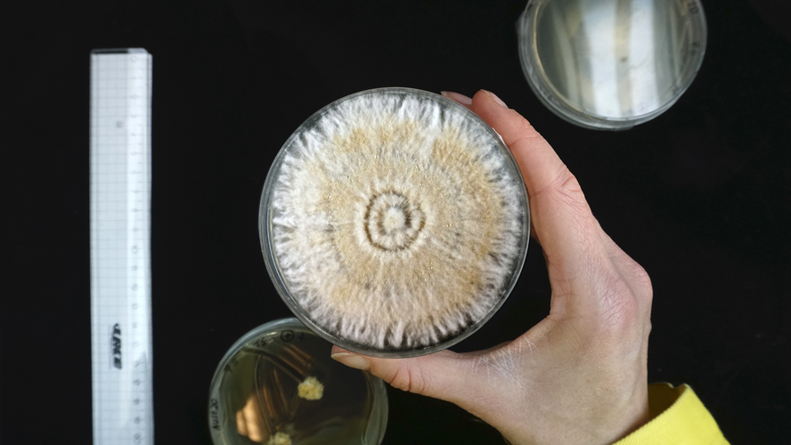
標題版面配置
Artificial Intelligence & Life Art
Theresa Schubert (DE)
副標題
Sound for Fungi. Homage to Indeterminacy
www.theresaschubert.com

Slide 3
Bio-Sound, Fungi Growth Sound, Art-Life, Bio-Media, Mind the Fungi
Keywords

Slide 4
Biography
Theresa Schubert (DE) is a Berlin-based artist exploring unconventional visions of nature, technology, and the self. Her work combines audiovisual and biomedia to conceptual and immersive installations or performances. By means of interdisciplinary methods such as biohacking, theoretical analysis, performative interpretation, and material experimentation, her works question the relation of humans to their environment and evolvement of matter and meaning beyond the Anthropos.
More recently, she works with UHD video environments and 3D Laser Scanning to challenge modes of perception and question the human-machine-nature relationship in hypertech societies.
Notes:
■ Art 作品報告內容： ‧ Summary：負責study的文章或作品之結論報告 (Summary先報告) ‧ Keyword：負責study的文章或作品之關鍵字定義、重要性說明 ‧ Background：負責study的文章、作品或事件的背景探索說明 (含作者背景、作品背後動機與影響） ‧ Connection：負責study的文章、作品或事件延伸影響議題探討、相關類似作品介紹、影響力、…
Theresa Schubert (DE)是一位柏林藝術家，探索自然、技術和自我的非傳統願景。她的作品將視聽和生物媒體與概念性和沈浸式裝置或表演相結合。通過生物黑客、理論分析、表演性解釋和材料實驗等跨學科方法，她的作品質疑人類與環境的關係以及超越人類的物質和意義的演變。 最近，她與超高清視頻環境和 3D 激光掃描合作，挑戰感知模式並質疑超技術社會中的人機自然關係。

Slide 5
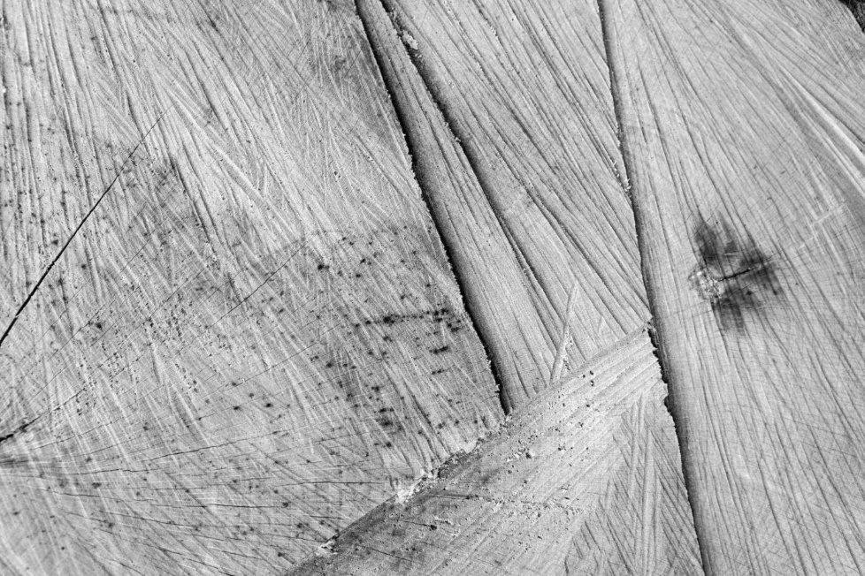
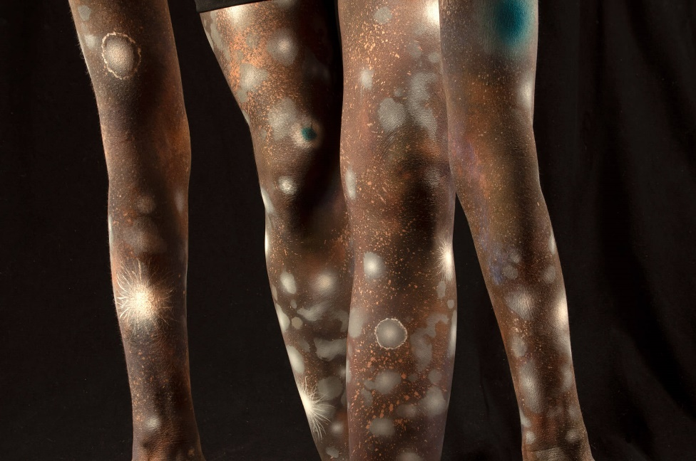
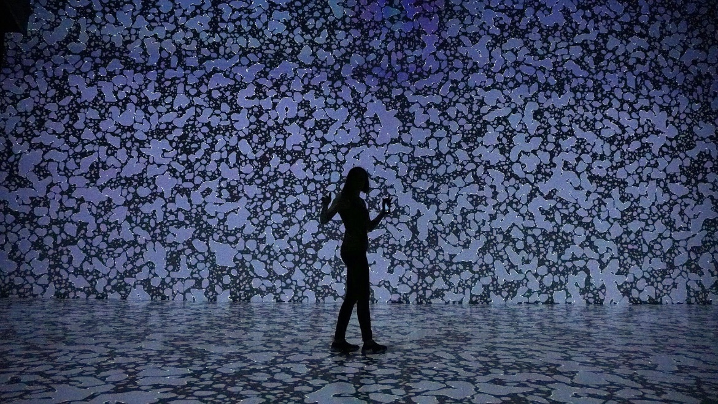
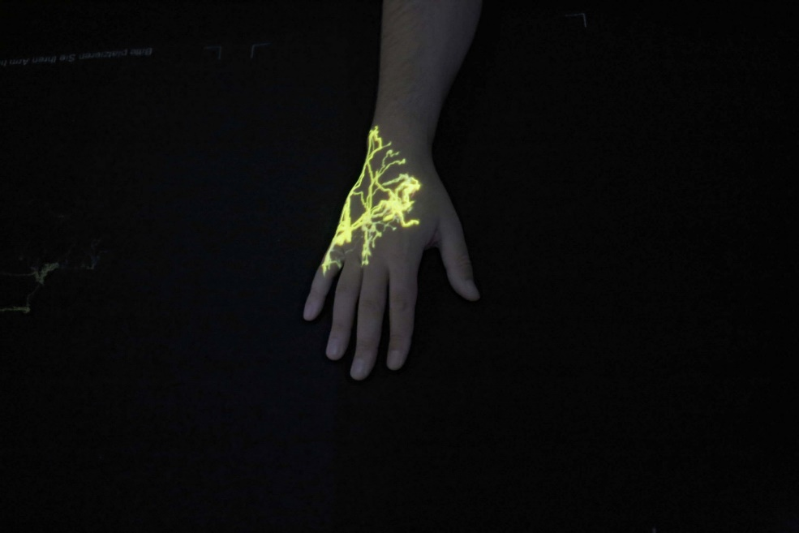
Related Works
Inside an Inside Forest
Teresa Schubert
milieu #01-04
Always Dead and Alive
bodymetries
Notes:
永遠死而活
材料和媒體
自定義代碼、元胞自動機、8K 視頻環境、5.1 聲音
年
2019年
#dark #engaging #ephemeral #hypnotic #immersive
Always Dead and Alive是根據特定元胞自動機規則創建的催眠視聽作品。該項目通過在幾何抽象和極簡主義之間創建視頻場景來研究感知模式，挑戰我們對時間和空間的認識。
Theresa Schubert 的Always Dead and Alive (2019) 是一個使用元胞自動機 (CA) 的 8K 視頻環境。在抽象幾何的編碼架構中，一系列自我生成的模式通過抽象的音景播放、完成和增強。這是一項身臨其境的感官作品，旨在以自然數學為基礎，在光、色和聲音的有機視聽流中體驗數字空間。
細胞自動機是一種數學模型，可以模擬細胞的有機自組織。由於已被制定為規則，CA 可以超越生物並轉移到數字環境中。換句話說，一個細胞被轉化為一個像素，保留了看似有機的、自我生成的能力。

Slide 6
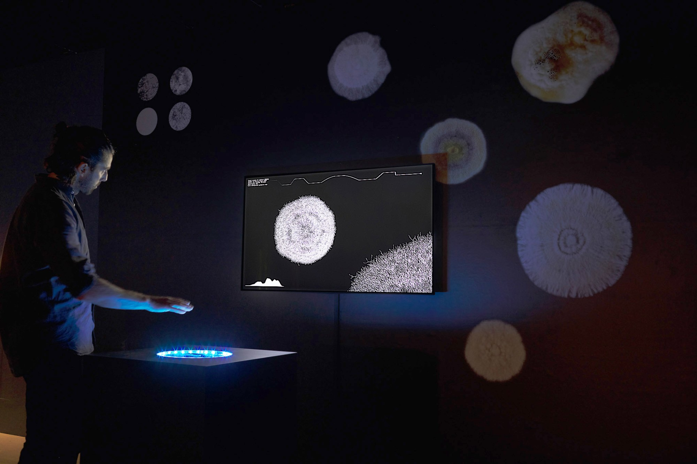
A generative video that simulates hyphae’s growth and via a hand tracking sensor allows people to interact with these.
https://calls.ars.electronica.art/prix/asset/283791/
Sound for Fungi. Homage to Indeterminacy
A visitor can take on the role of a sound frequency modulating the hyphae growth in real-time and move through the network.
Sound for Fungi. Homage to Indeterminacy

Slide 7
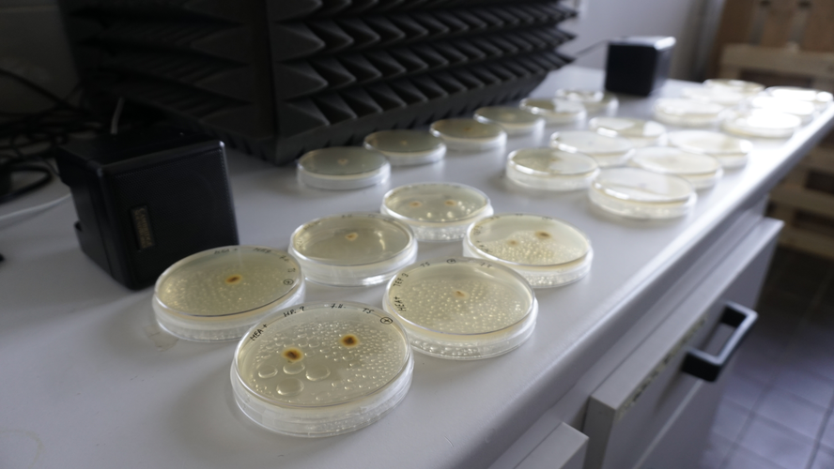
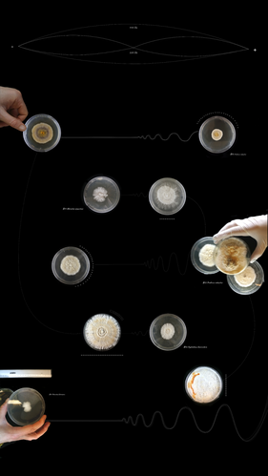
Schubert’s experiment where sound influenced mycelium growth.
110 Hertz, 220 Hertz and 440 Hertz
Notes:
交互式視頻裝置模擬舒伯特的實驗，其中聲音影響菌絲體生長。觀眾可以通過使用跟踪傳感器來探索這一生物過程，其中手部運動模擬聲音頻率的作用並實時改變真菌的生長。數字 3D 環境在宏觀和細胞層面之間轉換，揭示了由多個節點和連接組成的脆弱拓撲結構，讓我們一瞥連接“萬維網”的地下微生物網絡的複雜性。
Over the course of the residency, I repeated the experiment four times, took measurements, documented via photographs and made optical microscopic analyses. With every repetition, I changed the sound frequency. Since there were no available preliminary studies with arboreal mycelium, I based my choice of frequency on research from plant acoustics where a measurable response in roots occurs at 220 Hertz.(4) Further, I tested 110 Hertz and 440 Hertz as continuous sinus wave and on/off intervals of 10-30 seconds. Irrespective of the frequency, I could observe strong responses in most species, in some, the effect was inconclusive.

Slide 8
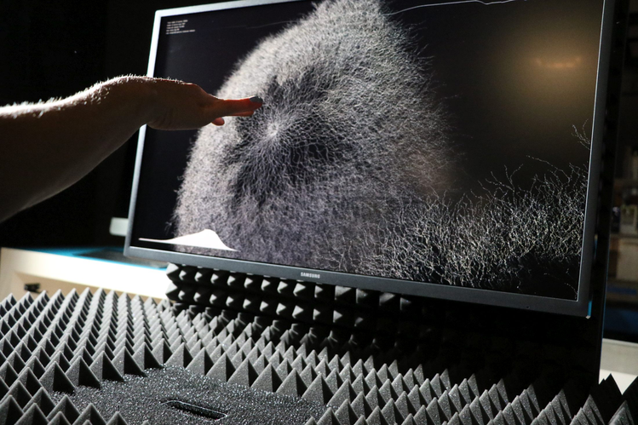
Audiences can explore this biological process by using a tracking sensor where hand movements simulate the role of a sound frequency and change the fungi’s growth in realtime.

Slide 9
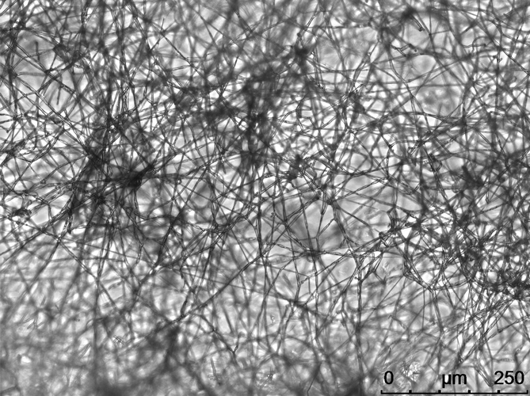
The digital 3D environment shifts between macro and cellular level perspectives, revealing fragile topologies comprised of multiple nodes and connections, offering a glimpse into the complexity of the underground network of microbes that connect the ‘Wood Wide Web.’
Notes:
交互式視頻裝置模擬舒伯特的實驗，其中聲音影響菌絲體生長。觀眾可以通過使用跟踪傳感器來探索這一生物過程，其中手部運動模擬聲音頻率的作用並實時改變真菌的生長。數字 3D 環境在宏觀和細胞層面之間轉換，揭示了由多個節點和連接組成的脆弱拓撲結構，讓我們一瞥連接“萬維網”的地下微生物網絡的複雜性。

Slide 10
Summary
標題引用了美國音樂作曲家約翰·凱奇 (John Cage) 將“不確定性”作為一種即興創作技巧的發展，在這種技巧中，作品的各個方面都留給機會或自由選擇。另一個參考是 Anna Tsing 和真菌學家 Alan Ryner 的工作，他們將蘑菇與這種不確定性的概念聯繫起來，因為它們會改變形狀。一些真菌在不同的生命週期中不斷擴張和生長，因此從理論上講，它們是不朽的。
即興創作——與其說是一種音樂過程，不如說是一種自然的生活現象——代表了一種存在本身。這種無意識的狀態使自發性和湧現成為可能，並且一直是貫穿舒伯特藝術實踐的指導原則。通過在這項工作中允許真菌數據的許多途徑和體驗，舒伯特將相同的開放式代碼應用於觀眾參與——促進了一種跨物種體驗，當遊客在與此互動時帶來平靜和耐心時，這種體驗效果最佳。

Slide 11
CONNECTION
John Cage Performing 4'33"
Cage offered some intriguing insights when asked afterwards about the event: ‘They missed the point. There’s no such thing as silence. What they thought was silence, because they didn’t know how to listen, was full of accidental sounds. You could hear the wind stirring outside during the first movement. During the second, raindrops began patterning the roof, and during the third the people themselves made all kinds of interesting sounds as they talked or walked out.’
Rollei 35 S
40mm f/2.8 Sonnar
0 sec. @ f/inf.
Kodachrome 64
My only concert photo, this is an environmental portrait of composer/performer John Cage playing his own composition, 4'33", on the piano
https://www.youtube.com/watch?v=JTEFKFiXSx4

Slide 12
CONNECTION
Fungi soundscape - antonio hofmeister ribeiro
Inspired by the unfamiliar shapes found in all kinds of fungi growing in nature, the autonomous algorithm transforms their images into music, resulting in an eery and uncanny composition that goes on indefinitely. The algorithm randomly selects images of fungus captured all across the world by researchers, then extracts the form, or growing pattern, using computer vision. This pattern is then fed into a bit matrix. This bits are then consumed in tempo by the sequencer and transformed into audible data.
https://antoniohof.com/Fungi-soundscape

