Slide 1
Exploring the structure of a real-time, arbitrary neural artistic stylization network
Wong, Shing Ming 05 Oct 2021

Slide 2
Info of the paper
Contributions: A new algorithm propose
fast training and inference
arbitrary artistic style transfer which means can operate in real time on never previously observed paintings
Research by Google and Université de Montréal
British Machine Vision Conference (BMVC) 2017
Times Cited: 174 (from Google Scholar at Oct 05, 2021)
Art generation, Style transfer, Computer Vision

Slide 3
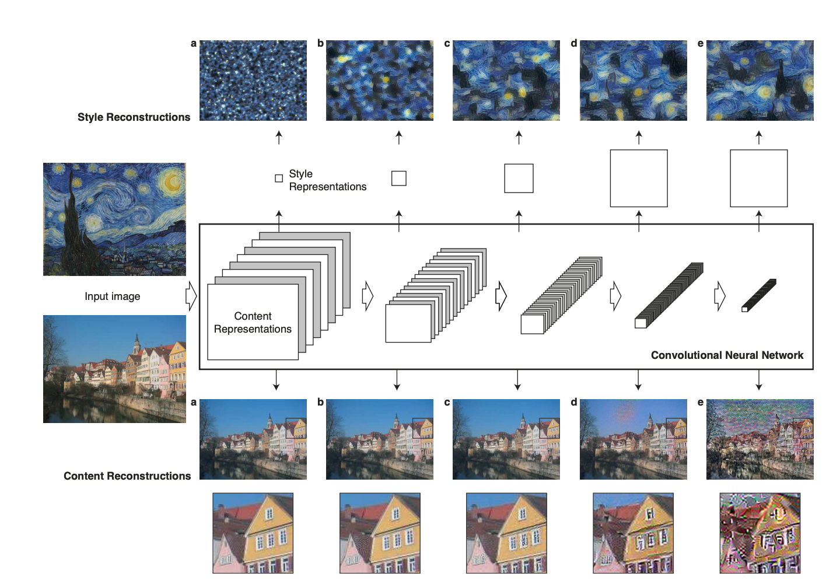
Related Work
Image Style Transfer Using Convolutional Neural Networks

Slide 5
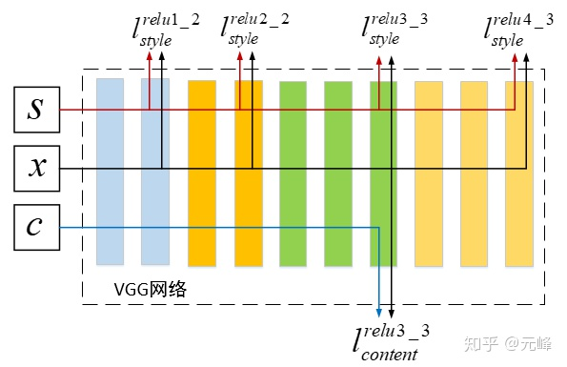
L. A. Gatys, A. S. Ecker, and M. Bethge. A neural algorithm of artistic style. arXiv preprint
arXiv:1508.06576, 2015.
$$l_{style}^{i}= \frac{1}{n_{i}} ∥G[f_{i}\left(x\right)]−G[f_{i}\left(s\right)]∥$$
$$l_{content}^{i}= \frac{1}{n_{i}} ∥G[f_{i}\left(x\right)]−G[f_{i}\left(c\right)]∥$$
Total loss of style
$$L_{s}(x, s)= \sum_{iεS}{l_{style}^{i}}$$
Total loss of content
$$L_{s}(x, s)= \sum_{iεS}{l_{content}^{i}}$$

Slide 6
The complete optimization objective

Slide 7
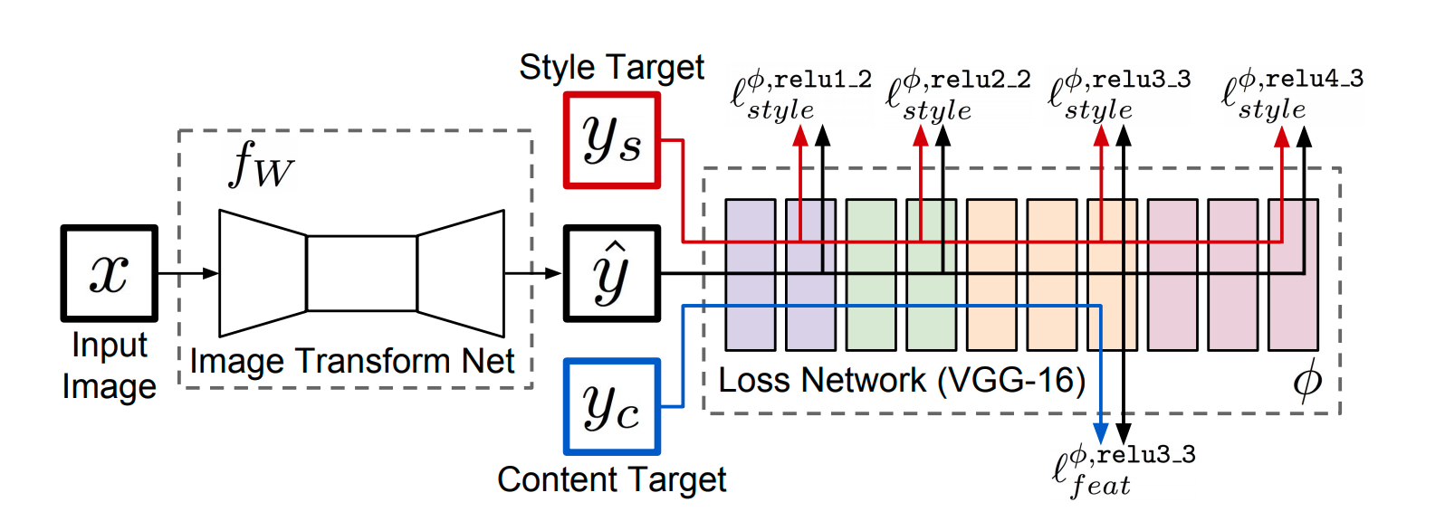
- J. Johnson, A. Alahi, and L. Fei-Fei. Perceptual losses for real-time style transfer and super-resolution. arXiv
preprint arXiv:1603.08155, 2016.
- D. Ulyanov, A. Vedaldi, and V. Lempitsky. Instance normalization: The missing ingredient for fast stylization.
arXiv preprint arXiv:1607.08022, 2016.

Slide 8
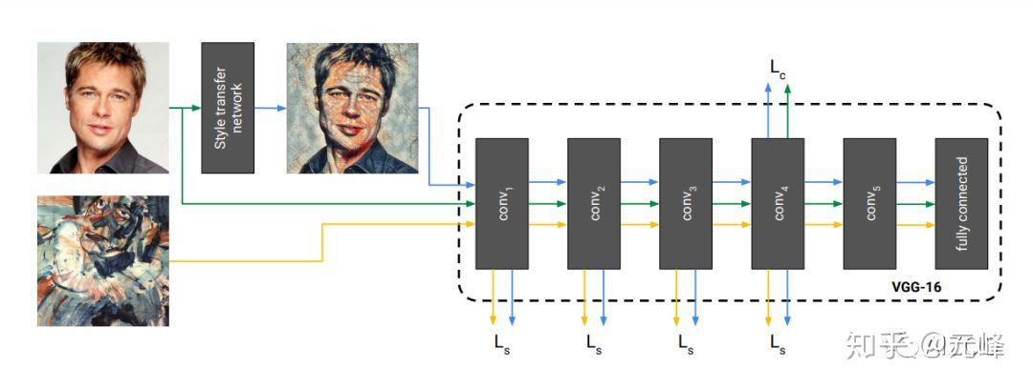
V. Dumoulin, J. Shlens, and M. Kudlur. A learned representation for artistic style. International Conference
of Learned Representations (ICLR), 2016.

Slide 9
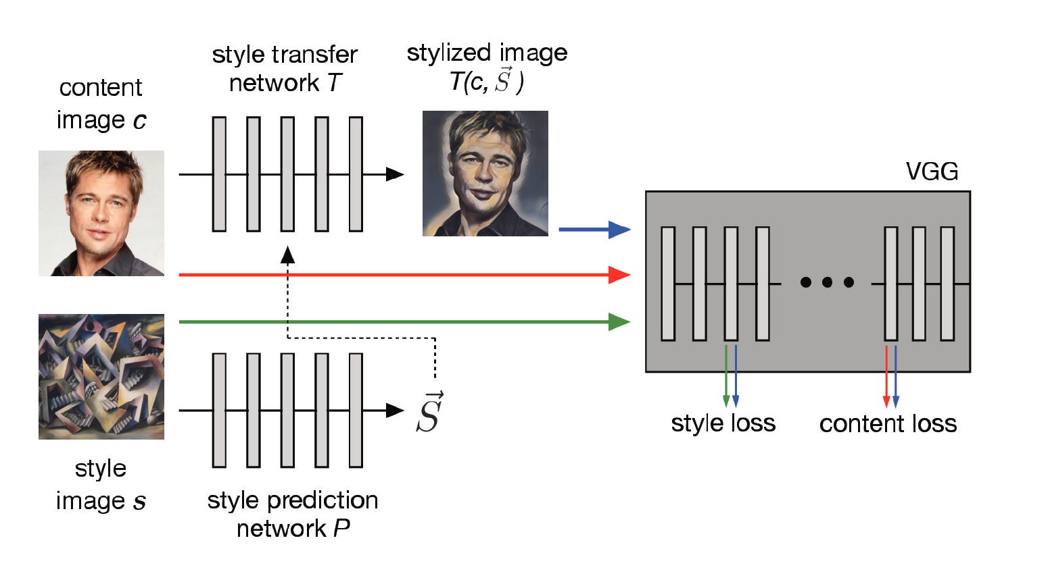
Method

Slide 10
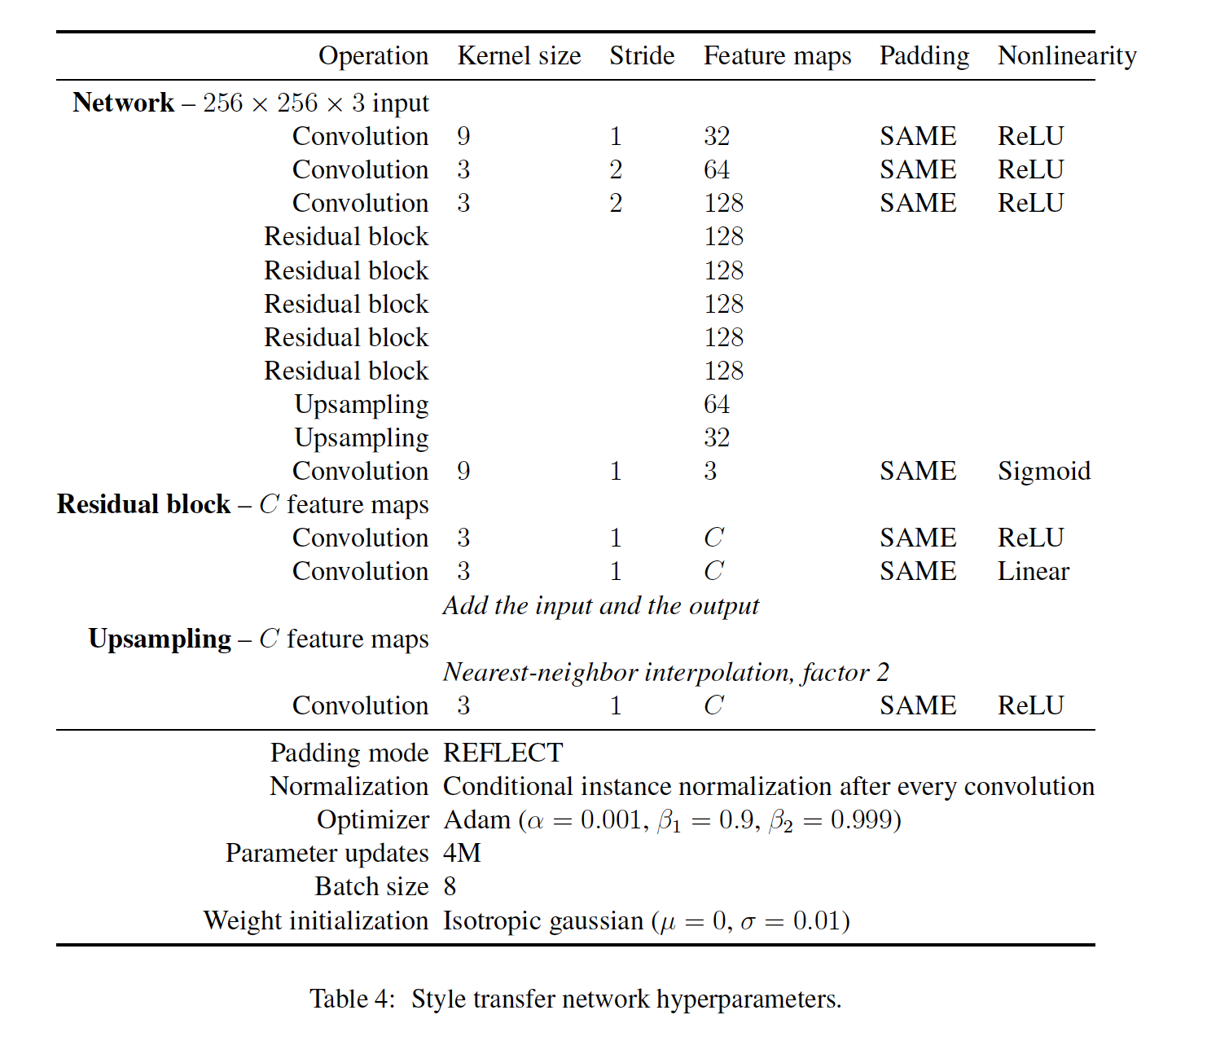
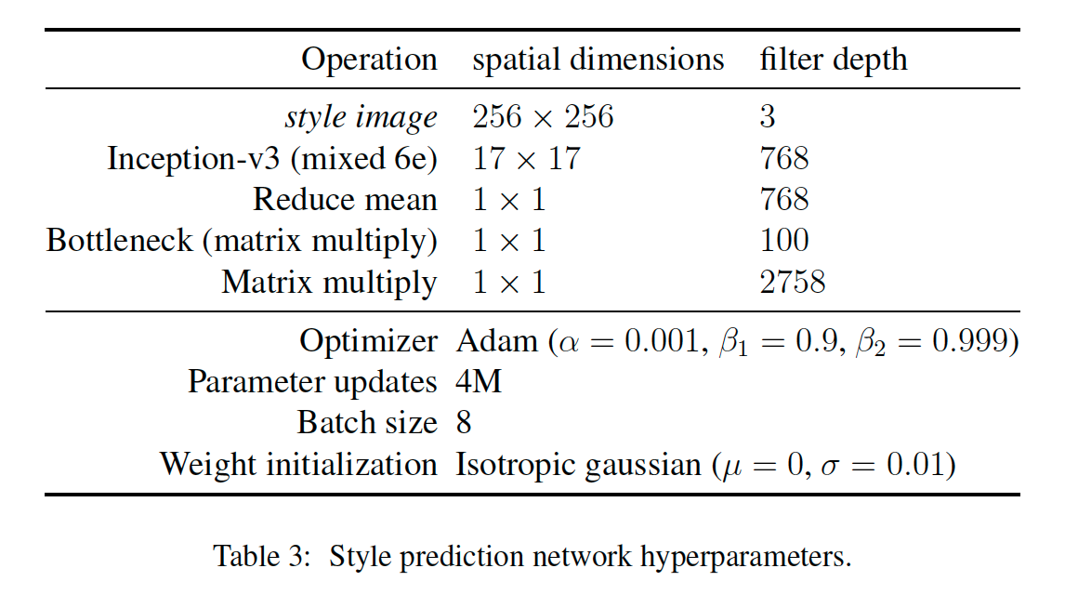

Slide 11
Result
content images:
ImageNet dataset
Style images:
Kaggle Painter By Numbers (PBN) dataset(79,433 labeled paintings)
Describable Textures Dataset (5,640 images labeled across 47 categories)
*Data Augmentation

Slide 12
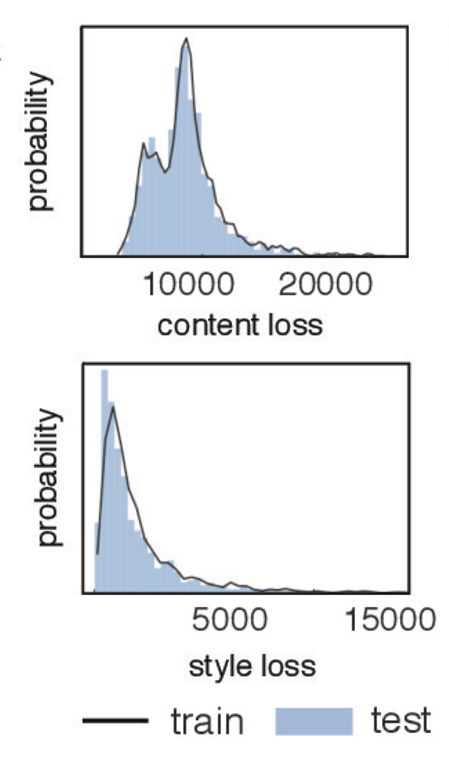
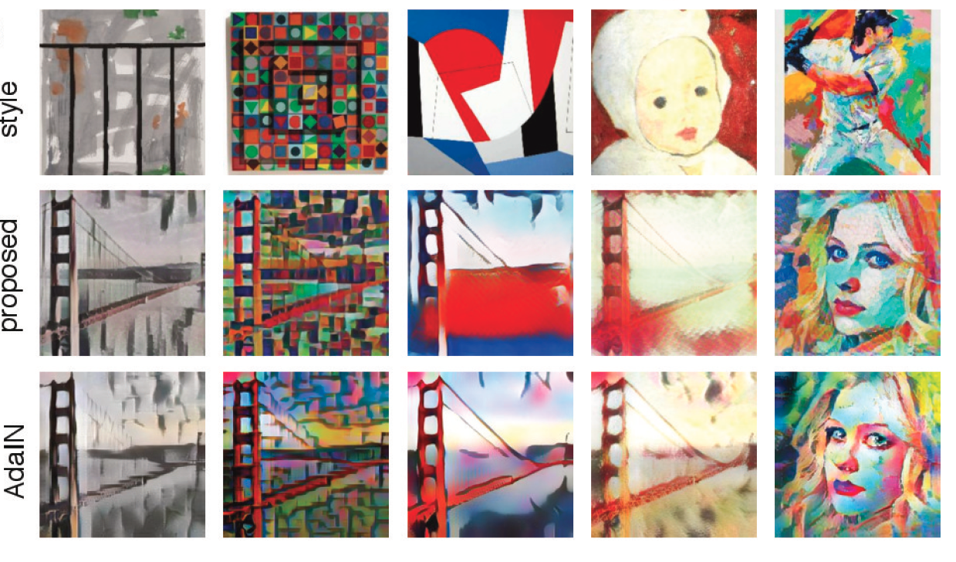

Slide 13
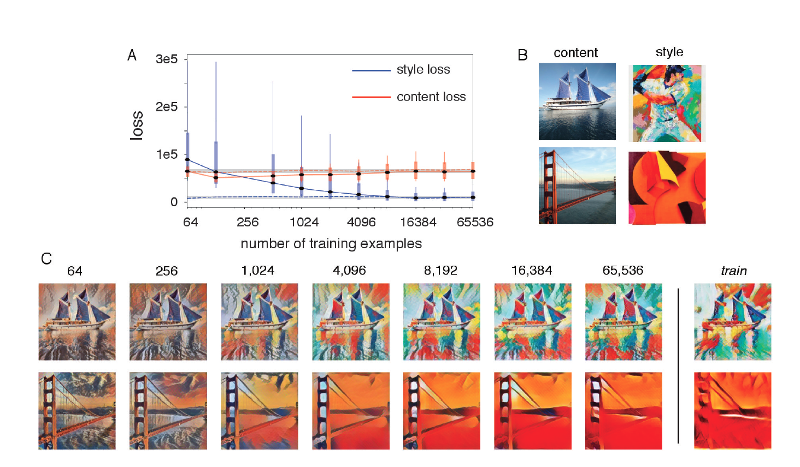

Slide 14
