Slide 1
科技藝術簡報
Enhanced Family Tree: Evolving Research and Expression Overview
SIGGRAPH 2020 Art Papers - ACM SIGGRAPH
學生:Tom Lee
課程指導:許素朱教授(小牛院長)
2021/06/15

Slide 2
Enhanced Family Tree: Evolving Research and Expression Overview
URL
Author
https://direct.mit.edu/leon/article/53/4/367/96918/Enhanced-Family-Tree-Evolving-Research-and
SIGGRAPH 2020 Art Papers - ACM SIGGRAPH
Fan Xiang,
Shunshan Zhu,
Zhigang Wang,
Kevin Maher,
Yi Liu,
Yilin Zhu,
Kaixi Chen,
Zhiqiang Liang

Slide 3
Enhanced Family Tree: Evolving Research and Expression
Abstract
Leonardo (2020) 53 (4): 367–373.
https://doi.org/10.1162/leon_a_01921
Enhanced Family Tree reimagines the possibilities of family trees with an evolving series of exhibits. The authors’ works combine genealogical data, visualization, 3D technologies and interactivity to explore and display ancient genealogical relationships. Their new approach may reveal questionable relationships in genealogical records. Moreover, the authors’ use of an organic metaphor of a “tree” can be further extended to increase public understanding and engagement. The audience's questions arising from this project show increased curiosity and nuanced questioning about their own family origins and development.

Slide 4
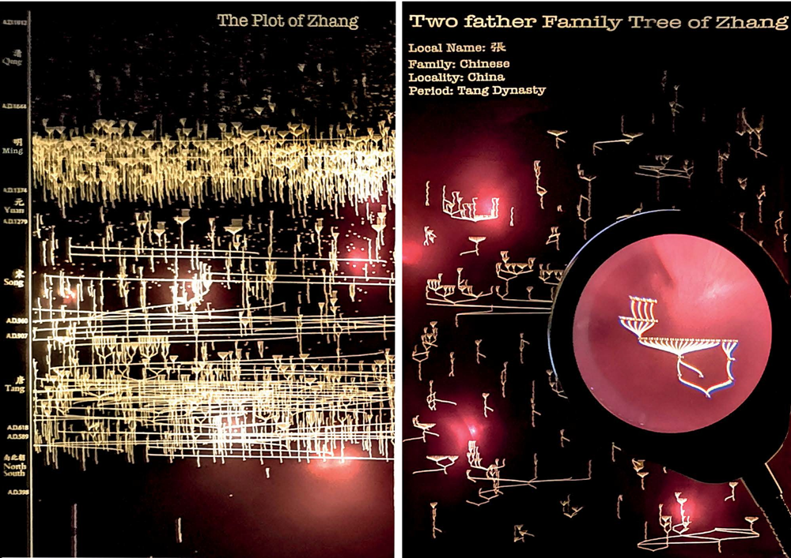
We are family

Slide 5
Framework
Enhanced Historical Research
Applied Case Study
Evolving Exhibition Design
  Generation 1: Graphic Display as an Exposure on X-ray Film
  Generation 2: 3D Trees in Crystal Cubes for Hand-Held Observation
  Generation 3: 3D-Rendering Experiments and Discoveries
  Generation 4: Interactive Family Tree Forest Installation
User Feedback
Conclusion

Slide 6
Conclusion
We have reported a progressive series of visualizations that we created to explore different ways complicated family histories could be communicated. Our project was iterated in many aspects: dimensions, material, scale, media and interaction. Each generation of the project led to different visual experiences and discoveries in the massive dataset of family histories. For historians, new forms of visualization may help them observe and discover questionable aspects of the data. More broadly, visualization that has an intriguing form can pique the interest of audiences so that historical lessons can be learned by a wider community. Our organic metaphor approach to expression could be further extended to create immersive narratives for museums and historians.

Slide 7
Good To Be Alive
活著真好

