Slide 1


科技藝術
書報討論課程
20210323
授課教師: 許素朱教授
報告學生: 翁政弘 iPhD109人工智慧組

Slide 2

Novice-AI Music Co-Creation via AI-Steering Tools for Deep Generative Models
ACM SIGCHI ’20: CHI 2020, April 25–30, 2020, Honolulu, HI, USA
Ryan Louie∗, Andy Coenen†, Cheng Zhi Huang, Michael Terry†, Carrie J. Cai† ∗Northwestern University, †Google Research ryanlouie@u.northwestern.edu, andycoenen@google.com, chengzhiannahuang@gmail.com, michaelterry@google.com, cjcai@google.com
Author’s summer internship at Google.
https://dl.acm.org/doi/10.1145/3313831.3376739

Slide 3
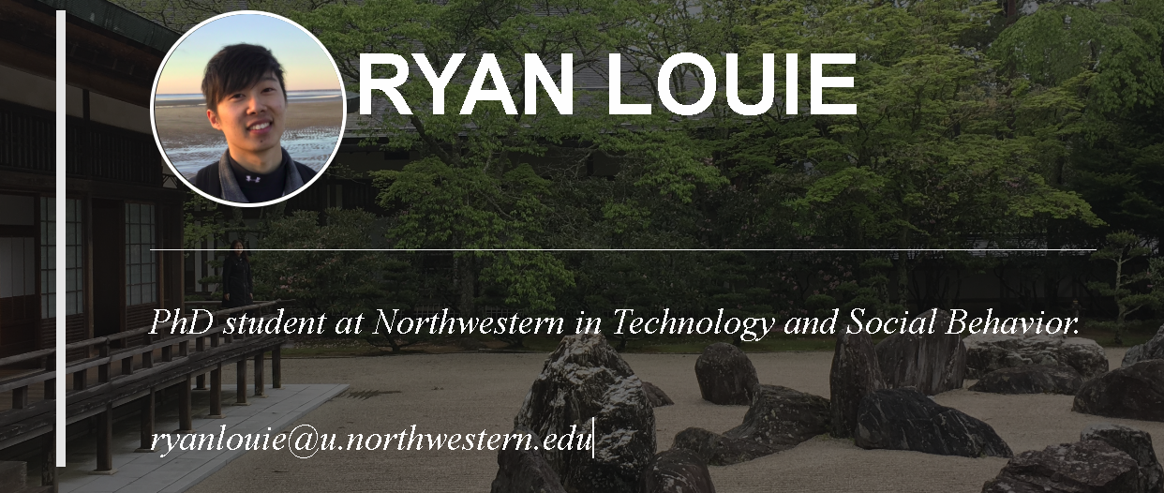
my interests in designing intelligent human-machine systems, and my desire to empower people to build stronger social connections, increase social capital, and increase their emotional well-being. Advancing these goals requires taking an interdisciplinary approach; in this vein, my work draws on methods from HCI, AI, and social science to devise novel technological solutions to complex human problems..
I am pursuing an interdisciplinary PhD in Computer Science and Communications through the Technology and Social Behavior Program at Northwestern University. I have had the pleasure of pursuing this research with Dr. Darren Gergle and my advisor, Dr. Haoqi Zhang.

Slide 4
ABSTRACT
利用 generative deep neural networks (DNNs)生成型深度神經網絡
  G-DNN已被學者驗證可以輔助作為創造新穎音樂作品的能力
  本文作者主要關注音樂如何用AI共同創作
    特別是對於新手有諾大的幫助
    在使用廣泛使用的互動音樂AI進行需求調查研究
    發現AI可以新手在不知所措時，更好地滿足共同創造的需求，
    開發了AI Steering Tool:
      Voice Lanes: 針對特定聲音的內容生成
      Example-Based Slider: 用於控制所生成的跟現有的內容相似
      Semantic Sliders:利用引導方式讓音樂產生帶有不同層次，如 高興/悲傷，常規/驚奇；
      研究發現 工具不僅可以提高用戶的信任度，控制力，理解力，和與AI合作的感覺，也有助於提高創作效率等

Slide 5
InTroduction
Rapid advances in deep learning have made AI to actively collaborate with humans to co-create new content.
One Promising application of machine learning has been the use of Generative Deep Neural Network (DNN)-backed systems for creative activities.
Poetry writing, drawing, music creation, dance, …, etc.
Filling in a missing section of a song.
Writing the next paragraph of a story.
Add an image to a design mood board.

Slide 6
Related Work
Human-AI co-Creation
Interactive Interface for ML Music Models
Deep Generative Music Models
Formative Needfinding Study
Motivations and Needs for Creating Music
Chanllenges in Co-Creating with Generative DNNs
  Information Overload
  Non-deterministic output

Slide 7
COCOCO
(Collaborative co-creation)
A music editor web interface for novice-AI co-creation
Augments standard generative music interface with a set of “AI Steering tools” as figures.1
COCOCO builds on top of Coconet, a deep generative model trainded on 4 part harmony
  Accepts incomplete music as input and output complete music
  Coconet works with music that can have
    4 parts or voice playing at the same time (Represented by Soprano Alto Tenor Bass 女高音 低音 男高音 低音)
    2-measures long
    32 timesteps of sixteenth-note beats
    Each voice can make on any one of 46 pitches
  Coconet is robustness
    able to infill any section of music, including gaps in the middle or start of the piece.
    To mirror the most recent interfaces backed by these infill capabilities.

Slide 8
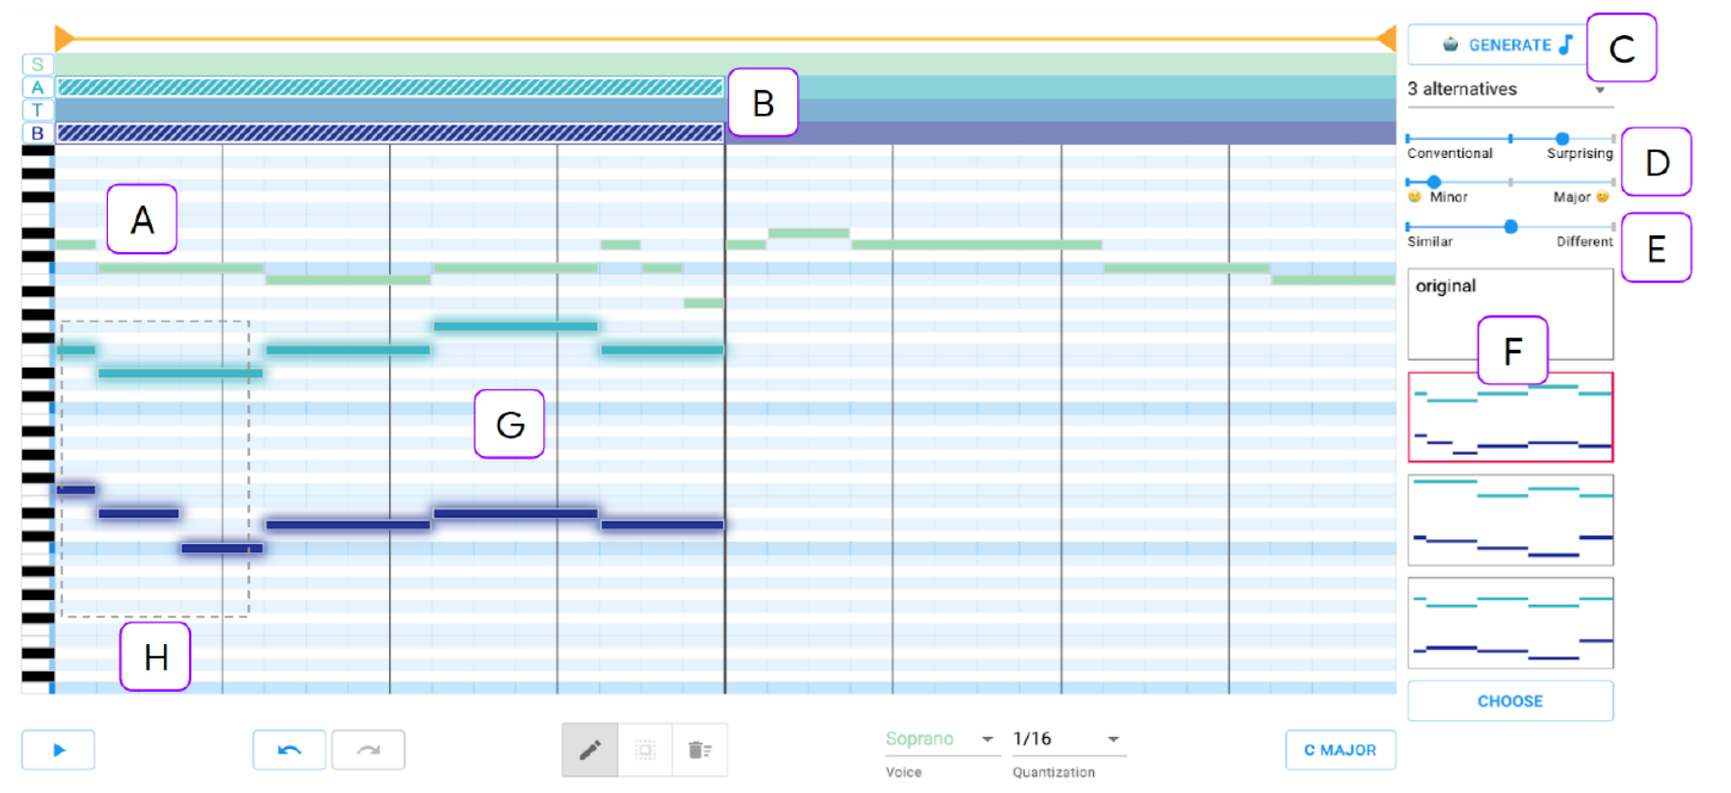
COCOCO
(Collaborative co-creation)
4 Voice lanes
Sematic slider (4)
Example-based slider
Piano Keyboard type: Notes input
Audition Multiple
Alternatives (3)

Slide 9
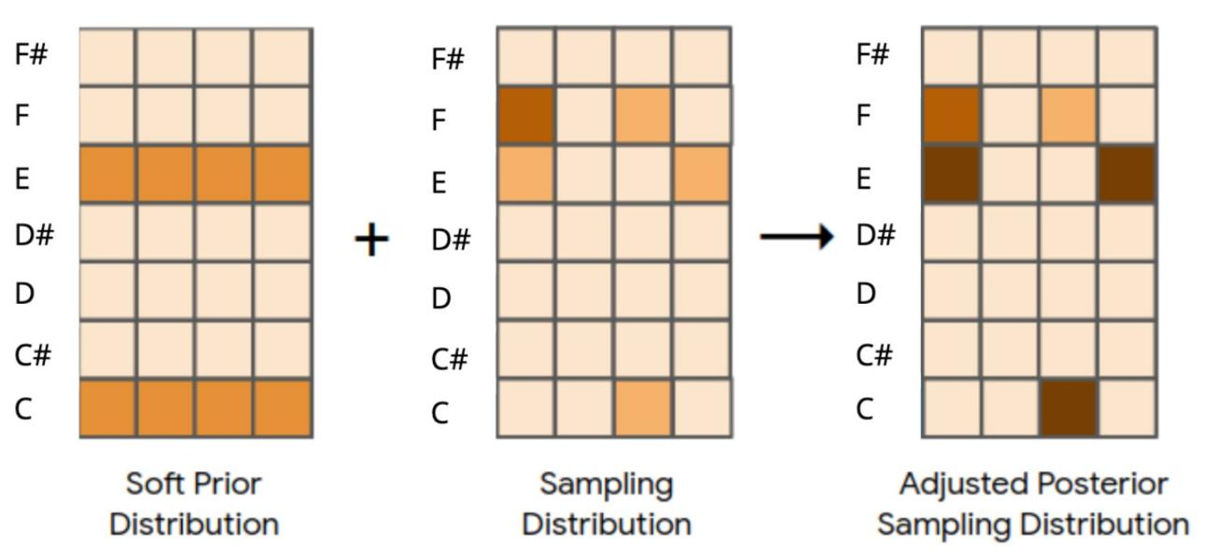
Soft Priors: a techniques for AI-Steering

Slide 10
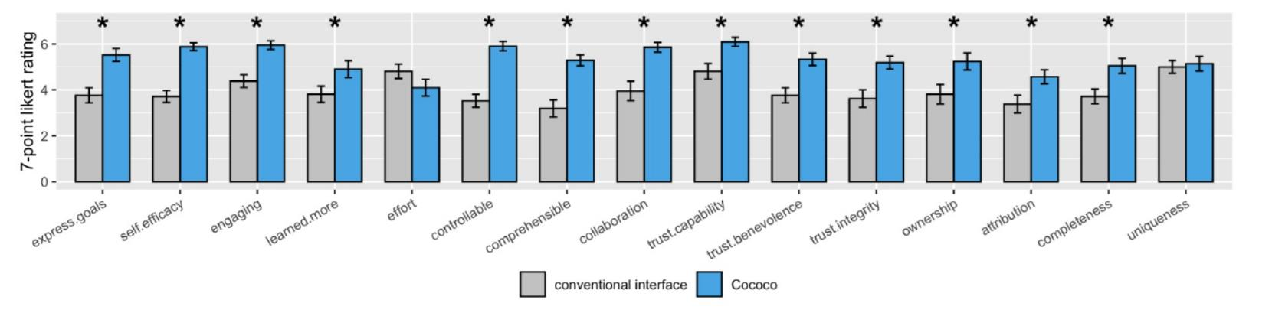
Results from Post-Study:
Survey comparing the conventional interface and Cococo, with Standard error bars

Slide 11
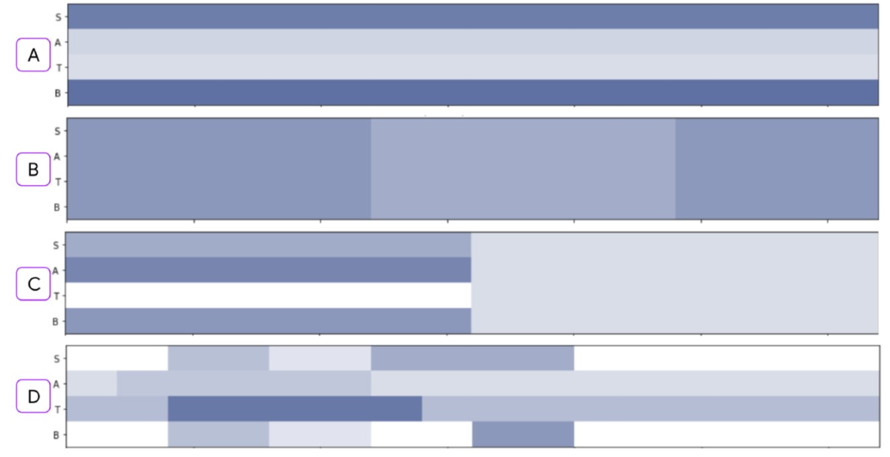
QuaLItative Findings
Voice by Voice (Most Common)
Temporal Chunks
Combination (A+B)
Ad-hoc bits

Slide 12
CONCLUSION
found that AI-steering tools not only enabled users to better express musical intent, but also had an important effect on users’ creative ownership and self-efficacy vis-a-vis the AI.
Future systems should expose mid-level building blocks, divulge the AI’s capabilities and limitations, and empower the user to define the partnership balance.
Taken together, this work advances the frontier of human-AI co-creation interfaces, leveraging AI to enrich, rather than replace, human creativity.

Slide 13
Connection & COmment
Gaming application
Transmission lost
AI-guided : Art work Co-Creation
  drawing/painting/writing/composing/dancing/…
AI-Application: the development for Art design
  Speed up/Slow down
AI Music/Sound/Voice/Audio
  DNN/LSTM/… time sequence algorithm have many reference resource

Slide 14
THANK YOu

