Slide 1

科技藝術
書報討論課程
20210309
授課教師:許素朱教授
報告學生: 翁政弘 iPhD109人工智慧組

Slide 2
Stepping Inside the Classification Cube :
An Intimate Interaction with an AI System
Authors: Avital Meshi and Angus G. Forbes
Classification Cube
10 × 10 × 10 ft wrapped with an opaque,
spandex fabric and lit with LED light strips.
SIGGRAPH '20: ACM SIGGRAPH 2020 Art Gallery August 2020 Pages 387–393 https://doi.org/10.1145/3386567.3388566

Slide 3
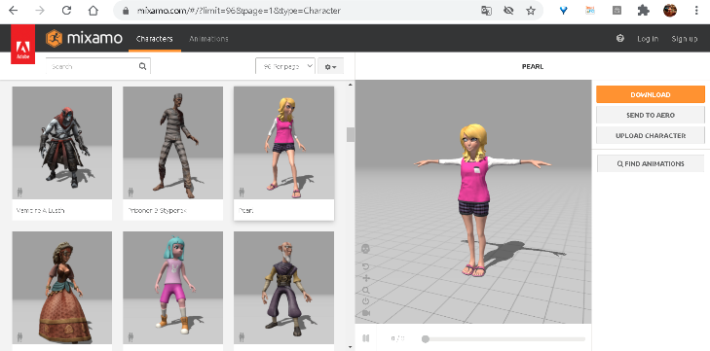
Machine learning (ML) algorithms
Adobe: https://www.mixamo.com
gender detection:
age detection:
emotion recognition:
action recognition:
Female (77.64%)
31 years old
Happy (62.85%)
air drumming (31.36%)
Invites viewers to
interact with an ML
classification system
* age detection 0~100
** angry, sad, disgusted, scared, happy, surprised or neutral
*** jumping, dancing and kicking, among 400 distinct actions

Slide 4
Male (92.98%)
30 years old
Neutral (60.69%)
belly dancing (76.35%)
Female (95.92%)
25 years old
Sad (37.18%)
Playing harmonics (46.67%)
Male (79.45%)
39 years old
Angry (26.47%)
Playing trombone (78.10%)
Male (66.67%)
36 years old
Sad (59.77%)
snatch weightlifting (34.07%)

Slide 5
Female (78.19%)
36 years old
Angry (45.97%)
Spinning pol (97.33%)
Female (63.98%)
29 years old
Happy (61.46%)
Front raises (2.02%)
Male (81.84%)
36 years old
Happy (90.96%)
Sign language interpreting (64.79%)
Male (64.51%)
37 years old
Neutral (38.67%)
Clopping (31.91%)
Female (55.56%)
39 years old
Angry (33.89%)
Robot dancing (28.89%)
Male (65.65%)
36 years old
Neutral (46.65%)
Robot dancing (42.28%)
Male (88.85%)
36 years old
Scared (37.49%)
Stretching Arm(30.07%)
Male (74.71%)
36 years old
Scared (58.66%)
Robot dancing (34.34%)

Slide 6
How do you think the Classification Cube?
Tensorflow Face Detector, software tool. Yixuan H.Y. Hu, www.github.com/yeephycho/tensorflow-face-detection
Age and Gender Estimation, software tool. Yusuke Uchida, www.github.com/yu4u/age-gender-estimation
Emotion-Recognition, software tool. Omar Ayman, www.github.com/omar178/Emotion-recognition
I3D Models Trained on Kinetics. Joao Carreira and Andrew Zisserman, www.github.com/deepmind/kinetics-i3d

Slide 7
Summary
Machine Learning had already been used in products and services used on a daily basis.
This technology can be an oppressive one that subjects us to biases and discrimination.
This technology may also provide an opportunity for an empowering visibility.
Cube as a futuristic mirror, reflecting how we are detected and classified in an increasingly digitized public domain.

Slide 8
What I Learn？
Who’s View
People’s Biases
Who’s View
Machine’s Biases
Your View
How People or Machine See you!

Slide 9
Thank You!

