Slide 1
科技藝術書報討論期末報告
李澤華
NTHU iPh.D

Slide 2
Introduction
360-degree Transparent Holographic Screen Display (https://dl.acm.org/doi/10.1145/3355049.3360517)
AlteredWind Manipulating Perceived Direction of the Wind by Cross-Modal presentation of Visual, Audio and Wind Stimuli (https://dl.acm.org/doi/10.1145/3355049.3360525)
Biofeedback Interactive VR System Using Biological Information Measurement HMD (https://dl.acm.org/doi/10.1145/3355049.3360523)
Brobdingnagian Glass A Micro-Stereoscopic Telexistence System (https://dl.acm.org/doi/10.1145/3355049.3360520)

Slide 3
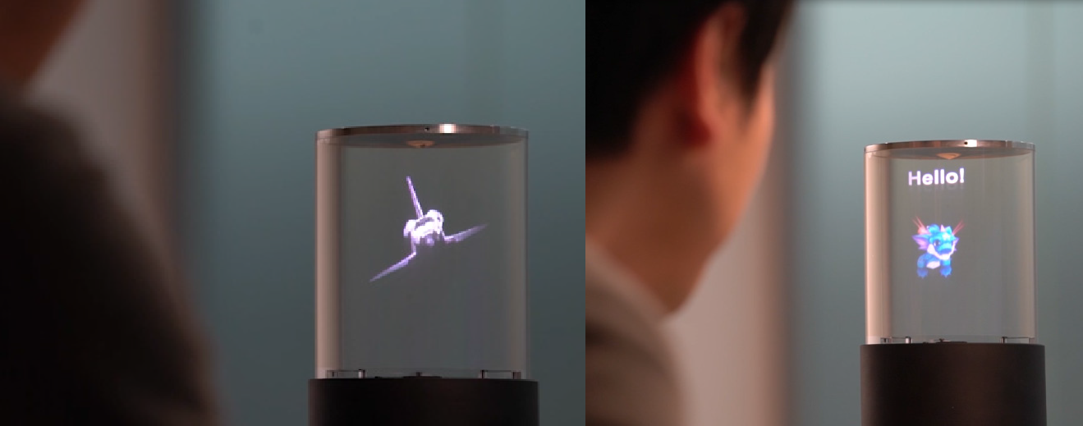
360-degree Transparent Holographic Screen Display (https://dl.acm.org/doi/10.1145/3355049.3360517)
(a)
(b)

Slide 4
AlteredWind Manipulating Perceived Direction of the Wind by Cross-Modal presentation of Visual, Audio and Wind Stimuli (https://dl.acm.org/doi/10.1145/3355049.3360525)

Slide 5
Biofeedback Interactive VR System Using Biological Information Measurement HMD (https://dl.acm.org/doi/10.1145/3355049.3360523)

Slide 6
Brobdingnagian Glass A Micro-Stereoscopic Telexistence System (https://dl.acm.org/doi/10.1145/3355049.3360520)

