Slide 1
科技藝術書報討論
Tom Lee

Slide 2
Introduction
[Alien] Star Dust: Signal to Noise – guided networked meditation (https://youtu.be/IBMLA40nGr8)
  Telluric Vibrations, UCLA Botanical Gardens – Los Angeles
  Victoria Vesna with Paul Geluso, Rhiannon Catalyst, John Brumley, Ivana Dama, Clinton Van Arman
Crosser & LaMigra (https://youtu.be/sNSUu9NXhkk)
  Emilie Trice & LAST/RESORT present Garden del Rio Grande
  Rafael Fajardo (US)
CINETic Residencies(https://youtu.be/rnIlIFce2HU)
  UNATC Distant Art
  Kıvanç Tatar (CA/TR), João Tragtenberg (BR), Saint Machine (RO), Leonard Nicola Hein & Claudia Schmitz (US/DE)
sound:frame & Pausanio virtual – Area for Virtual Art(https://youtu.be/z5h1yMOM_UA)
  Ars Electronica Gallery Spaces Garden
  sound:frame / Eva Fischer (AT), Marijn Bril (NL), Angie Pohl (AT)

Slide 3
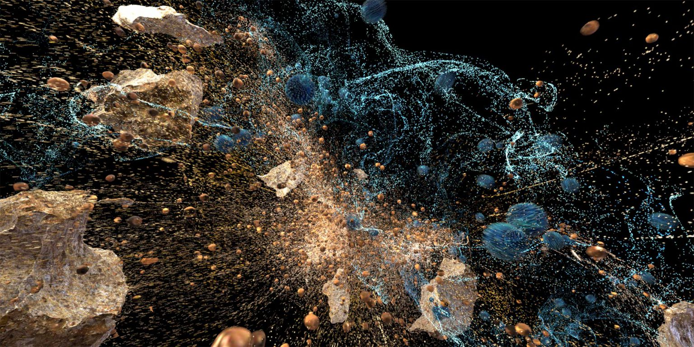
[Alien] Star Dust: Signal to Noise – guided networked meditation (https://youtu.be/IBMLA40nGr8)

Slide 4
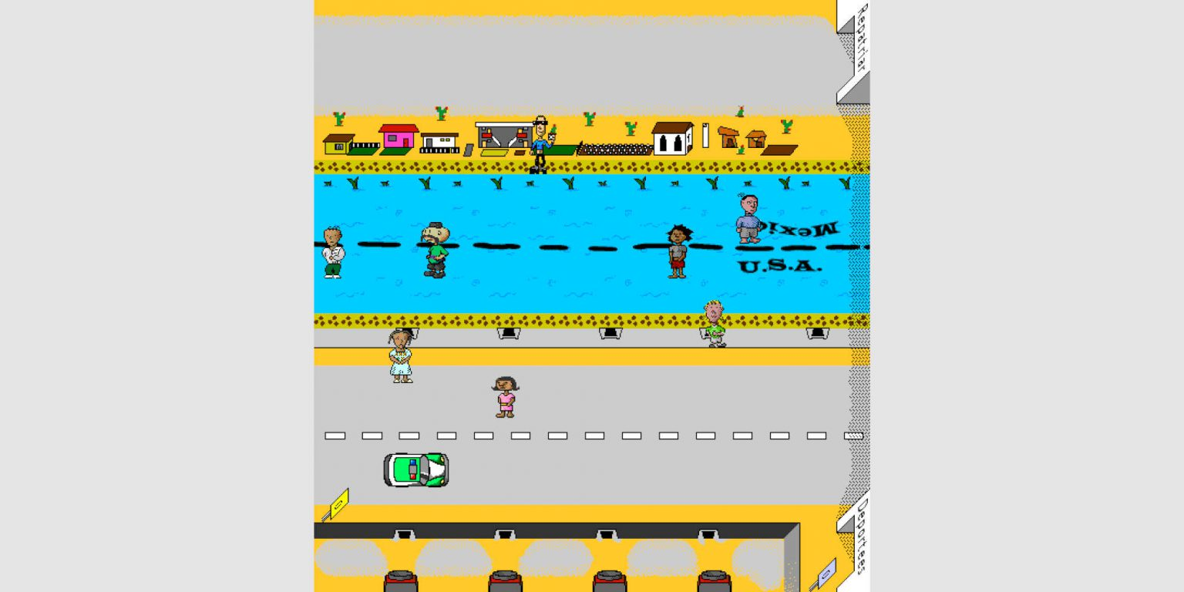
Crosser & LaMigra (https://youtu.be/sNSUu9NXhkk)

Slide 5
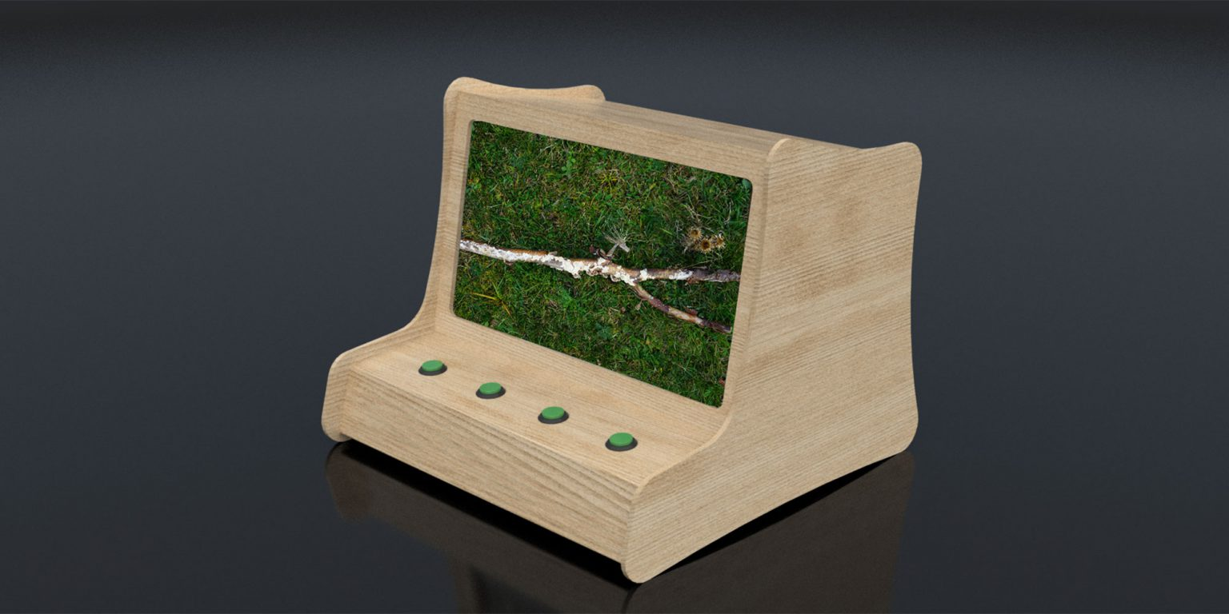
CINETic Residencies(https://youtu.be/rnIlIFce2HU)

Slide 6
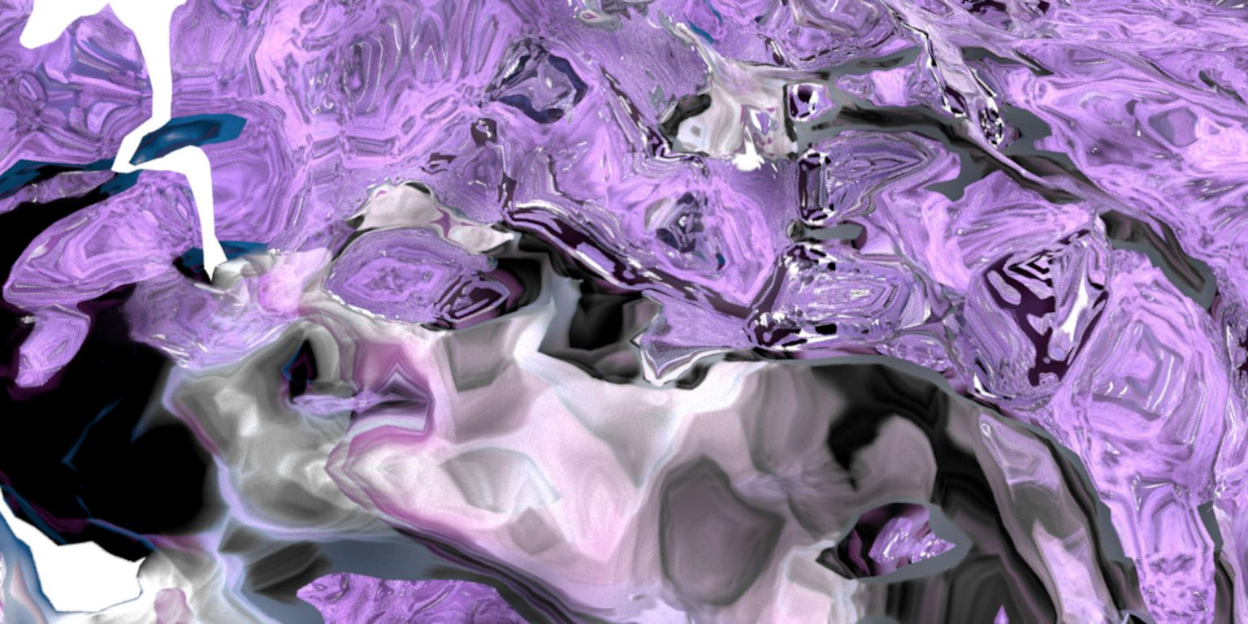
sound:frame & Pausanio virtual – Area for Virtual Art(https://youtu.be/z5h1yMOM_UA)

