Slide 1
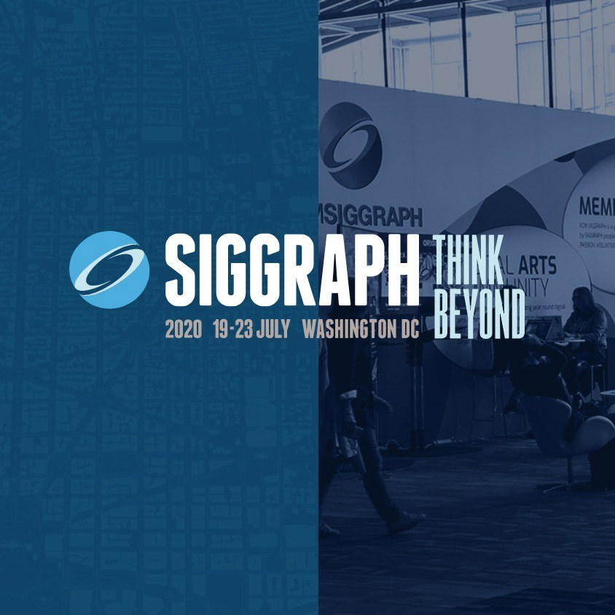
Research Center for Technology and Art
Seminar Presentation
Topic:
Inside the Classification Cube:
An Intimate Interaction With AI System
Author:
Avital Meshi,
University of California, Santa Cruz
清華大學 IPHD 楊元福 108003817

Slide 2
SIGGRAPH 2020 19-23 July Washington DC

Slide 3
Agenda
Art Statement
Background
Methodology
Demo & Connection
Classification Cube
Avital Meshi
Neural Network
Face Imitate
It invites people to interact with an AI classification system and experience in real time how they are viewed through its lens.
Digital Art and New Media
Research Interests:
Behavior of Virtual People, Sroty-telling in Virtual Reality, Virtual relationships and experiences, and Virtual-worlds.
Face Morpher, Face Rotator, and Combiner
Face feature manual adjustment, and real time image imitation

Slide 4
Art Statement
“Inside the Classification Cube: An Intimate Interaction With an AI System” is a SIGGRAPH 2020 Art Papers selection that explores one of society’s most frequently asked questions — how do people portray themselves versus how others portray them? Here, we catch up with new media artist Avital Meshi to learn how the “Classification Cube” installation invites people to interact with an AI classification system and experience in real time how they are viewed through its lens.

Slide 5
Background
Author: Avital Meshi
University of California Santa Cruz, Santa Cruz, CA 2019
Master of Fine Arts
Department of Digital Arts and New Media
Recipient, Art's Dean Excellence Award
School of the Art Institute of Chicago, Chicago IL 2016
Bachelor of Fine Art
Major in Photography
Merit Recipient – Distinguished Scholar
Camera Obscura School of Art, Tel-Aviv, Israel 2012
Certificate, Continuing Studies
The Hebrew University of Jerusalem, Israel 2006
Master of Science
Major in Evolution, Systematics and Ecology
Excellence Scholarship for Master Students recipient
The Hebrew University of Jerusalem, Israel 2003
Bachelor of Science
Major in Biology

Slide 6
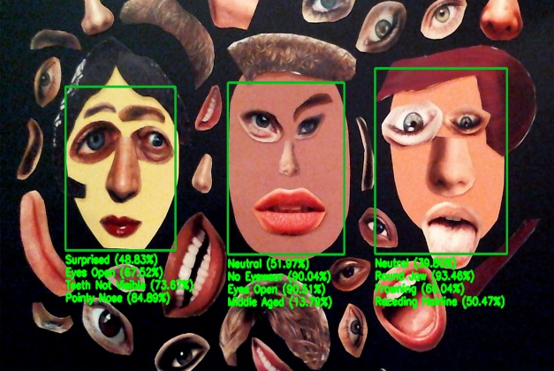
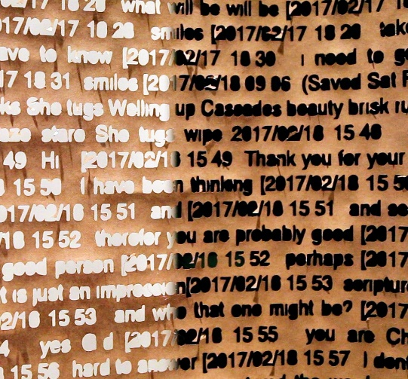
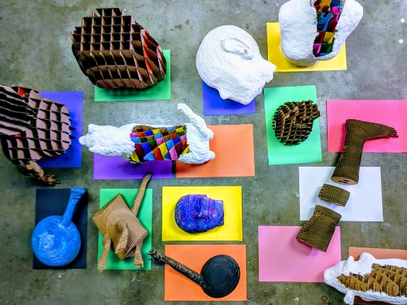
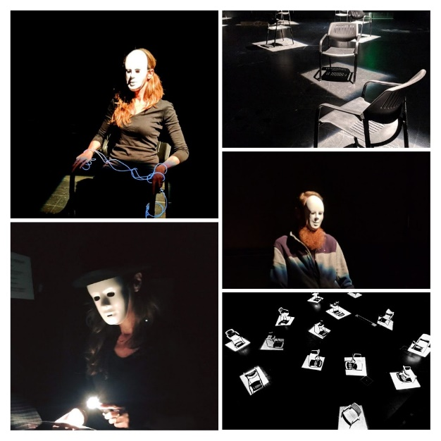
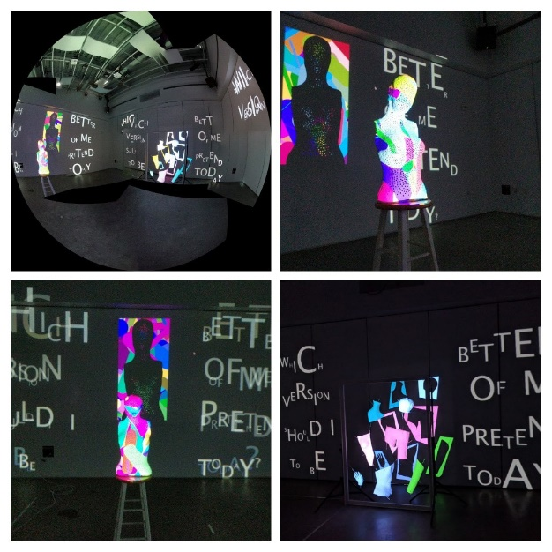
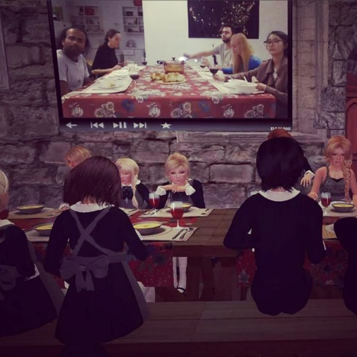
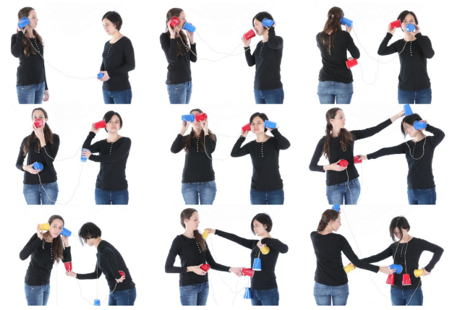
Background
Don’t Worry, Be Happy! (2020)
Live Feed (2018)
Face it! (2019)
Memorial for a Virtual Friendship (2018)
Imagined (2016)
Digital Creatures (2018)
Virtual Chairs (2018)
We are all different as second languange (2015)
Better Version (2018)
Homemade Virtual Soup (2017)

Slide 7
Background
The “Classification Cube” art installation was developed as Meshi's MFA thesis project for the Digital Arts and New Media program at University of California, Santa Cruz (UC Santa Cruz). Throughout this studies, Meshi mainly focused on the role of avatars and possibilities for embodiment in virtual worlds, along with the performative engagement that comes with this practice.

Slide 8
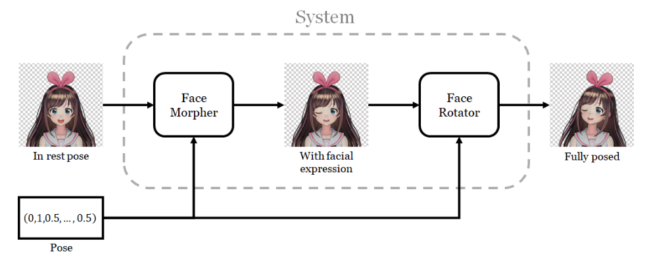
Methodology
Input
Output
Final Output

Slide 9
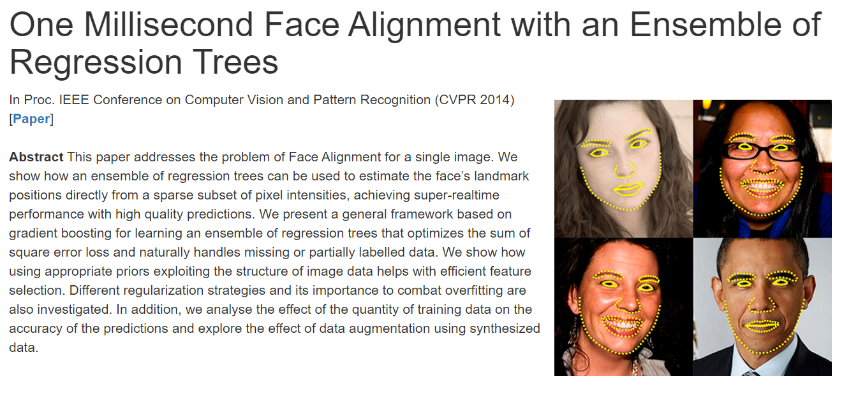
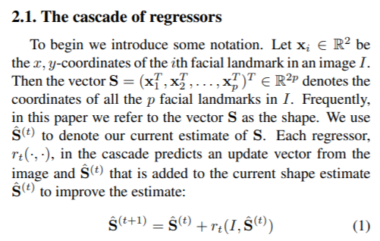
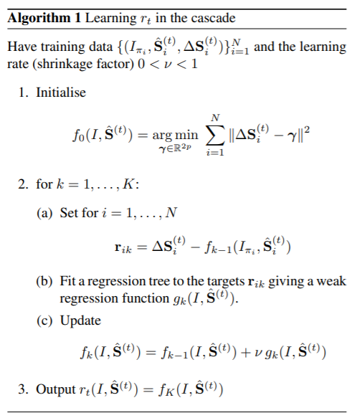
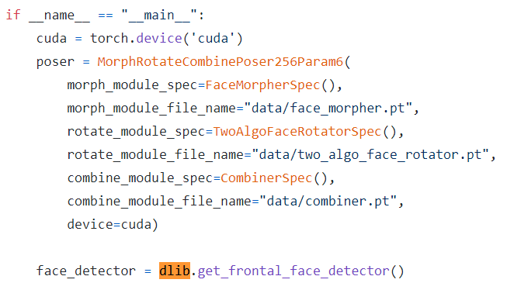
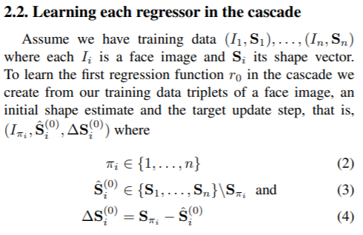
Methodology
Face Alignment
http://www.csc.kth.se/~vahidk/papers/KazemiCVPR14.pdf

Slide 10
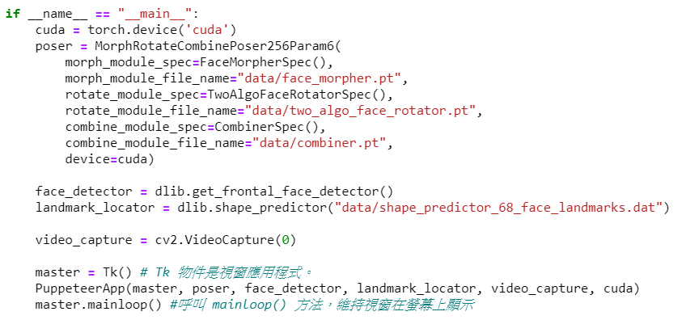
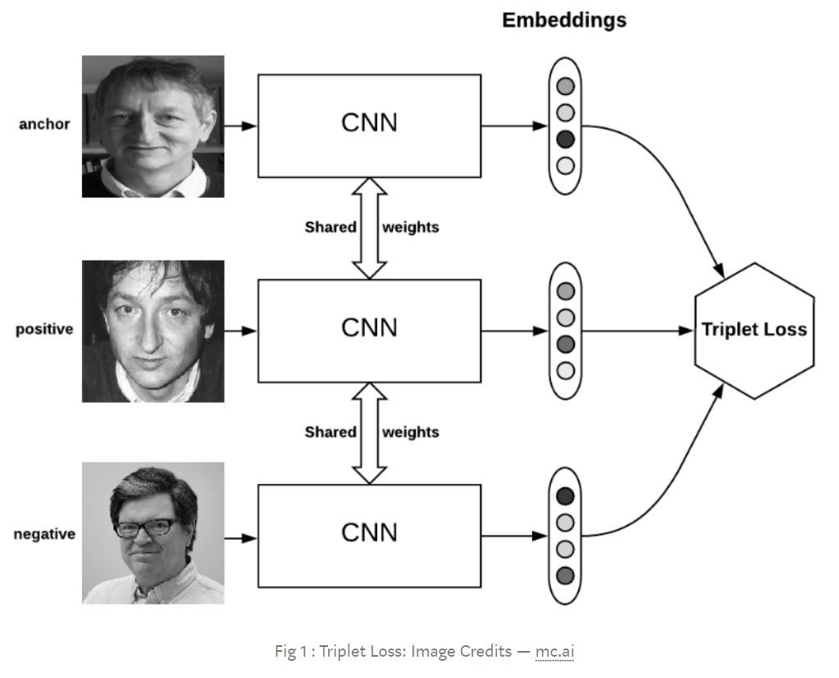
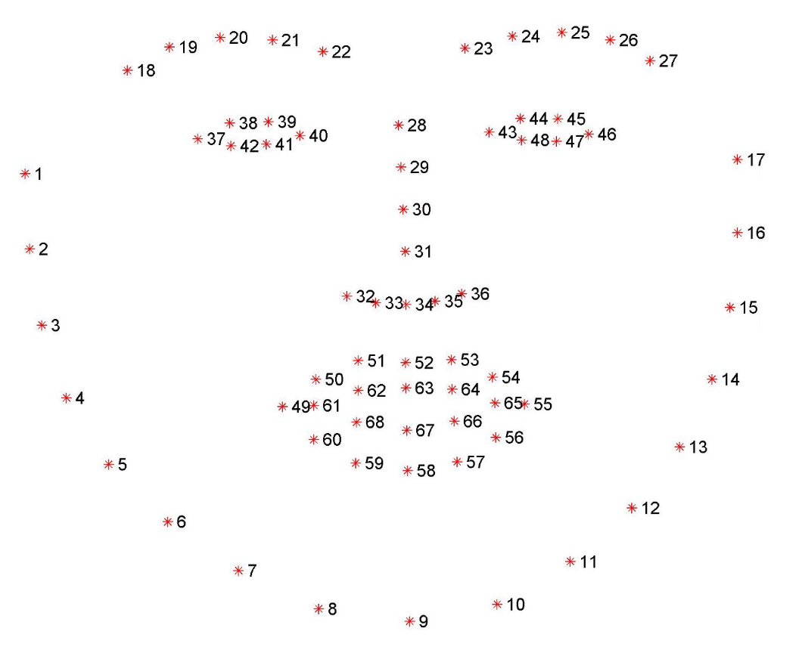
Methodology
triplet loss:
Face Landmark: FaceNet

Slide 11
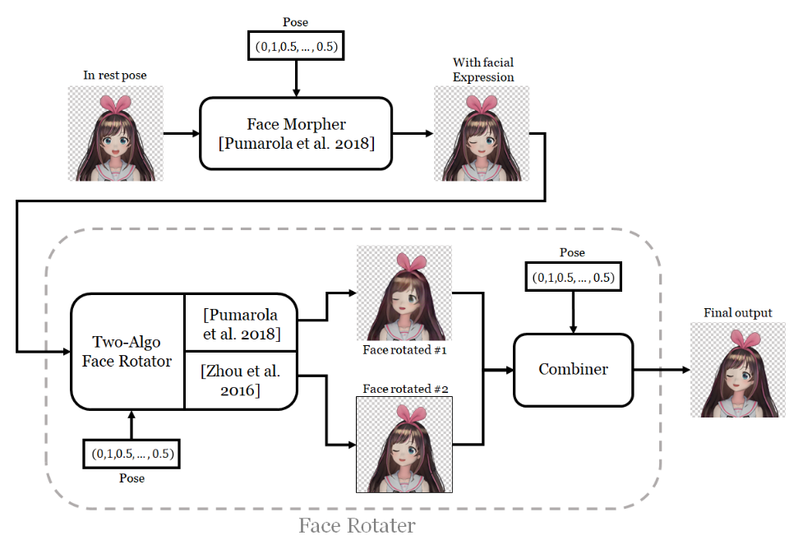
Methodology
Interaction

Slide 12
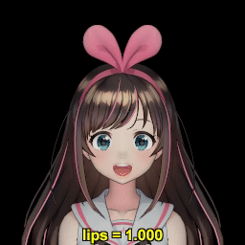
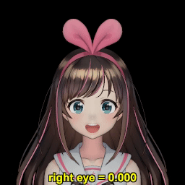
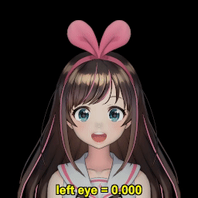
Methodology
As said earlier, the character's face configuration is controlled by a "pose." In this case, it is a 6-dimensional vector. Three components control the facial features and have values in the closed interval [0,1].
Two components control the opening of the eyes; one for the left eye and the other for the right. The value of 0 means the eye is fully open, and 1 means the eye is fully closed.
One component controls the opening of the mouth. This time, however, 0 means the mouth is fully closed, and 1 means the mouth is fully open. The contradicting semantics of the eye and the mouth parameters stem from the semantics of morph weights of the 3D models.

Slide 13
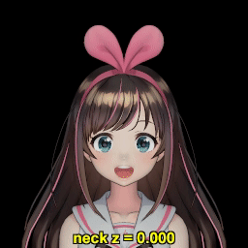
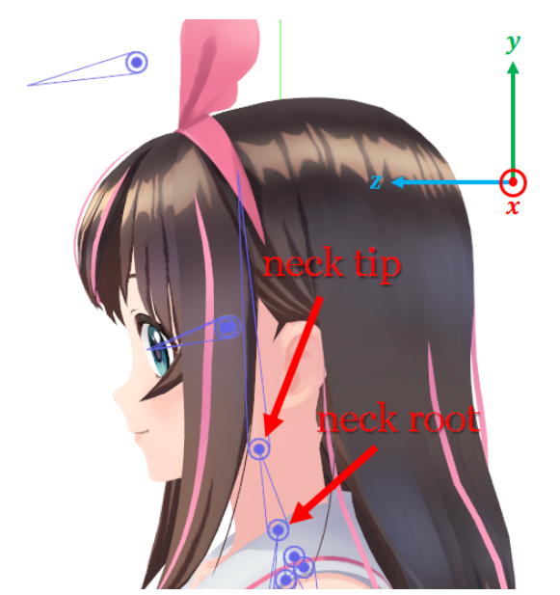
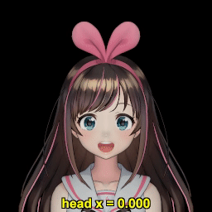
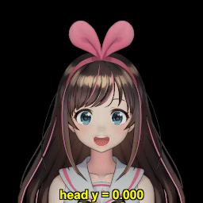
Methodology
The three other components control how the head is rotated. In 3D animation terms, the head is controlled by two "joints," connected by a "bone." The neck root joint is at where the neck is connected to the body, and the neck tip joint is at where the neck is connected to the head. In the skeleton of the character, the tip is a child of the root. So, a 3D transformation applied to the root would also affect the tip, but not the other way around.

Slide 14
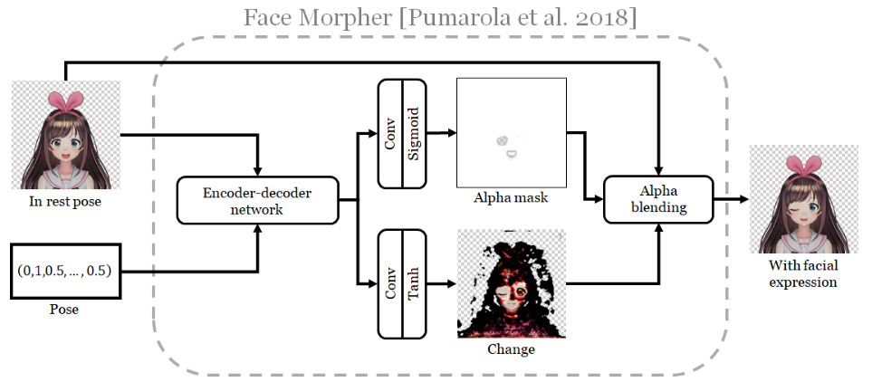
Face Morpher
The first step to pose a character's face is to modify its facial features. More specifically, we need to close its eyes and mouth.
In their paper, Pumarola et al. describes a network that can modify human facial features according to the given Action Units (AU), which represent movements of facial muscles .
The network modifies facial expression by producing a change image, which is combined with the original input image through an alpha mask .To do so, the input image and the pose is fed to an encoder-decoder network which will produce a 64-dimensional feature vector for each pixel of the input image. This image of feature vectors is then processed with two separate trains of a 2D convolutional unit and a suitable nonlinearity to produce the alpha mask and the change image.
They optimized the network with the Adam algorithm using the same setting as Pumarola et al.'s: batch size of 25. The network was trained for 6 epochs (3,000,000 examples), taking about 2 days with their GeForce GTX 1080 Ti GPU.

Slide 15
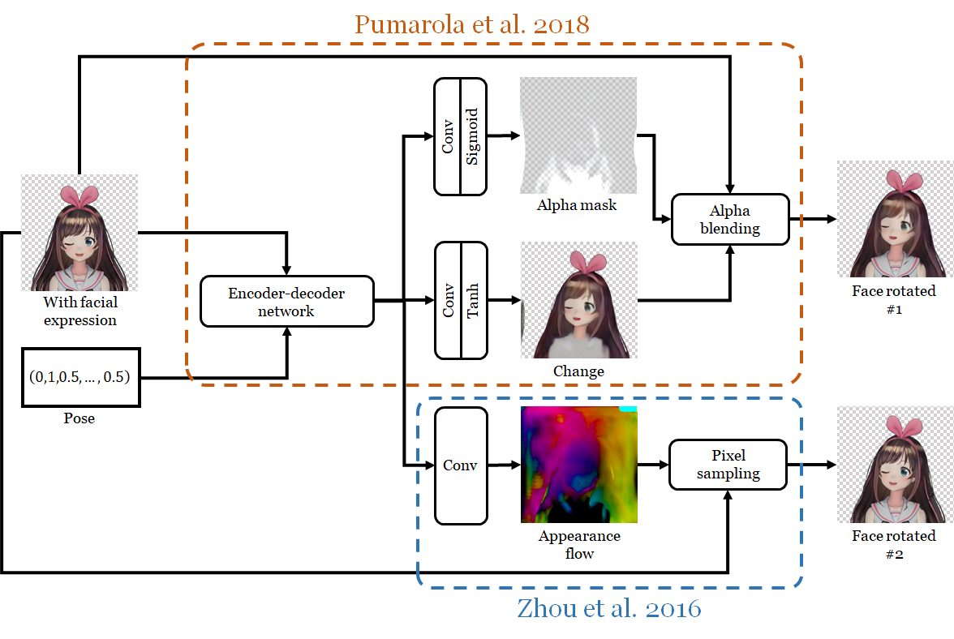
Face Rotator
The face rotator consists of two subnetworks. The two-algorithm rotator rotates the character's face with two different algorithms, each with its own strength and weakness. To combine their strength, the combiner takes the two output images, blends them together with an alpha mask, and also retouches the image to improve quality.

Slide 16
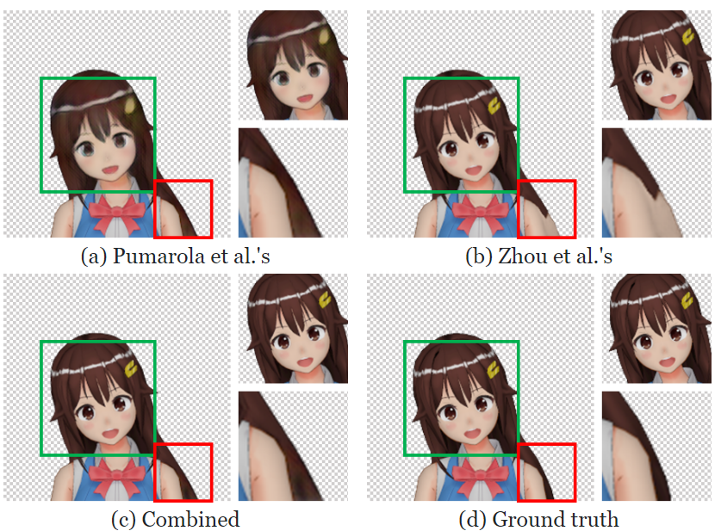
Combiner
It is instructive to see the outputs of the two-algorithm rotator to see that one of them alone does not suffice. We see in Figure that Zhou et al.'s algorithm used the arm pixels to reconstruct the disoccluded hair. On the other hand, Pumarola et al.'s hair has a more natural color. By combining the outputs of the two algorithms, we can get a much better result: relocated visible pixels would remain sharp, and pixels of disoccluded parts would have natural colors. The combiner network is depicted in Figure at next page.

Slide 17
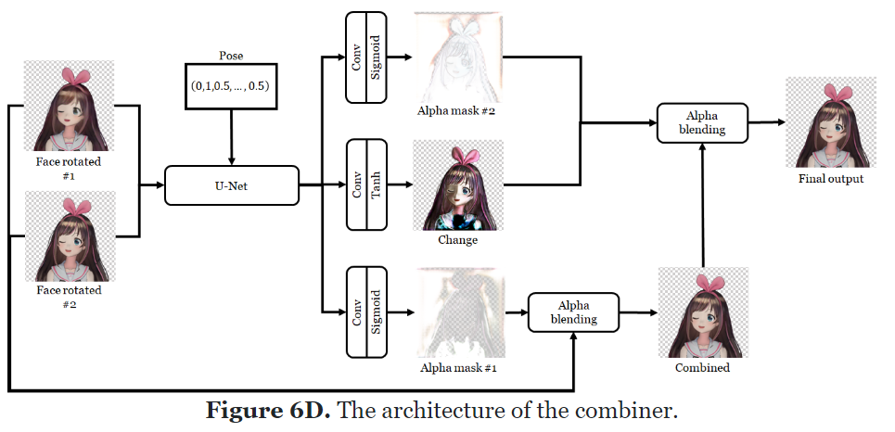
Combiner
This study use U-Net as the main body of the combiner in order to facilitate per pixel operations. Its output is then transformed into two alpha masks and a change image. The first alpha mask is used to combine the two input images. The second alpha mask and the change image are then combined with the output of the previous step to produce the final output. This last step "retouches" the combined image to improve its quality.

Slide 18
Connection
Improvement opportunities
Generative Adversarial Nets
Reinforcement Learning
Future applications
Autopilot, sleep detection, animation, virtual companion
Privacy
The most important aspect of developing the AI interaction was making sure that viewers were comfortable enough to interact with the system. These days, there is a sense of panic around AI recognition and classification systems, their invasion of our privacy, and their susceptibility to bias.

Slide 19
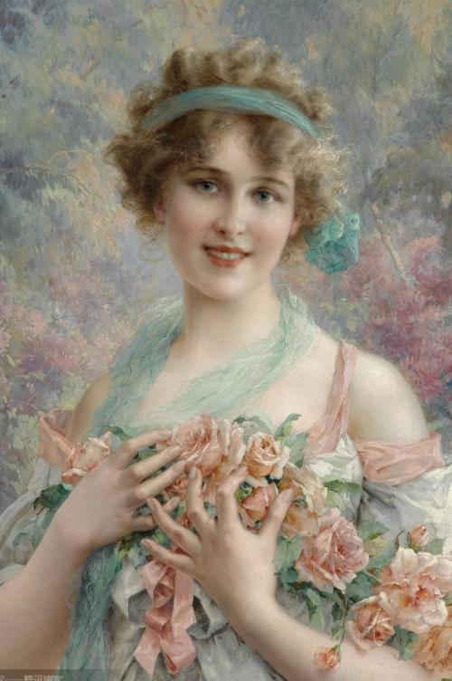
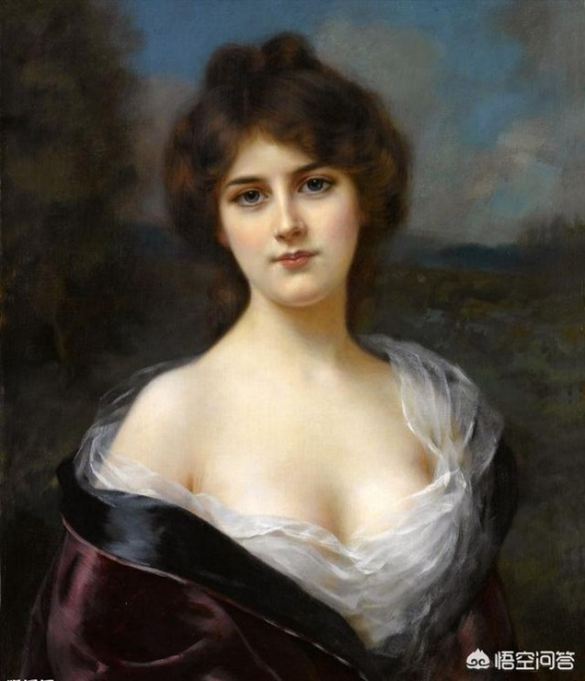
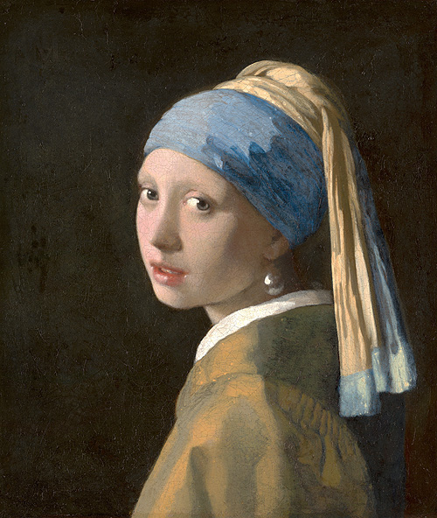
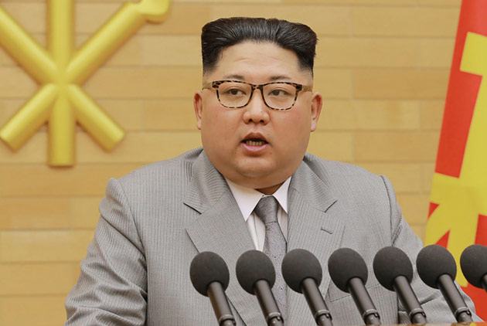
Demo (Face Detection / Face Alignment / Intimate Interaction)

