Slide 1
Deep Appearance Models for Face Rendering
STEPHEN LOMBARDI, Facebook Reality Labs
JASON SARAGIH, Facebook Reality Labs
TOMAS SIMON, Facebook Reality Labs
YASER SHEIKH, Facebook Reality Labs
108跨院碩科技藝術書報討論
Speaker : Chia-Ying Shih
Date : 2020.06.09

Slide 2
ABSTRACT
We introduce a deep appearance model for rendering the human face. Inspired by Active Appearance Models(AAM), we develop a data-driven rendering pipeline that learns a joint representation of facial geometry and appearance from a Multiview capture setup. Vertex positions and view-specific textures are modeled using a deep variational autoencoder that captures complex nonlinear effects while producing a smooth and compact latent representation.
At inference time, we condition the decoding network on the viewpoint of the camera in order to generate the appropriate texture for rendering. The resulting system can be implemented simply using existing rendering engines through dynamic textures with flat lighting. This representation, together with a novel unsupervised technique for mapping images to facial states, results in a system that is naturally suited to real-time interactive settings such as Virtual Reality (VR).

Slide 3
INTRODUCTION
With the advent of modern Virtual Reality (VR) headsets, there is a need for improved real-time computer graphics models for enhanced immersion. Traditional computer graphics techniques are capable of creating highly realistic renders of static scenes but at high computational cost. Rendering the human face is particularly challenging. Humans are social animals that have evolved to express and read emotions in each other’s faces. As a result, humans are extremely sensitive to rendering artifacts, which gives rise to the well-known uncanny valley in photo-realistic facial rendering and animation.
The primary challenge posed by the traditional graphics pipeline stems form its physics inspired model of light transport. For a specific known object class, like a human face, it is possible to circumvent this generic representation, and instead directly address the problem of generating images of the object using image statistics from a set of examples. This is the approach taken in Active Appearance Models (AAMs), which synthesize images of the face by employing a joint linear model of both texture and geometry (typically a small set of 2D points), learned from a collection of face images.

Slide 4
INTRODUCTION
Inspired by the AAM, in this work we develop a data-driven representation of the face that jointly models variations in sparse 3D geometry and view-dependent texture. Departing from the linear models employed in AAMs, we use a deep conditional variational autoencoder (CVAE) to learn the latent embedding of facial states and decode them into rendering elements (geometry and texture). A key component of our approach is the view-dependent texture synthesis, which can account for limitations posed by sparse geometry as well as complex nonlinear shading effects such as specularity. We explicitly factor out viewpoint from the latent representation, as it is extrinsic to the facial performance, and instead condition the decoder on the direction from which the model is viewed.
View-specific texture enables the modeling of view-dependent effects such as specularity. In addition, it can also correct for imperfect geometry stemming from biased or low resolution estimates. This is a significant departure from the traditional graphics pipeline, which requires highly accurate geometry as well as all elements of the shading model to achieve realism through physically-inspired light transport.

Slide 5
INTRODUCTION
Specifically, we found that learning a common CVAE over headset images and re-rendered versions of the multiview capture images allows us to correspond the two modalities through their common latent representation. This, in turn, implies correspondence from headset images to latent codes of the deep appearance model, over which we can learn a regression. Coupled with the deep appearance model, this approach allows the creation of a completely personalized end-to-end system where a person’s facial state is encoded with the tracking VAE encoder and decoded with the rendering VAE decoder without the need for manually defined correspondences between the two domains.

Slide 7
INTRODUCTION
This paper makes two major contributions to the problem of real-time facial rendering and animation: • A formulation of deep appearance models that can generate highly realistic renderings of the human face. The approach does not rely on high-precision rendering elements, can be built completely automatically without requiring any manual cleanup, and is well suited to real-time interactive settings such as VR. • A semi-supervised approach for relating the deep appearance model latent codes to images captured using sensors with drastically differing viewpoint and modality. The approach does not rely on any manually defined correspondence between the two modalities but can learn a direct mapping from images to latent codes that can be evaluated in real-time.

Slide 8
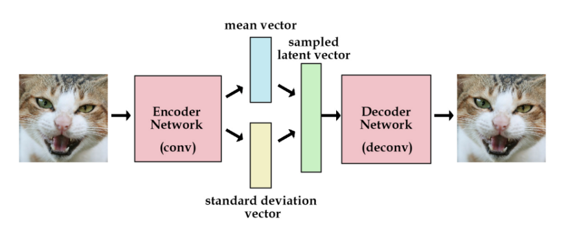
名詞補充
VAE(Variational Autoencoder) & CVAE(Conditional variational autoencoder ) : VAE加上額外條件(儲存變數)後構成CVAE

Slide 9
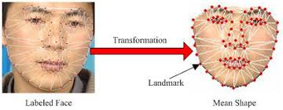
名詞補充
AAM (Active Appearance Model) : 前身為ASM(Active Shape Model), 運用 PCA(Principal components analysis)來建立描述形狀特徵的模型；相較ASM，AAM除了建立線性模型外，還記錄並分析了臉部的紋理特徵，並結合兩者嘗試找出關聯。

Slide 10
名詞補充
生成對抗網絡（英語：Generative Adversarial Network，簡稱GAN）是非監督式學習的一種方法，通過讓兩個神經網路相互博弈的方式進行學習。該方法由伊恩·古德費洛等人於2014年提出。生成對抗網絡由一個生成網絡與一個判別網絡組成。生成網絡從潛在空間（latent space）中隨機取樣作為輸入，其輸出結果需要盡量模仿訓練集中的真實樣本。判別網絡的輸入則為真實樣本或生成網絡的輸出，其目的是將生成網絡的輸出從真實樣本中盡可能分辨出來。而生成網絡則要盡可能地欺騙判別網絡。兩個網絡相互對抗、不斷調整參數，最終目的是使判別網絡無法判斷生成網絡的輸出結果是否真實。(wiki)

Slide 11
RELATED WORK
Active Appearance Models (AAMs) and 3D morphable models (3DMM) have been used as an effective way to register faces in images through analysis-by-synthesis using a low dimensional linear subspace of both shape and appearance. Our deep appearance model can be a seen as a re-purposing of the generator component of these statistical models for rendering highly realistic faces. To perform this task effectively, there are two major modifications that were necessary over the classical AAM and 3DMM approaches; the use of deep neural networks in-place of linear generative functions, and a system for view-conditioning to specialize the generated image to the viewpoint of the camera.
We learn to generate view-specific texture maps of how the face changes due to facial expression and viewing direction. This greatly simplifies the learning problem, achieving high-resolution realistic output as a result. Our method learns how appearance changes due to expression and view rather than prescribing it. Most importantly, these approaches are geared towards data-limited scenarios and, as a result, do not scale well in cases where data is more abundant. Our approach is designed specifically to leverage large quantities of high quality data to achieve the compelling depiction of human faces.

Slide 12
RELATED WORK
To drive our model we develop a technique for learning a direct end to-end mapping from images to deep appearance model codes. Most approaches assume a complete view of the face where correspondences are easily defined through facial landmarks. The main difference to our work is in how corresponding expressions are found between the two domains. Since we leverage unsupervised domain adaptation techniques, the only requirement of our method is that the distribution of expressions in both domains are comparable.
Many of these methods rely on Generative Adversarial Networks (GANs) to translate between two or more domains, sometimes with additional losses to ensure semantic consistency. Some works also use VAE in conjunction with other components to learn a common latent space between domains. Our approach differs from these works in that we leverage the pre-trained rendering VAE to help constrain the structure of the common latent space, resulting in semantics that are well matched between the modalities.

Slide 13
CAPTURING FACIAL DATA
To learn to render faces, we need to collect a large amount of facial data. For this purpose, we have constructed a large multi-camera capture apparatus with synchronized high-resolution video focused on the face. The device contains 40 machine vision cameras capable of synchronously capturing 5120×3840 images at 30 frames per second. All cameras lie on the frontal hemisphere of the face and are placed at a distance of about one meter from it. We use zoomed in 50mm lenses, capturing pore-level detail, where each pixel observes about 50µm on the face.
To keep the distribution of facial expressions consistent across identities, we have each subject make a predefined set of 122 facial expressions.

Slide 14
BUILDING A DATA-DRIVEN AVATAR
Our primary goal is to create extremely high-fidelity facial models that can be built automatically from a multi-camera capture setup and rendered and driven in real time in VR (90Hz).
We unify the concepts of 3D morphable models, image-based rendering, and variational autoencoders to create a real-time facial rendering model that can be learned from a multi-camera capture rig. The idea is to construct a variational autoencoder that jointly encodes geometry and appearance. In our model, the decoder outputs view-dependent textures—that is, a texture map that is “unwrapped” from a single camera image.
The critical piece of the proposed method is that we use a conditional variational autoencoder (CVAE) to condition on the viewpoint of the viewer, allowing us to output the correct view-specific texture. At test time, we can execute the decoder network in real-time to regress from latent encoding to geometry and texture and finally render using rasterization.

Slide 15
BUILDING A DATA-DRIVEN AVATAR
For this work, we assume that coarse facial geometry has been tracked and we use it as input to our algorithm with the original camera images. After geometry is tracked, we “unwrap” texture maps for each camera and for every frame of capture. Unwrapping is performed by tracing a ray from the camera to each texel of the texture map and copying the image pixel value into the texel if the ray is not occluded. These view-specific texture maps are what we want to generate at test time: reproducing them will cause the rendered image to match the ground truth image after rendering. To learn how to generate them efficiently, we use a conditional variational autoencoder (CVAE). Because we jointly model geometry and appearance, our autoencoder has two branches: an RGB texture map and a vector of mesh vertex positions.

Slide 16
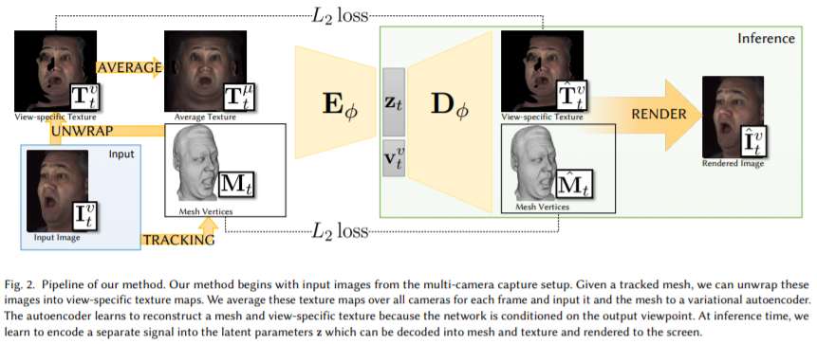
V = 40 T = texture map w = texel (occluded (0) or unoccluded (1) )
Mt = a 3D mesh ⊙ = element-wise product Eϕ = the encoder
Dϕ = the decoder zt = subject’s facial state I = image

Slide 17
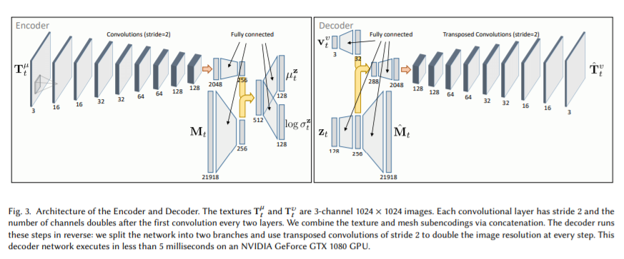
The decoder network must execute in less than 11.1 milliseconds to achieve 90Hz rendering for real-time VR systems. (5 milliseconds on an NVIDIA GeForce GTX 1080 graphics card)
We use the Adam algorithm [Kingma and Welling 2013] to optimize this loss.

Slide 18
DRIVING A DATA-DRIVEN AVAT
In this section, we detail how to animate our avatar by controlling the latent facial code z with an unsupervised image based tracking method. The primary challenge for driving performance with these avatars is obtaining correspondence between frames in our multi-camera capture system and frames in our headset. Note that this is a unique problem for virtual reality avatars because one cannot wear the headset during the multi-camera capture to allow us to capture both sets of data simultaneously, as the headset would occlude the face. We address this problem by utilizing unsupervised domain adaptation.

Slide 19
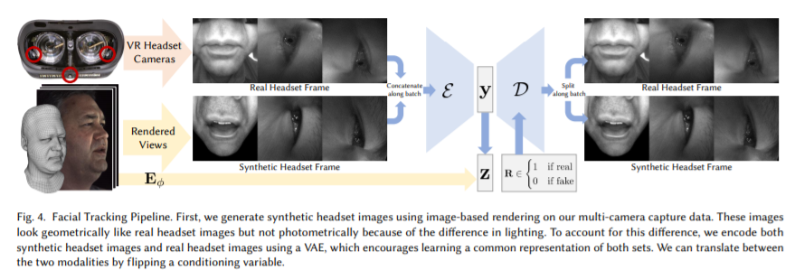
DRIVING A DATA-DRIVEN AVAT
y = real headset images or the set of synthetic images E = the encoder Ht = headset frame = mouth + left eye + right eye D = the decoder

Slide 20
DRIVING A DATA-DRIVEN AVAT
We don’t use any normalization in these networks. Our encoder network runs in 10ms on an NVIDIA GeForce GTX 1080, which enables real-time tracking. To train the network, we optimize the reconstruction loss, retargetting loss, and KL-divergence loss.
We optimize this loss using the Adam optimizer .
This completes the entire pipeline: a headset image is input to the headset encoding network E to produce the headset encoding y, then it is translated to the multi-camera encoding z, and finally it is decoded into avatar geometry Mˆ and texture Tˆ and rendered for the user.

Slide 21
RESULT - Qualitative Result
Our model is able to capture subtle details of motion and complex reflectance behavior by directly modeling the appearance of the face.

Slide 22
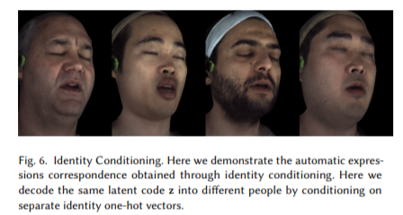
RESULT - Qualitative Result

Slide 23
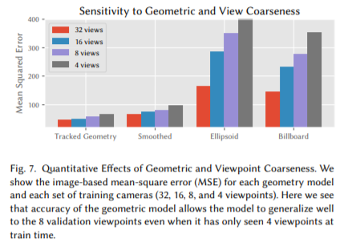
RESULT - Effect of Geometric and Viewpoint Coarseness
Our model is able to “correct” for any bias in mesh tracking by altering the output of the texture maps to best match the true view-specific texture map. There is a limit, however, to the ability of the texture network to resolve those errors. To explore this, we have constructed a series of experiments to analyze quantitatively and qualitatively how the model behaves when the geometry becomes coarser and viewpoints become sparser.

Slide 24
RESULT - Effect of Geometric and Viewpoint Coarseness

Slide 25
RESULT - Video - driven Animation

Slide 26
RESULT - Video - driven Animation

Slide 27
MY OPINION
整篇論文架構非常嚴謹，最後results部分還做了多方的實驗將整個model調整至最好的狀態。在discussion中有提到未來的目標是繼續處理關於照明改變以及較難細部處理的粗糙表面(如頭髮)的模擬，至於臉部以下的人物虛擬化也是他們的目標，真的很厲害!
為了要看懂所以查了許多資料學到許多不同的東西。
Facebook做這個對於他以後要推廣虛擬聊天室感覺會很有用，如果能夠將訓練好的model普及，應用在遊戲產業的可能性也非常大。
有時候我認為人臉的失真也有它有趣和漂亮之處，看到這樣一個研究內心其實有點複雜，當世界太清楚的時候，不知道會不會是一件好事。

