Slide 1
Research Center for Technology and Art
Seminar Presentation
AI
ACM SIGGRAPH
2017
Artificial Intelligence
Physics Forest
- Real-time fluid simulation using machine learning
[ Award of Distinction ]
清華大學科技藝術書報討論 - IPHD 人工智慧組 楊元福
Ref: https://dl.acm.org/doi/abs/10.1145/3098333.3098337

Slide 2
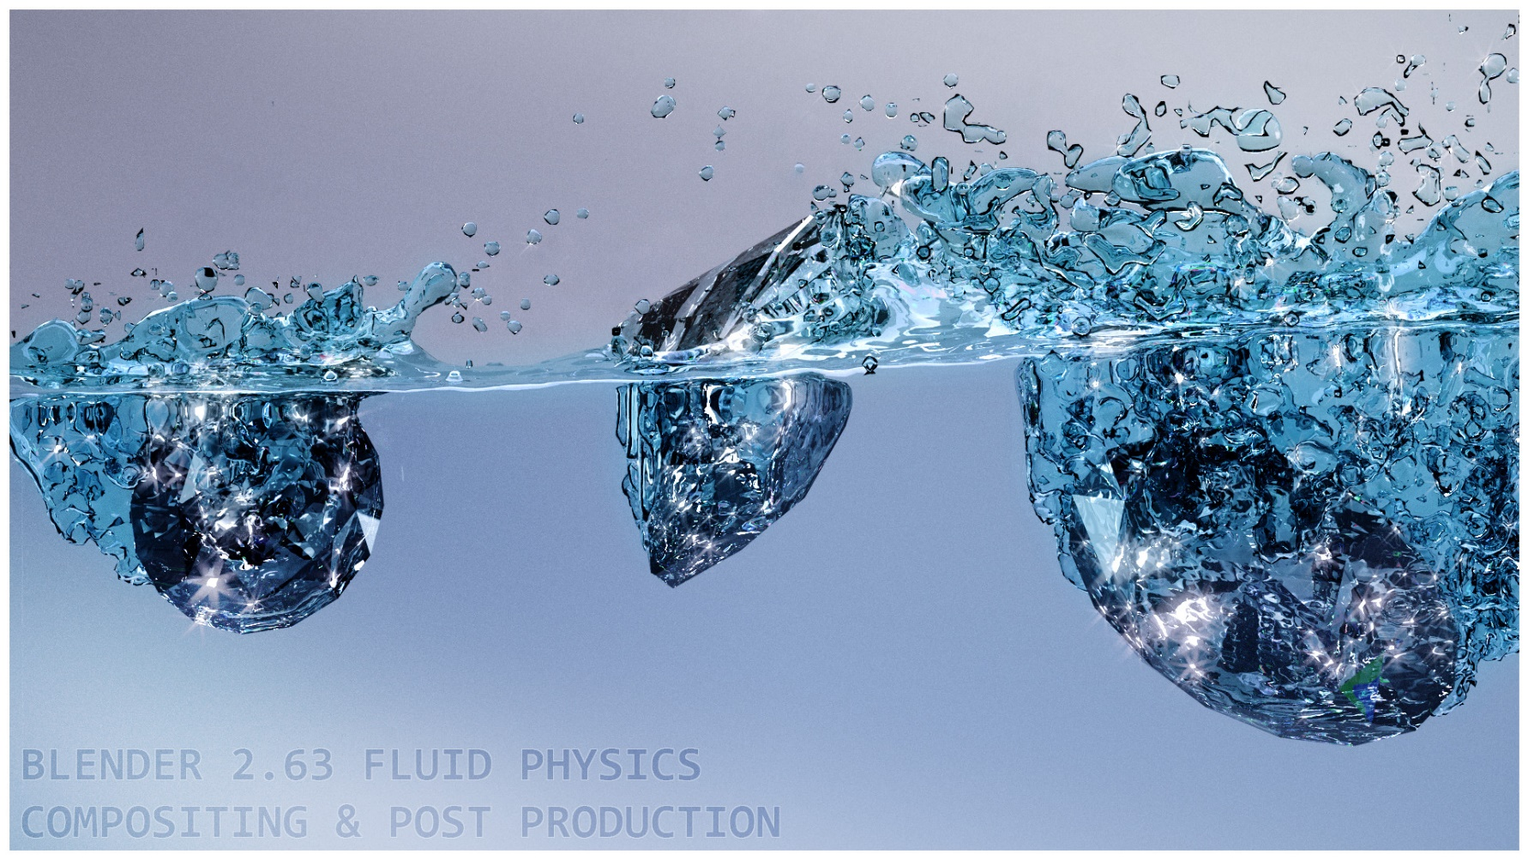
Project Introduction
PhysicsForests is a fluid-simulation framework that can simulate large scenes with several million particles in real time, including surface generation, foam, rigid-body coupling, and rendering. Instead of solving underlying Navier-Stokes equations, it predicts particle behavior approximately using machine-learning-based Regression Forest method that is trained on a large set of randomly generated scenes obtained by a traditional fluid solver. The result is faster and more stable than standard methods.

Slide 3
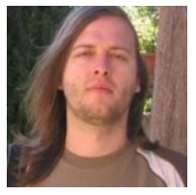
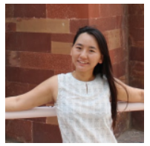
Authors
Apagom AG
Ľubor Ladický received a Ph.D. in computer vision from Oxford Brookes University in 2011. He worked as a researcher in the Visual Geometry Group at the University of Oxford and in the Computer Vision and Geometry Lab at ETH Zürich. His current research interest is speeding up physics simulation using machine learning. In 2017, he co-founded and is a CEO of Apagom AG, transferring this line of research to industry.
SoHyeon Jeong worked on a physics simulation of natural phenomena for her Ph.D. at Korea University and joined the computer graphics lab at ETH Zürich. During her post-doctoral studies, she worked on real-time fluid simulation using machine learning and later co-founded Apagom AG.

Slide 4
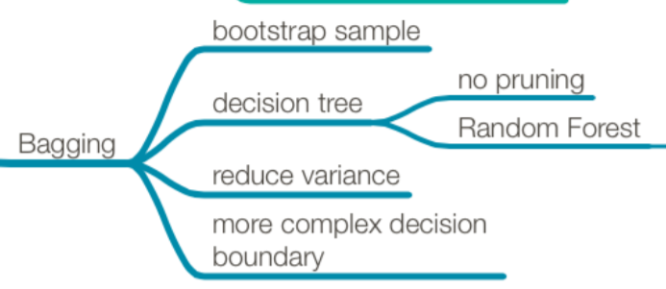
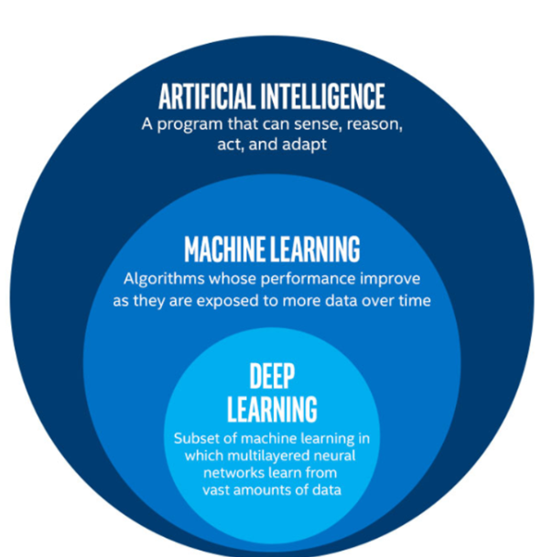
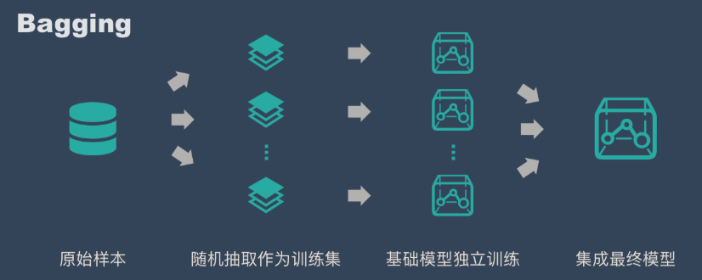
Machine Learning
Ensemble
Ref: https://easyai.tech/ai-definition/ensemble-learning/

Slide 5
Random Forests –
Leo Breiman
1954: PhD Berkeley (mathematics)
1960-1967: ULCA (mathematics)
1969-1982: Consultant
1982-1993: Berkeley (statistics)
1984 “ Classification & Regression Tress “
1996 “ Bagging “
2001 “ Random Forests “

Slide 6
Decision Tree
task: distinguish people by gender
G$(x)=\sum_{c=1}^{C}{\left[b\left(x\right)=c\right]G_{c}(x)}$
yes
no
D = ${{{\{(x}_{n},y_{n})\}}_{n=1}^{N}}_{}$
function Decision Tree (data )
if termination criteria met
reture base hypothesis
else:
Classifier-1: 喜歡看球賽?
$$g_{t}(x)$$
(1) Learn branching criteria b(x)
(2) Split D to C parts
(3) Build sub-tree
(4) return
Classifier-2: 喜歡看帥哥?
$D_{c}$ = ${\{(x}_{n},y_{n}):b\left(x_{n}\right)=C\}$
$$G_{c} ←Decision Tree(D_{c})$$
yes
no
yes
no
$$\sum_{c=1}^{C}{\left[b\left(x\right)=c\right]G_{c}(x)})$$
Four choices: number of branches, branching criteria, termination criteria, & base hypothesis

Slide 7
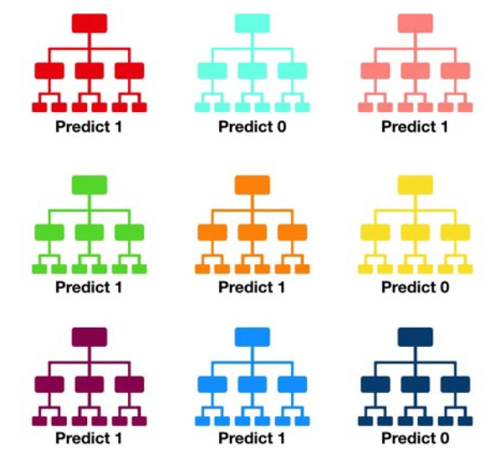
Random Forest
Random Forest = Bagging + Decision tree
function RandonForest(D)
For t = 1, 2, …, T
(1) Request size-N data by boostrapping with D
(2) Obtain tree by Dtree( )
$${\tilde{D}}_{t}$$
$$g_{t}$$
$${\tilde{D}}_{t}$$
$$g_{t}$$
Return G = Uniform({ })
Result: six 1s and tree 0s ➔ prediction: 1

Slide 8
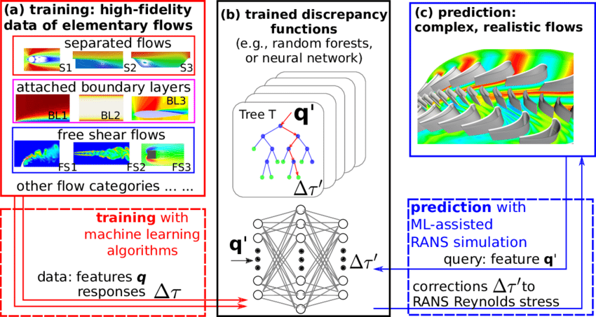
Art Statement
Physics Forests. This data-driven fluid simulation, with surface generation, foam, coupling with rigid bodies, and rendering, is capable of simulating several million particles in real time. It uses the regression forest to estimate the behavior of particles and rendered surfaces. The method can handle a wide range of fluid parameters.

Slide 9
Demo - Physics Forest

Slide 10
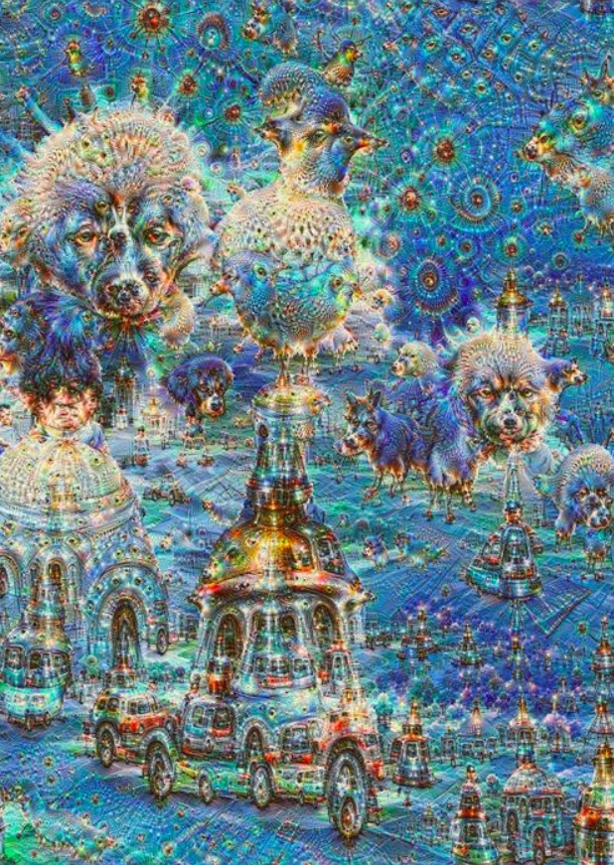
Connection
Adding factor of “ color “ with fluid simulation may be unexpectedly artistically presented
Trying different ML models may have different effects
~ Bagging / Boosting / RNN / CNN / LSTM
This method may be applied to AI painting
In 2016, Google held an art exhibition and auction in San Francisco, with 29 works including psychedelic seascapes, Van Gogh-style forests, and bizarre landscapes composed of castles and dogs

