Slide 1
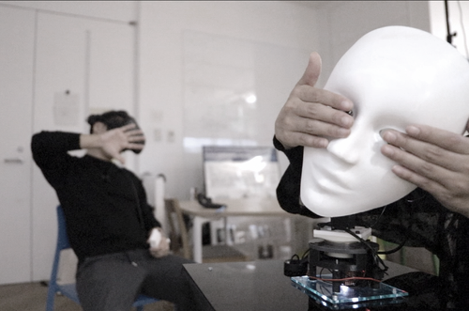
TeleSight: Enabling asymmetric collaboration in VR between
HMD user and Non-HMD users
2020.03.31 108清華大學跨院碩書報討論
Speaker: 施佳瑩
2019 ACM SIGGRAPH – Emerging Technology

Slide 2

Authors
Taichi Furukawa
Daisuke Yamamoto
Moe Sugawa
Roshan Peiris
Kouta Minamisawa
Graduate School of Media Design Keio University
CCS CONCEPTS• Human-centered computing → Human computer interac-tion (HCI).

Slide 3
Introduction
VR (Virtual Reality) experience using HMD (Head-mounted Display) is becoming public entertainments. Also, VR as a framework to build the new sense and perception world freely, a recent development focus mainly on in-creasing the immersion and enjoyment for the person who wearing HMD (HMD user). On the other hand, such extended experience in the VR is hard to share with every other person in this environment (Non-HMD user) and this leads to the experiential gap.
Central question :
How to solve the problem of the experimental gap ?
Several types of research have been proposed using the approach of Asymmetric Interaction/Collaboration in VR to the problem of the experimental gap.

Slide 4
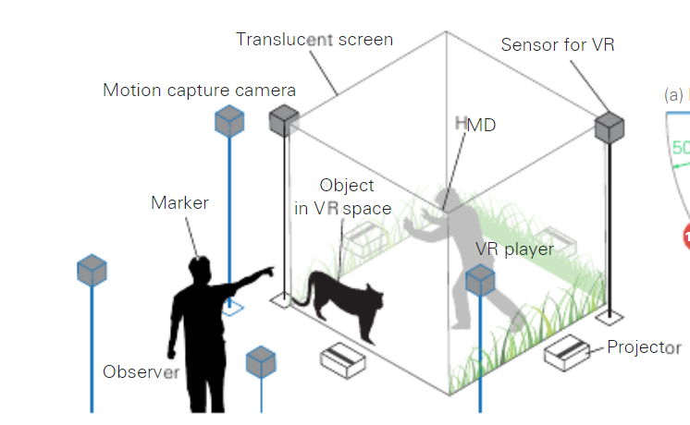
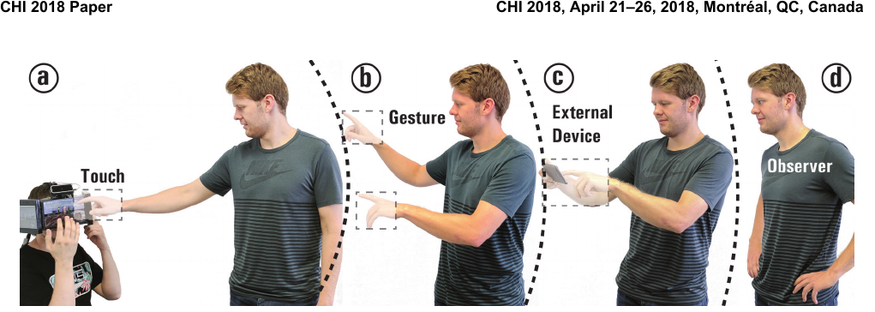
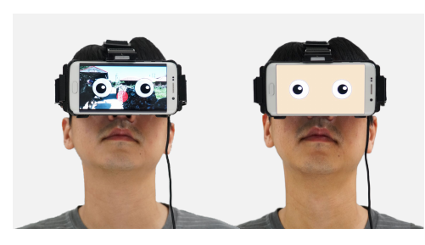
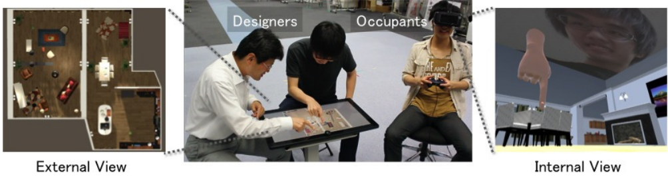
Introduction – Others’ research
Gugenheimer [Gugenheimer et al.2018] purposed modified VR HMD consisting of three touch displays and a depth camera and its enabled asymmetric co-located interaction with surrounded players.
Chan [Chan and Minamizawa 2017] proposed a system that promotes Non-HMD user’s understanding of VR experience by displaying HMD user’s gaze. (Physical interaction)
Ishii [Ishii et al.2017] designed to visually represent VR space through a projection system and improve the perspective gap in the VR experience.
Ibayashi [Ibayashi et al. 2015] proposed a space layout interface for direct communication with an HMD user immersed in VR space.

Slide 5
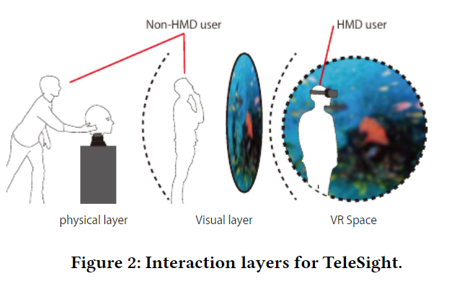
Introduction – TeleSight
TeleSight, enabling asymmetric collaboration in VR between HMD user and Non-HMD users in the same place. It enables embodied interaction inside the HMD. The experience scenarios lead to the interaction with the vision of HMD user.
TeleSight provides unique experience scenario using two interaction layers : a physical layer for direct tangible interaction with players in VR space (Avatar robot), a visual layer that visually expresses VR space (Projection system).

Slide 6
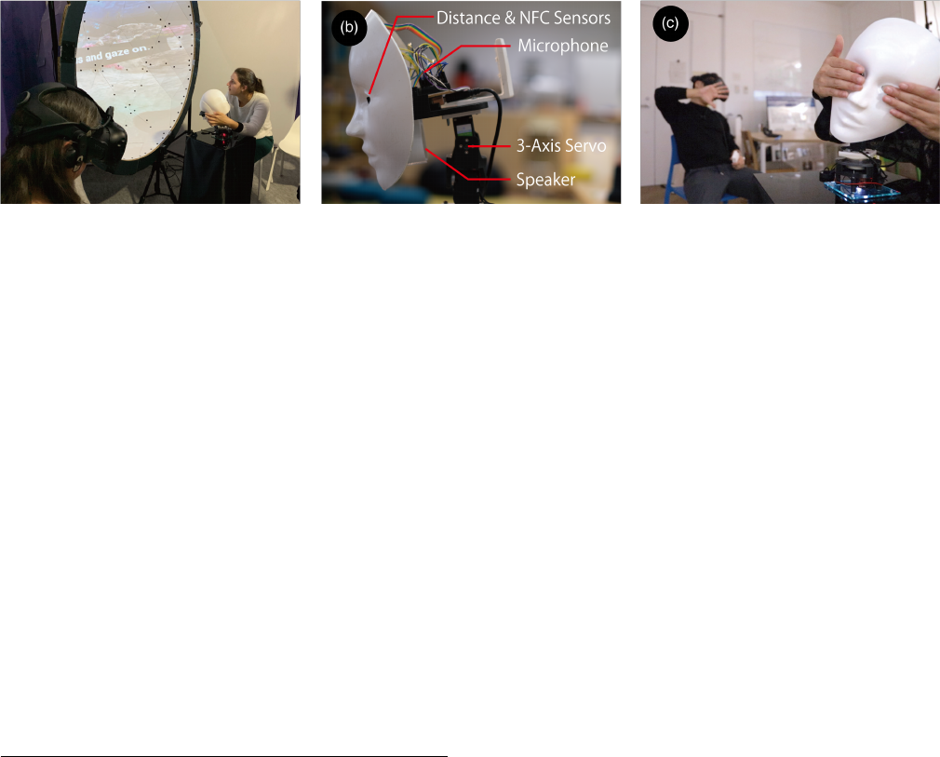
System Design
The TeleSight system consists of a projection system as a visual layer and an avatar robot as a physical layer.(Fig. 1a)
The avatar robot reproduces the motion of the HMD user with a 3-axis servo actuator. The actions such as wearing items and covering eyes with hands can be identified using a sensor module consisting of a distance sensor and an NFC sensor mounted on both eyes of the robot.(Fig. 1b) The robot has a speaker and a micro-phone. The voice of the HMD user emits from the robot, and the HMD user can hear what the Non-HMD user is talking to the robot through the microphone.
The projection system using a dome projector screen, and it aims to present a 180-degree view centered on the player in the VR space. As a result, the visual layer can present a wider range than the VR space seen by the HMD user as information, contributing to an asymmetric experience scenario.

Slide 7
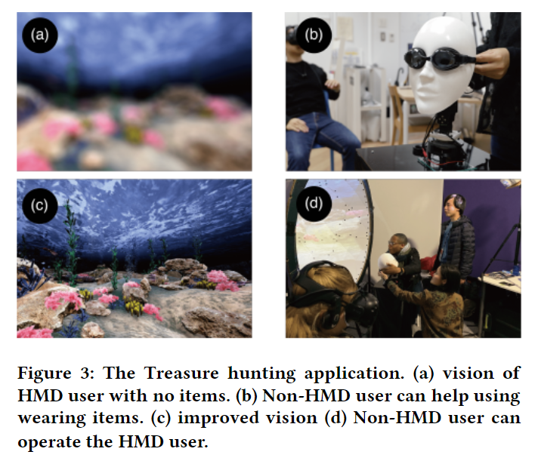
Experience Scenario
VIDEO

Slide 8
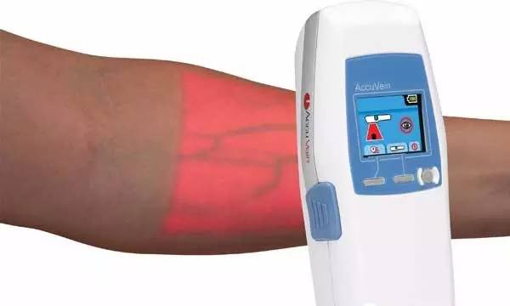
My opinion
針對文章撰寫，該篇論文有多處文法上的錯誤，且圖片編號後未如實的在該圖片標上編號，造成閱讀上的困擾。
TeleSight 的名字取的很棒。
NFC若能與血管顯像儀與血流偵測器結合，加上VR的設備後，或許對於醫療學習者能有所幫助，或是未來能當作偵測玩家緊張程度變化的一環。

