Slide 1
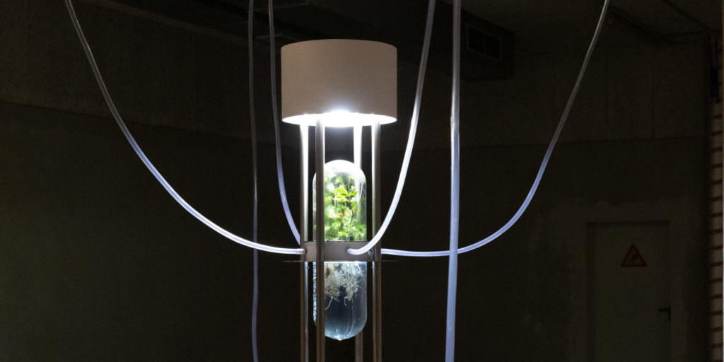
Earthlink Saša Spačal
108清華大學跨院碩書報討論 施佳瑩
2019 Ars Electronica Festival
Notes:
開頭詞:
2019年的作品
作品名
斯洛維尼亞藝術家

Slide 2
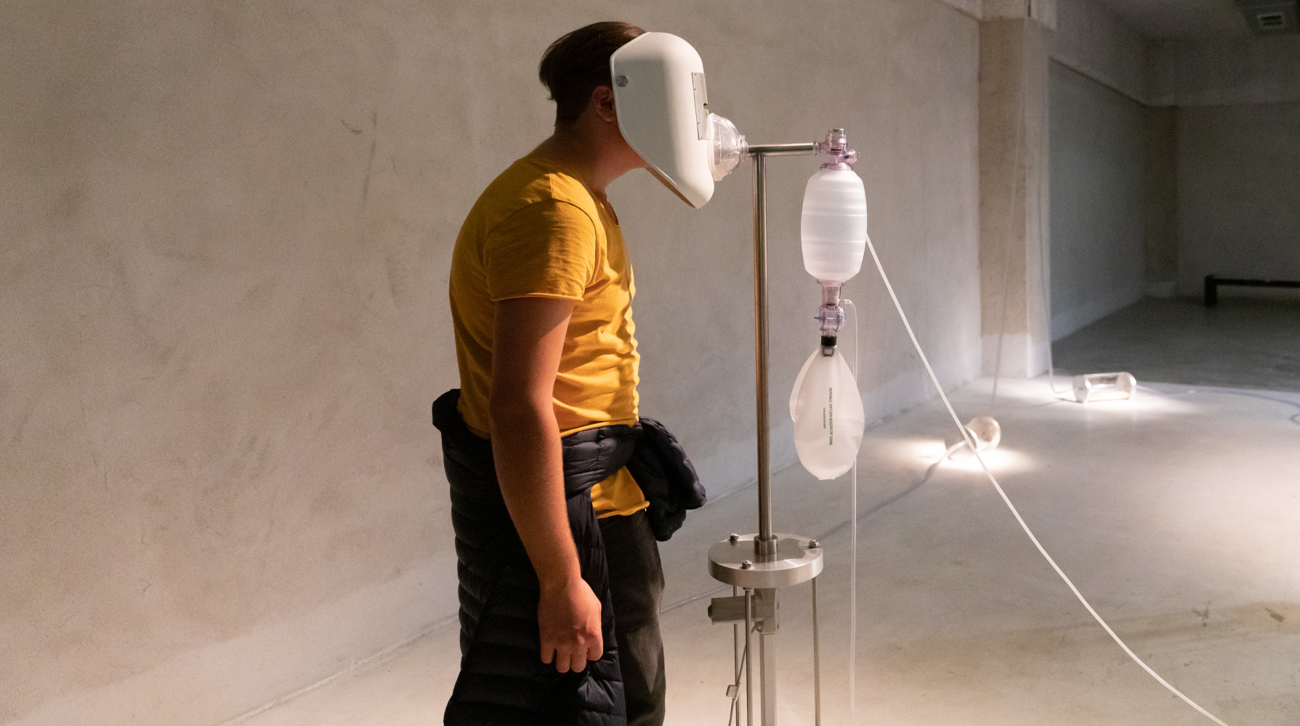
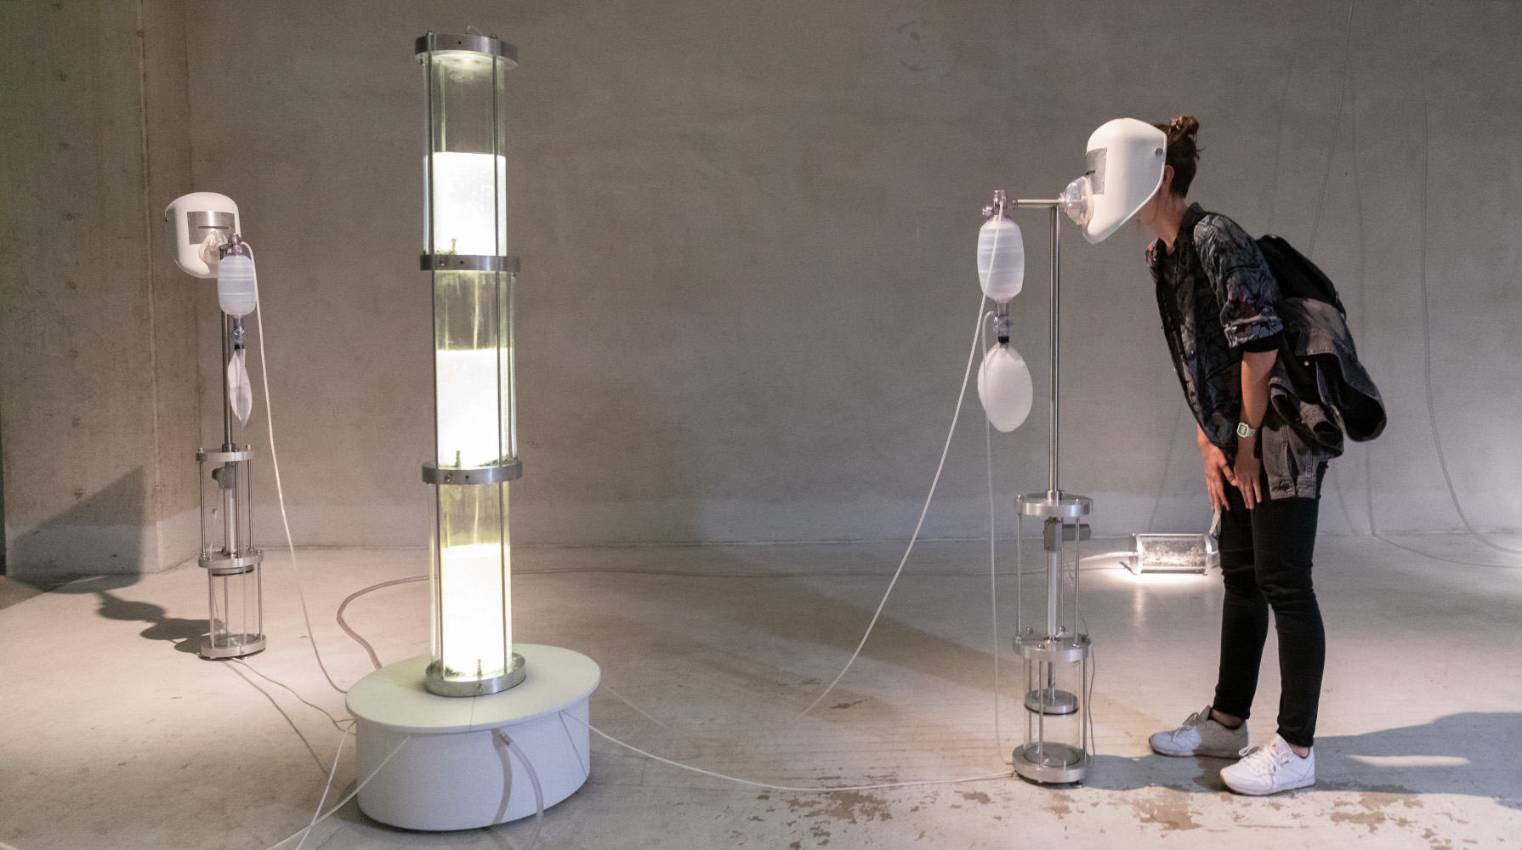
Art statement
“The relational capacity of the posthuman subject is not confined within our species, but it includes all non-anthropomorphic elements, beginning with the air we breathe.”
– Rosi Braidotti
Notes:
介紹作品前以藝術家引用羅西·布雷多蒂(當代哲學家與女性主義理論家)的話當開頭
“現代人類與他者的關係並不侷限於人類，從我們的呼吸開始，關係中包含著所有非擬人的元素。”

Slide 3
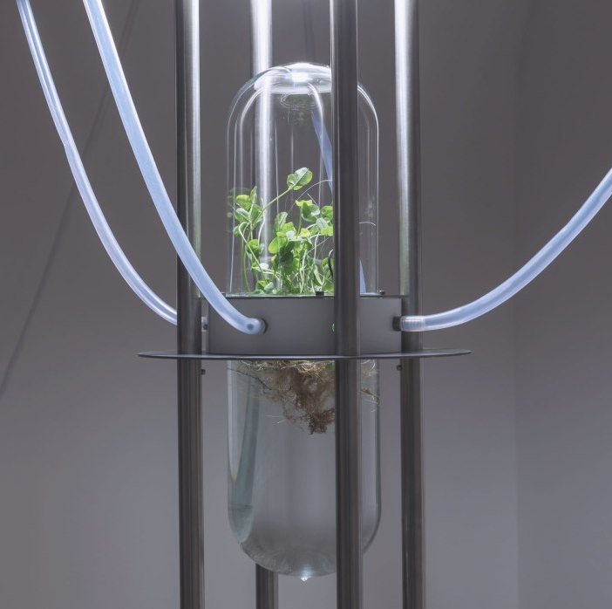
Art statement
Central Question:
人類與環境以及整個行星系統—地球是如何聯繫在一起的？
How are humans connected to the environment and the entire planetary system — the Earth?
Answer:
透過呼吸的過程，人類同時影響著環境與地球和被其影響。
Respiration are intimate processes that bind humans to the planet.

Slide 4
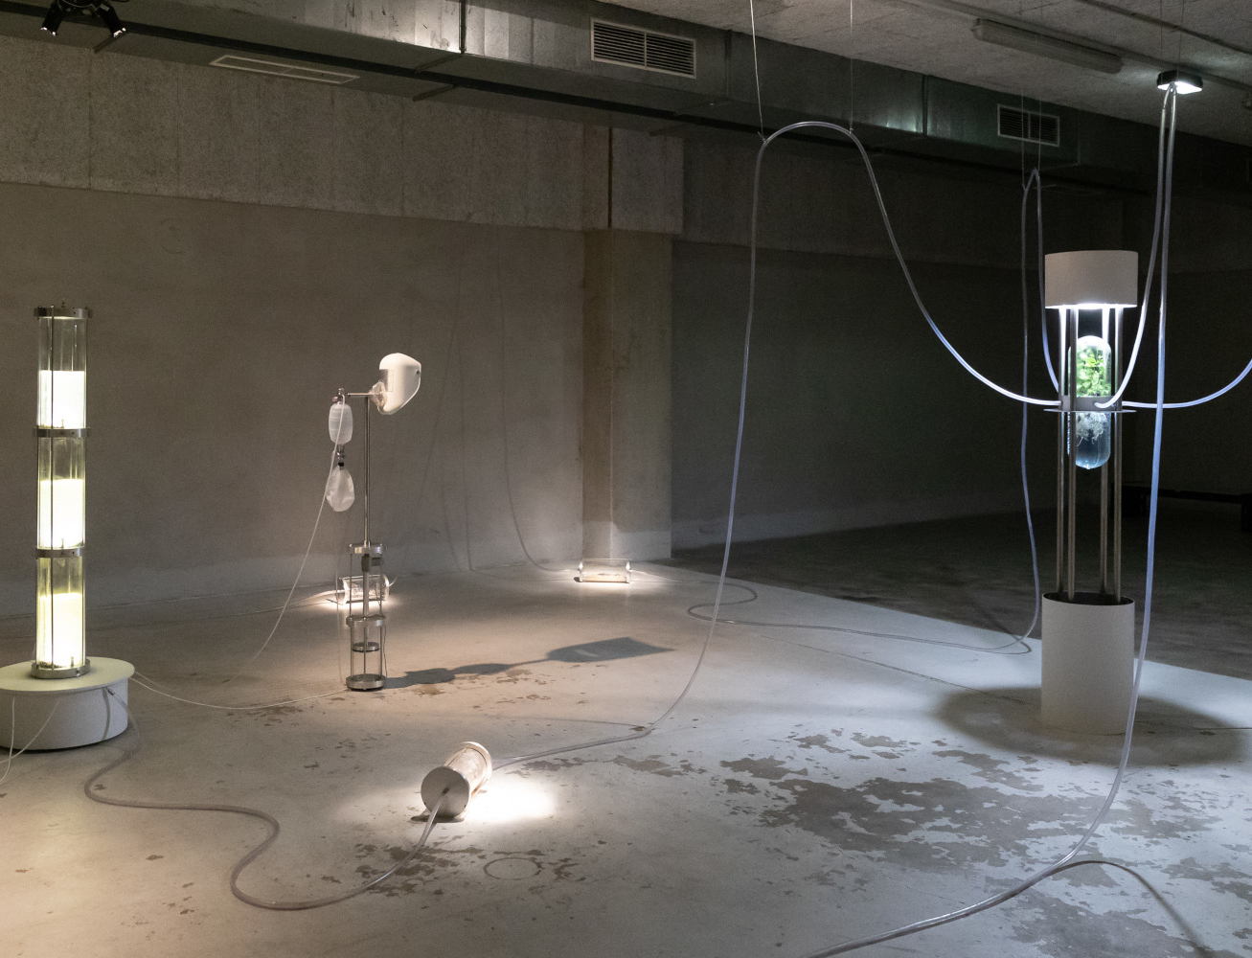
Art statement
作品本身透過展現地球的循環系統，使觀眾能以更動態與持續性的方式，認識現代人類活動對地球環境的影響。
Earthlink, enabling a more dynamic and sustainable perception of human activity within the environment, performs a planetary biogeochemical feedback loop catalyzed by microbial metabolism.

Slide 5
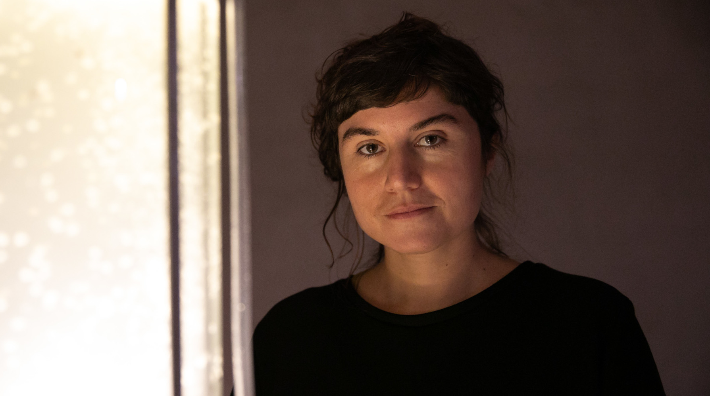
Artist
Saša Spačal是一位研究環境文化與行星循環系統關係的藝術家，其研究聚焦在如何利用發展技術介面並結合有機物(生命系統)和無機物(礦物土壤等)創作，並讓觀者反思人類社會與地球環境的共生。
Her work focuses on the relationship between environment-culture and planetary metabolism. By developing technological interfaces and relations with an organic and mineral soil agents, she tries to address the posthuman condition.
Saša Spačal(1978 - , Slovenia)
- Postmedia artist

Slide 6
About Earthlink - How it works?
The exteriorized lungs, collecting visitors’ microbiomes, are persistently being rinsed by droplets of cypress extract(futile cleansing for the colonies).
The microbiomic capsules serve as connectors between the three installations – Inspiration, Expiration and Symbiome.
INSPIRATION
EXPIRATION
SYMBIOM
BIOMES
Air is enriched with the soil bacteria Mycobacterium vaccae(as a non-pathogenic aerosol). The distribution is not evenly by the respiratory masks.
Symbionts, in the hydroponic chamber, processing gasses and negotiating the survival of numerous species in the loop. (Represent symbiosis)
Notes:
Mycobacterium vaccae 牛分枝桿菌
red clover Trifolium pratense三葉草 and root nodule bacteria Rhizobiaceae 根瘤菌which exchange carbon and nitrogen compounds.
吸氣圍繞著擴展和生長的空間，微生物群是動物，人類，真菌，植物和種子的來源。
呼氣: 這些微生物膠囊中的微生物來自工業雞骨頭，火山岩，微塑料和乾珊瑚。

Slide 7
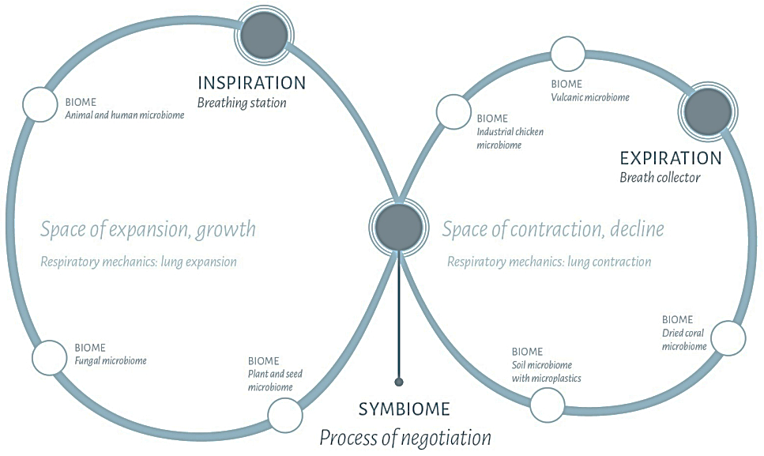
About Earthlink - INTRA_FLUX
Intra_flux [neologism]: The flow of intra-actions that occurs among actors in the planetary metabolism.

Slide 8
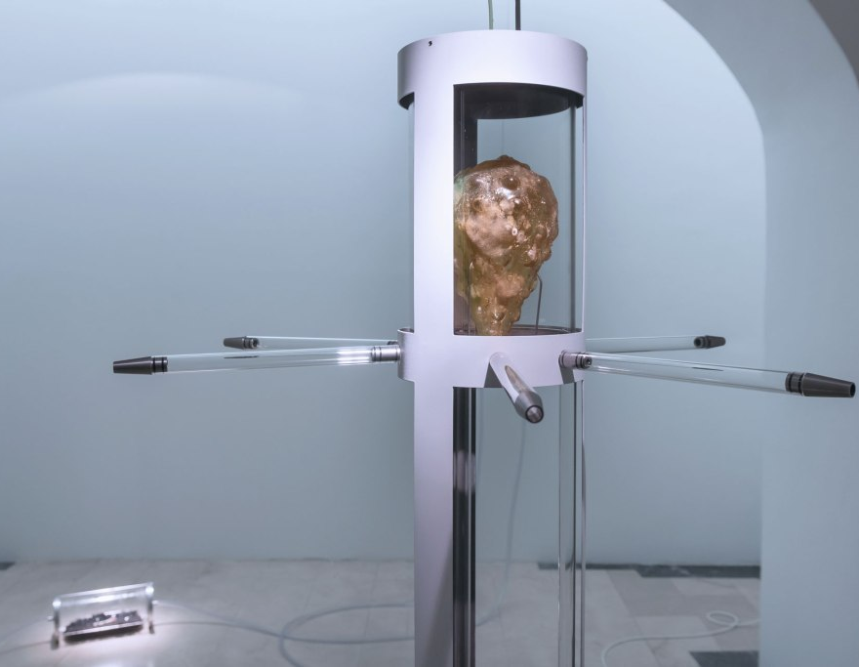
About Earthlink - Info
Earthlink, 2018
Saša Spačal
Consultation, microbiology: Mirjan Švagelj, PhD
Curator: Jani Pirnat
Glasswork: Pero Kolobarić, Zvonko Drobnič
Construction: Anil Podgornik, Scenart, Ambrož Modrijan
Photographs: Miha Godec and Saša Spačal
Special thanks to: Jurij Krpan
Production: Museum and Galleries of Ljubljana
Co-production: Projekt Atol Institute
Exhibition: Match Gallery, Ljubljana, Slovenia [Nov. 2018 – Jan. 2019]
Exhibition was supported by City of Ljubljana.

Slide 9
Other Info
Mycobacterium vaccae
Research areas being pursued with regard to killed Mycobacterium vaccae vaccine include immunotherapy for allergic asthma, cancer, depression, leprosy, psoriasis, dermatitis, eczema and tuberculosis.
Journals and patents
Dorothy M. Matthews, Susan M. Jenks, Ingestion of Mycobacterium vaccae decreases anxiety-related behavior and improves learning in mice, Behavioural Processes, Volume 96, 2013, Pages 27-35, ISSN 0376-6357, https://doi.org/10.1016/j.beproc.2013.02.007. IF: 2.02
Siebler, P.H., Heinze, J.D., Kienzle, D.M. et al. Acute Administration of the Nonpathogenic, Saprophytic Bacterium, Mycobacterium vaccae, Induces Activation of Serotonergic Neurons in the Dorsal Raphe Nucleus and Antidepressant-Like Behavior in Association with Mild Hypothermia. Cell Mol Neurobiol 38, 289–304 (2018), https://doi.org/10.1007/s10571-017-0564-3. IF: 3.58
Mycobacterium vaccae for down-regulation of the Th2 activity of the immune system(US6878377B2)

Slide 10
心得
雖然作品想要傳達多個層次的意義，
但作品本身的設計與展示無法讓觀眾第一時間了解。
除此之外，該作品介紹的網站也不易閱讀，
編排上無法讓人直接理解，實在讓人覺得可惜。
作品名稱的命名雖然很直接的點出藝術家所關注的問題，
但在了解其作品的意義後，會讓人覺得該名稱僅部分含蓋了要傳達的理念，
或許名稱能有更佳的選擇。
整體而言雖然該作品有些小遺憾，但綜觀其整體外觀以及考慮到想傳達的理念，
個人還是非常喜歡該件作品。除了本身有美感外，也能讓觀眾思考相關議題，
是一件非常棒的作品。

