Slide 1
Real-time Visual Feedback for Golf Training Using Virtual Shadow Atsuki Ikeda Dong-Hyun Hwang Hideki Koike

Slide 2
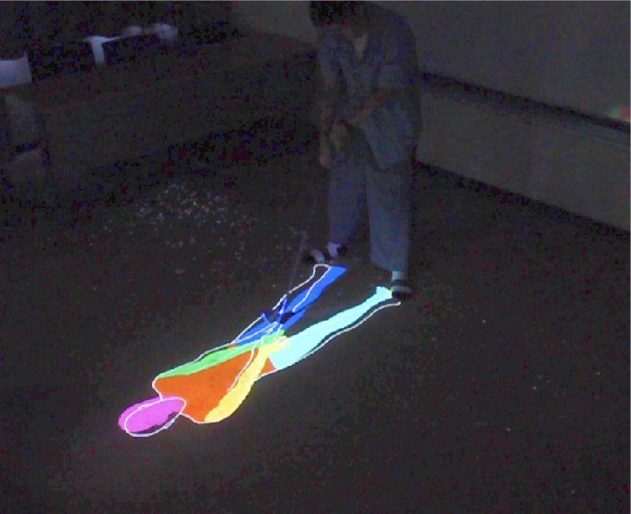
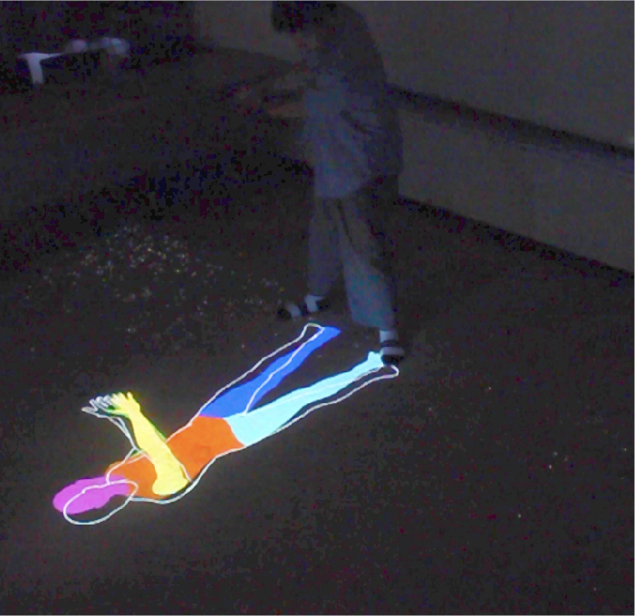
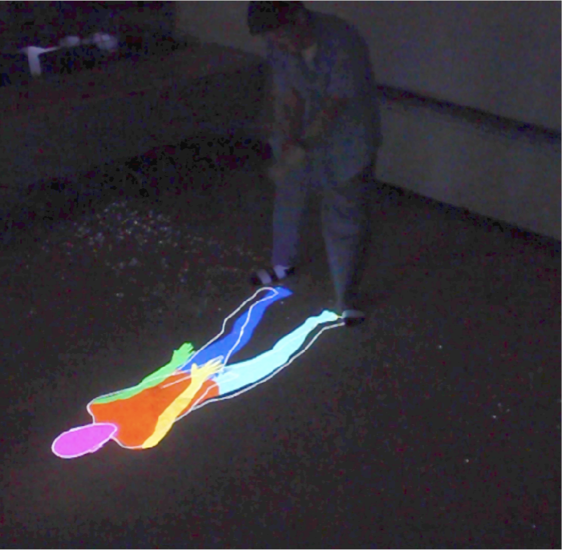
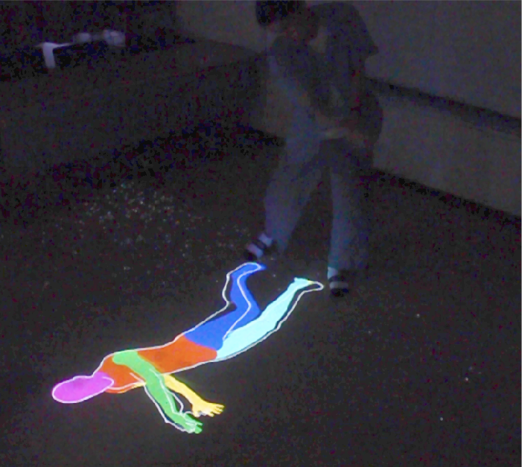
Abstract
In this work, we propose a golf training system using real- time visual feedback. The system projects the virtual shadow of the user on the ground in front of the user; this shadow provides feedback to the user without form collapse. Addi- tionally, an expert’s contour is overlaid on the virtual shadow of the user to make them aware of the difference between their form and that of the expert. In this system, the user can receive feedback with a fixed face orientation according to the actual golf swing; such feedback cannot be realized in systems projecting feedbacks on a wall. Moreover, by imitating the shadows already used in conventional golf training, the cost of adaptation to this training system can be reduced.
Author Keywords
augmented reality, virtual shadow, sports training
实时视觉反馈的高尔夫训练系统。系统将用户的虚拟阴影投射到用户面前的地面上.
专家的轮廓覆盖在用户的虚拟阴影上，使他们意识到他们的动作与专家的动作之间的差异。

Slide 3
Introduction
In most sports, including golf, skills can be improved by im- itating the motions of experts. Various systems and feed- back methods have been proposed in the field of motion- training support systems. In particular, many systems em- ploy real-time visual feedback; among these, some systems project the feedback on a wall or a side display. However,
in golf, a system that projects feedback onto a wall may un- dergo form collapse when users raise their heads to see the visual feedback.
On the other hand, golf players often use shadows in train- ing such as the golf shadow drill. Additionally, since shad- ows are daily phenomena, they may provide users an intu- itive perception of their forms. Therefore, the cost of adap- tation to systems employing shadows is expected to be low.
To explore the impact of shadows in golf training, we pro- pose a prototype system that projects the virtual shadow of the user on the ground in front of the user. This shadow provides visual feedback without the problem of form col- lapse (Figure 1).
通过模仿专家的动作可以提高技能。许多系统采用实时视觉反馈; 其中，一些系统将反馈投射到墙壁或侧面显示器上。
当用户抬起头来观察视觉反馈时，将反馈投射到墙上的系统可能会崩溃。
由于阴影是日常现象，它们可以为用户提供直观感知。
我们提出了一个原型系统，用于将用户的虚拟阴影投射到用户面前的地面上。这种阴影提供了视觉反馈，

Slide 4
Related Work
Real-time feedback can enable the users to adjust their motions, poses, and behaviors immediately during training. Therefore, learning systems that provide real-time feedback are popular. In particular, several form training systems with visual feedback that simultaneously display the forms of an expert and a user have been proposed.
In My Tai-Chi Coaches[1], a user is surrounded by vir- tual mirrors that project the user and expert avatars into a mixed-reality environment. Kyan et al. [4] proposed a sys- tem that enables the easier identification of differences be- tween the user and expert by overlaying the user’s model, which is semitransparent, on the expert’s model. Kuramoto et al. [3] proposed a system that overlays an expert’s skele- tons on that of the user as projected in pseudo mirrors.
Hoang et al. proposed Onebody[2], in which the skeleton of the expert and that of the user are overlapped in the virtual space, allowing the user to view the feedback from a first- person viewpoint.
Many studies have also explored the interactive relationship
between shadows and human cognition. Xu et al.[7] sug- gested that the interface using the shadow may be an intu- itive interaction. Pavani and Galfano[6] strongly suggested that shadows cast by our own body have a special status for cognitive processing, directing attention to the body in a fast and highly specific manner
相关工作
实时反馈可以使用户在训练期间立即调整他们的动作，已经提出了几种具有视觉反馈的形式训练系统
1通过佩戴光学透视头戴式显示器，用户可以根据需要拥有自己的私人教练
4使用流行的Microsoft（MS）Kinect摄像系统捕获的骨骼关节跟踪获取人体运动数据，同时通过虚拟环境以3D可视化形式反馈提供指导和性能评估。通过在专家模型上覆盖用户的半透明模型
3提出了一个系统，它将专家的角色覆盖在伪镜像中投射的用户的角色上。增强练习镜（APM）是一个学习支持系统，它显示学习者运动重叠教师的镜像，以及它们之间的差异。此外，身体运动的速度和加速度对于理解教师的动作也很重要。在本文中，我们提出了一种教学动作的速度和加速度的可视化方法，以便学习者更容易和清楚地理解它。
2 系统使用教师和学生的骨骼跟踪，呈现为虚拟化身。使用虚拟现实耳机，学生可以想象教师的化身的移动，代替他们自己的身体。
阴影和人类认知之间
7本文介绍了一种基于投影仪的虚拟阴影用户界面，用于空间增强现实（SAR）环境（2006）
6 建议我们自己的身体投射的阴影具有特殊的认知处理状态，以快速和高度特异的方式引导对身体的注意

Slide 5
Proposed System
The prototype system displays differences in motion by overlapping the user’s silhouette with the contours of the expert.
System Configuration
As shown in Figure 2, the system captures the user’s form with Kinect1 and projects the corresponding virtual shadow using a short-focus projector on the ground in front of the
user. In addition, the system projects the expert’s virtual contour on the user’s virtual shadow.
Because the expert’s form is projected only in terms of con- tour lines, which are always drawn on the user’s virtual shadow, the user can perceive both forms without occlu- sion. The user can perceive an incorrect motion by recog- nizing the differences between the virtual shadow and the contour lines of the expert. The user can imitate the ex- pert’s form by fitting the user’s virtual shadow onto the con- tours of the expert. By projecting the virtual shadow on the ground, the user can receive visual feedback while focusing on the ball on the ground.
Method
The shadow of the user is projected based on the silhou- ette of a three-dimensional (3D) model. We use SMPL[5] to synthesize a realistic 3D model of the human body. First, the joint angles of the user are acquired by Kinect, and the model is adjusted to the user’s pose. The system uses only the user’s joint angles in order to make the system robust to body size. Next, the system applies the fragment shader to the model to extract the silhouette. Because the extracted silhouette has no roughness, it resembles a shadow.
The system captures the depth texture of the expert’s form and compares the depth of each pixel with the depths of the neighboring ones. The pixels at which the depth changes sharply are considered to be contours. Therefore, the con- tours are drawn even in the overlapping body parts. The system renders different body parts with different colors be- cause the ordinary monochrome silhouettes may make it difficult to recognize the overlapping body parts, such as arms.
The expert’s contour is based on the same model; the only difference is that the contour is based on the joint angle of
the expert motion acquired previously. If the user and the expert have the same joint angles, the silhouette and con- tours are completely matched. Therefore, the loss of depth information, which is a disadvantage of two-dimensional feedback, can be compensated by the difference in the size of the silhouette and contours. In the contours, in addition to the outside line, the contours of the overlapped body parts are also projected to make it easier for the user to recognize the form.
Through an algorithm based on dynamic time warping, the system estimates the current position of the user’s motion relative to the entire motion sequence of the expert. There- fore, the user can recognize the differences between their form and the correct form that they should be executing.
The images of the user’s silhouette and expert’s contours thus obtained are overlapped by considering the positions of their feet. By projecting the overlapped image that is in- verted and upside down fixed to the user’s feet, the system provides the virtual feedback using the virtual shadow.
·系统使用Kinect1捕获用户
短焦投影仪在前面的地面投影相应的虚拟阴影
使用SMPL 来合成一个逼真的人体三维模型
将片段着色器应用于模型以提取轮廓
普通的单色轮廓可能使得难以识别重叠的身体部位
如果用户和专家具有相同的关节角度，则轮廓和轮廓完全匹配。
将重叠的图像投影到用户的脚上，使用虚拟阴影提供虚拟反馈。

Slide 6
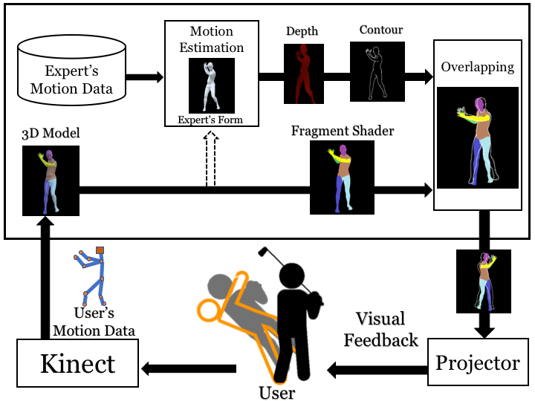

Slide 7
Conclusion
In this paper, we proposed a golf form training support sys- tem that employs the use of virtual shadows. The system urges the user to intuitively understand their form by view- ing silhouettes. Furthermore, overlapping the user’s form with the contour lines of an expert’s form allows the user to recognize the differences between their form and the ex- pert’s form. Visual feedback is projected onto the ground in front of the user; the user can thus receive feedback and imitate the form with the correct face position as that re- quired for the actual golf swing. In the future, we will con- duct a user study of the proposed system and evaluate the effectiveness of using virtual shadows.
Acknowledgements
This work was supported by JST CREST Grant Number JPMJCR17A3, Japan.
结论
在本文中，我们提出了一种采用虚拟阴影的高尔夫形式训练系统。 该系统通过查看轮廓促使用户直观地了解他们的形式。
此外，将用户与专家的轮廓线重叠，用户识别其之间的差异。 视觉反馈被投射到用户面前的地面上; 因此，用户可以接收反馈并模仿具有正确的形式，如实际的高尔夫挥杆。 将来，我们将对拟议系统进行用户研究，并评估使用虚拟阴影的有效性。

Slide 8
REFERENCES
1 .Ping-Hsuan Han, Yang-Sheng Chen, Yilun Zhong, Han-Lei Wang, and Yi-Ping Hung. 2017. My Tai-Chi Coaches: An Augmented-learning Tool for Practicing Tai-Chi Chuan. In Proceedings of the 8th Augmented Human International Conference (AH ’17). ACM, New York, NY, USA, Article 25, 4 pages. DOI: http://dx.doi.org/10.1145/3041164.3041194
2. Thuong N. Hoang, Martin Reinoso, Frank Vetere, and Egemen Tanin. 2016. Onebody: Remote Posture Guidance System Using First Person View in Virtual Environment. In Proceedings of the 9th Nordic Conference on Human-Computer Interaction (NordiCHI ’16). ACM, New York, NY, USA, Article 25, 10 pages. DOI:http://dx.doi.org/10.1145/2971485.2971521
3 . I. Kuramoto, Y. Nishimura, K. Yamamoto, Y. Shibuya, and Y. Tsujino. 2013. Visualizing Velocity and Acceleration on Augmented Practice Mirror Self-Learning Support System of Physical Motion. In 2013 Second IIAI International Conference on Advanced Applied Informatics. 365–368. DOI: http://dx.doi.org/10.1109/IIAI-AAI.2013.28
4. Matthew Kyan, Guoyu Sun, Haiyan Li, Ling Zhong, Paisarn Muneesawang, Nan Dong, Bruce Elder, and Ling Guan. 2015. An Approach to Ballet Dance Training Through MS Kinect and Visualization in a CAVE Virtual Reality Environment. ACM Trans. Intell. Syst. Technol. 6, 2, Article 23 (March 2015), 37 pages. DOI: http://dx.doi.org/10.1145/2735951
5. Matthew Loper, Naureen Mahmood, Javier Romero, Gerard Pons-Moll, and Michael J. Black. 2015. SMPL: A Skinned Multi-person Linear Model. ACM Trans. Graph. 34, 6, Article 248 (Oct. 2015), 16 pages. DOI: http://dx.doi.org/10.1145/2816795.2818013
6. Francesco Pavani and Giovanni Galfano. 2015. The multisensory body revealed through its cast shadows. Frontiers in Psychology 6 (2015), 666. DOI: http://dx.doi.org/10.3389/fpsyg.2015.00666
7. H. Xu, D. Iwai, S. Hiura, and K. Sato. 2006. User Interface by Virtual Shadow Projection. In 2006 SICE-ICASE International Joint Conference. 4814–4817. DOI: http://dx.doi.org/10.1109/SICE.2006.314974

