Slide 1
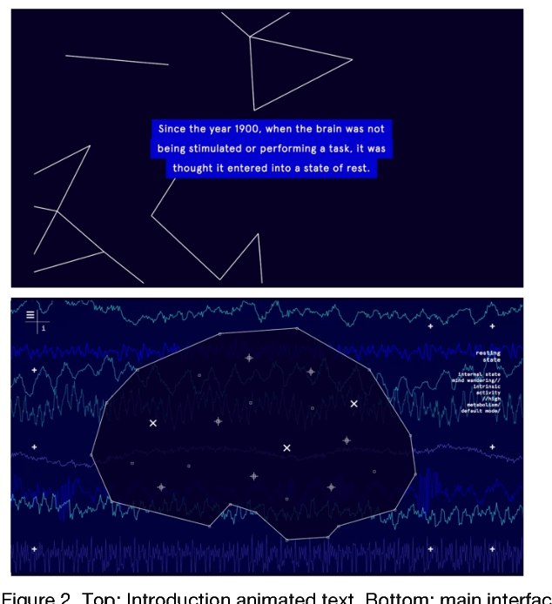
Understanding People's Interaction with Neural Sci-Art
Authors:
Manuela Garretón，Karina Hyland，Denis Parra
（from Pontificia Universidad Católica de Chile)
IEEE VIS Arts2017
https://vimeo.com/230827867

Slide 2
Abstract
Abstract
Introduction
1. Introduction
Relate Work
2. Related Work
3. Default Mode Network
Methode
4. Design Goals
5. Default Stories
6. Evaluation
7. Results
Conclusions
8.Conclusion

Slide 3
Default Mode Network(DMN)
- A complex neural network;
神游時負責運作的神經網路
Default Stories
- To introduce novel scientific finding to non-expert audience; 非專業人士也可以理解科技新發現
- Motivated by related works that combine science and art; 從結合科技與藝術的作品得到啓發
- A web interactive documentary
一個網路互動紀錄片
“….This work will serve as a starting point for new projects that present complex scientific research to non-expert public, by using interactive web experiences. ”
利用互動網頁體驗將複雜的科學研究展示給非專業人群的新型研究項目的出發點
Abstract
Abstract
Introduction
1. Introduction
Relate Work
2. Related Work
3. Default Mode Network
Methode
4. Design Goals
5. Default Stories
6. Evaluation
7. Results
Conclusions
8.Conclusion

Slide 4
Abstract
Abstract
Introduction
1. Introduction
Relate Work
2. Related Work
3. Default Mode Network
Methode
4. Design Goals
5. Default Stories
6. Evaluation
7. Results
Conclusions
8.Conclusion
每個人都經歷過某種程度的心智游移的狀態（白日夢）。
神經科學發現在這樣的狀態時，大腦對應區域内的一個複雜的神經網絡(Default Mode Network(DMN)
預設模式網路)會永久地活動，這樣的活動可以被形容為ming-wandering，即白日夢。
本論文的目的在於通過製作一個浸入式紀錄片Default Stories讓非專業人士理解DMN的概念。

Slide 5
藝術與科學的跨領域項目
-利用新的數位方式講述真實的故事，如Interactive Documentary.
Sci-Art: interaction between arts, sciences and technologies(new media, digital art and interactive art)
“I-dos” or “interactive narratives”?
“I-dos”: A form of nonfiction narrative that uses action and choice, immersion and enacted perception as ways to construct the real, rather than represent it. (J. Aston and S. Gaudenzi, “Interactive documentary: setting the field”, Studies in Documentary Film, vol. 6, no. 2, pp. 125-139, 2012.)
“interactive narratives” :A type of narrative form that allows someone other than the author to affect, choose or change the plot. (M.S. Meadows, “Pause & effect: the art of interactive narrative”, Pearson Education, 2002. )
Abstract
Abstract
Introduction
1. Introduction
Relate Work
2. Related Work
3. Default Mode Network
Methode
4. Design Goals
5. Default Stories
6. Evaluation
7. Results
Conclusions
8.Conclusion

Slide 6
“interactive narratives”
自1970年代起出現，尤其被應用在科幻電腦游戲上（ text-based, such as the Colossal Cave Adventure (1976) and Zork (1977), or multimedia-based, such as Myst (1993) ）
“type of narrative form that allows someone other than the author to affect, choose or change the plot”
本文將作品定義爲“I-dos”類型，突出i-docs能夠實際對使用者理解現實的方式作出影響
“…have the opportunity to actually impact on the way the viewer/player perceive reality.”
“…the user has an active role in the construction of his/her own story”
Abstract
Abstract
Introduction
1. Introduction
Relate Work
2. Related Work
3. Default Mode Network
Methode
4. Design Goals
5. Default Stories
6. Evaluation
7. Results
Conclusions
8.Conclusion

Slide 7
The activity of the default mode, often compared to a stream of consciousness, can be made out of limitless amount of varied contents. This kind of thoughts appear spontaneously in your mind and they can skip rapidly into other thoughts, even other times and spaces, and end it up somewhere unexpected. This makes the default mode network a nonlinear system, where small changes at the beginning can amplify in the process and cause enormous changes at the end
Abstract
Abstract
Introduction
1. Introduction
Relate Work
2. Related Work
3. Default Mode Network
Methode
4. Design Goals
5. Default Stories
6. Evaluation
7. Results
Conclusions
8.Conclusion

Slide 8
Three Design Goals
網頁設計理念
- Engage the public through enticing aesthetics
浸入式體驗互動設計(獨創音樂，具有美感的畫面)，吸引使用者注意力并確保用戶在問答結束前不會退出頁面
- Provide the user with content fragments to build a personal story
選擇較爲普遍的生活情境作爲問題答案，經過選擇構成非綫性敘事的故事。
爲了完善設計，選擇個人電腦作爲載體，確保個性化的私人體驗。
- Produce awareness of the network
將DMN這項發現有意識地傳達給使用者，理解神游這樣的活動并非是無目的的。DMN在一些特定精神活動中扮演著重要作用
Abstract
Abstract
Introduction
1. Introduction
Relate Work
2. Related Work
3. Default Mode Network
Methode
4. Design Goals
5. Default Stories
6. Evaluation
7. Results
Conclusions
8.Conclusion

Slide 9
DEFAULT STORIES
收集使用者瀏覽網頁的數據來分析用戶與界面的互動以及他們如何察覺和理解DMN
Visit: http://historias.xdefault.cl/en
5.1 Preface：
5.2 Main Body
5.3 Closure
Abstract
Abstract
Introduction
1. Introduction
Relate Work
2. Related Work
3. Default Mode Network
Methode
4. Design Goals
5. Default Stories
6. Evaluation
7. Results
Conclusions
8.Conclusion

Slide 10
DEFAULT STORIES
5.1 Preface
DMN被發現過程簡介
“the brain constantly tells stories to itself, and it does so by default”

Slide 11
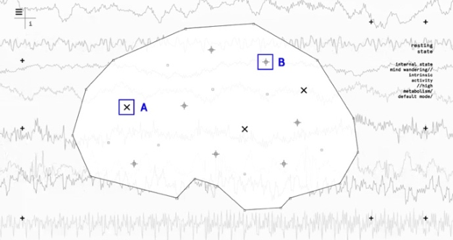
DEFAULT STORIES
5.2 Main Body
腦内resting state：7個獨白故事（盡可能使用最爲普遍的内容來吸引更多觀衆，獲得認同感），引起大腦内在對白
畫面模糊: default mode ,大腦放空，對外界事物的注意力受到限制
外界刺激將default mode打斷時，畫面迅速變得清晰
腦外attention state：點擊外側，通過聲音與畫面示意外界刺激滲入腦内
resting state/
attention state

Slide 12
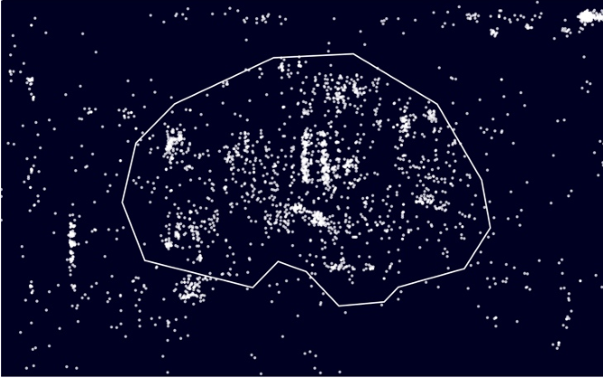
EVALUATION
6.1 Data collection
網頁點擊記錄及問卷調查
- 僅有最早的三個答案被記錄下來。- 通過這些記錄分析用戶的選擇。
6.2 Participants
- 98人被邀請進行測試（49男49女）
- 其中21-27歲的用戶有59人，其餘人數平均分散在另外4個年齡組（14-20， 28-34，35-42，42以上）。
- 最初的測試在西班牙進行，所有測試者都使用西班牙語。
6. Evaluation

Slide 13
RESULTS 從兩方面分析結果：
- click-log analysis –to understand sequences of action
(分析頁面點擊記錄，得出選擇順序)
- frequent itemsets –to find a relation between sequences of actions and how people perceive the default mode network
(分析重複頻率，得出選擇順序的不同與對DMN理解程度之間的關係)
7.1 User interaction analysis
7.2 How do people experience the DMN?
Abstract
Abstract
Introduction
1. Introduction
Relate Work
2. Related Work
3. Default Mode Network
Methode
4. Design Goals
5. Default Stories
6. Evaluation
7. Results
Conclusions
8.Conclusion

Slide 14
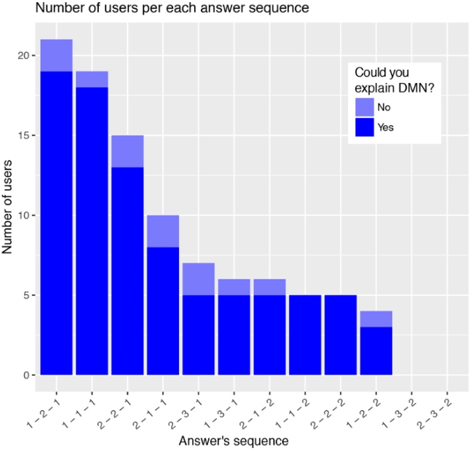
RESULTS
7.1 User interaction analysis
點擊分佈在腦内區域和腦外區域，
腦内區域更爲頻繁。
根據問題與答案的數量可得出共有12種可能的組合方式。
實際收集到的數據占了其中的10種組合。

Slide 15
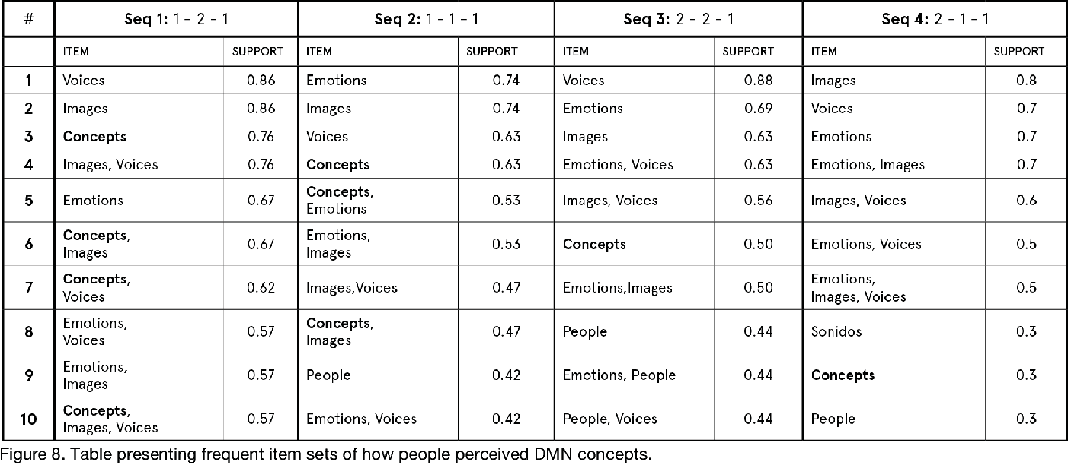
RESULTS 7.2 How do people experience the DMN?
利用出現頻率最高的四種組合分析人對DMN的感知
(回答Which elements describe better your personal experience of the DMN?)

Slide 16
CONCLUSIONS
- Default Stories:
a work in progress interactive documentary with the purpose to engage non-expert public with a scientific concept –the default mode network– by means of interacting with an aesthetic experience.
- Fututre work (evaluations):
Make use of the interactions pattern to design a more personalized experience for this Sci-Art project
- In term of research: Incorporate Design-Based Research for Sci-Art domain(get to know the participant perceptions with unguided discussions)
Abstract
Abstract
Introduction
1. Introduction
Relate Work
2. Related Work
3. Default Mode Network
Methode
4. Design Goals
5. Default Stories
6. Evaluation
7. Results
Conclusions
8.Conclusion

