Slide 1
科技藝術書報討論
第三週
孫佳興
9月27日南大實驗室

Slide 2
有人建造了一个岩石分选机器人，它是彻头彻尾的催眠

Slide 3
JLLER
*Jller* is part of an ongoing research project in the fields of industrial automation and historical geology. It is an apparatus that sorts pebbles from a specific river by their geologic age. The stones were taken from the stream bed of the German river Jller, shortly before it merges with the Danube, close to the city of Ulm. The machine and its performance is the first manifestation of this research.
A set of pebbles from the Jller are placed on the 2x4 meter platform of the machine, which automatically analyzes the stones in order to then sort them. The sorting process takes place in two steps: Intermediate, pre-sorted patterns are formed first, to make space for the final, ordered alignment of stones, defined by type and age. Starting from an arbitrary set of stones, this process renders the inherent history of the river visible.
The history, origin and path from each stone found in a river is specific to the location, as every river has a different composition of rock types. The origin of those stones is well documented. For instance, the ones from the river Jller derive from two origins. Some come from rocks, that are the result of erosions in the Alps and are carried in from smaller rivers. Other stones have been ground and transported by glaciers that either still exist, or existed in the ice ages. As the Alps and flats, which were once covered by glaciers, have shifted, even deeper rock-layers were moved and as a result, stones from many geologic periods make their way into a river.
When the history of a river is known, the type of stone can be directly related to its geological age. One very common sedimentary rock is the dark grey limestone from the Triassic period (225 million years ago). It was formed from the layers of sediments in the primeval ocean. Granodiorite, on the other hand, is an igneous rock of volcanic origin from the Tertiary Period (30 to 40 million years ago). Between those types there is a variety of metamorphic rocks, created by the transformation of existing rock types through the influence of temperature and pressure over time. Furthermore, a small amount of pebbles are formed by non-rock materials like red brick or slag, which have their origin in the Anthropocene.
Most of the time, stones do not appear as a singular uniform material, but as a composition of different, laminated or layered materials. A prominent example of this are the white lines of lime in grey pebbles.
**Technology:** The machine works with a computer vision system that processes the images of the stones and maps each of their locations on the platform throughout the ordering process. The information extracted from each stone are dominant color, color composition, and histograms of structural features such as lines, layers, patterns, grain, and surface texture. This data is used to assign the stones into predefined categories. Those categories represent the range of stones that can be found in the specific river and correspond directly to the age of the stone. They are the result of a classification system that is trained by sets of manually selected and labeled stones. Because there are only a limited number of stone types that can be found in a specific river, this system proves to be very accurate. The stones get picked up by an industrial vacuum gripper, which can rotate around its own axis. This way the pebbles can also be aligned.
Jller was presented as part of *Ignorance*, a collaborative exhibition by German artist Benjamin Maus and Czech artist Prokop Bartoníček.

Slide 4
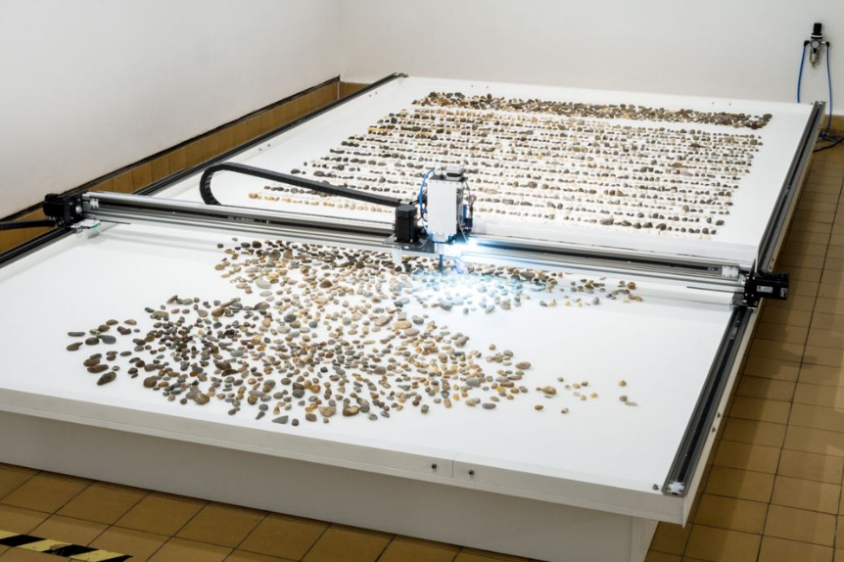

Slide 5
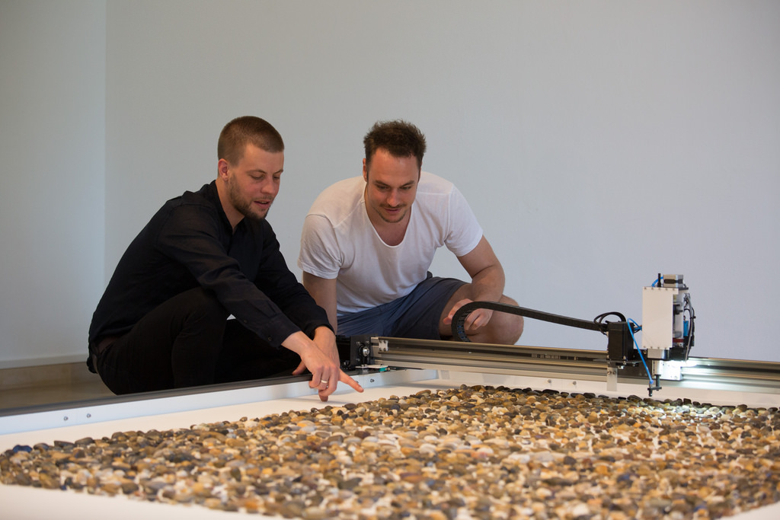
Idea
1，運用科學理性的方法對JLLER河流的地質的歷史進行分析研究，探究對自然環境的變化對文明的影響，這種變化也是影響人類文明的重要要素。也是當代藝術需要探討的議題。
2，JLLER不久前與多瑙河合併，形成不同的地質岩石。通過科技對不同地质年龄特定河流中的鹅卵石进行分类。
3，石头经过冰川运输或岩石層移動，最終匯入到一條河流，每種石頭來自不同河流中的岩石類型，呈現出不同的顏色、線條、圖案。例如：“常见的沉积岩是三叠纪时期（2.25亿年前）的深灰色石灰岩，它是由原始海洋中的沉积层组成的。另一方面，花岗闪长岩是第三纪（3000万至4000万年前）火山岩的火成岩。这些变质岩石是随着时间的推移温度和压力的影响而改变成现有岩石类型。”
Bartoníček says. "This need to collect things and sort them is really one of the most elemental points where we humans start to be humans.”
——收集分類這些石頭的需求，這實際上是我們人類開始的最重要因素之一。

Slide 6
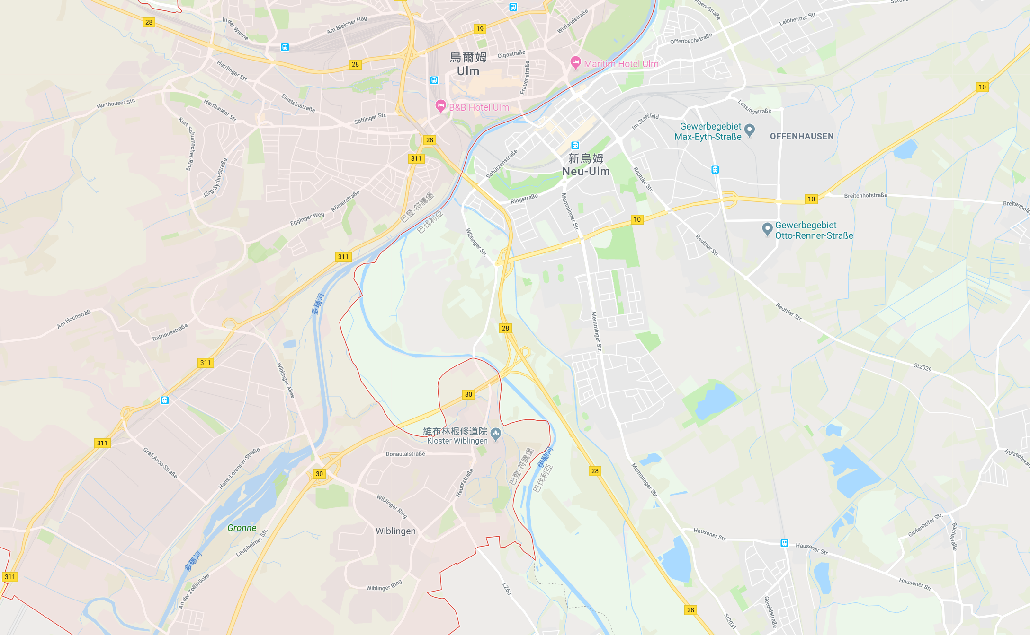

Slide 7
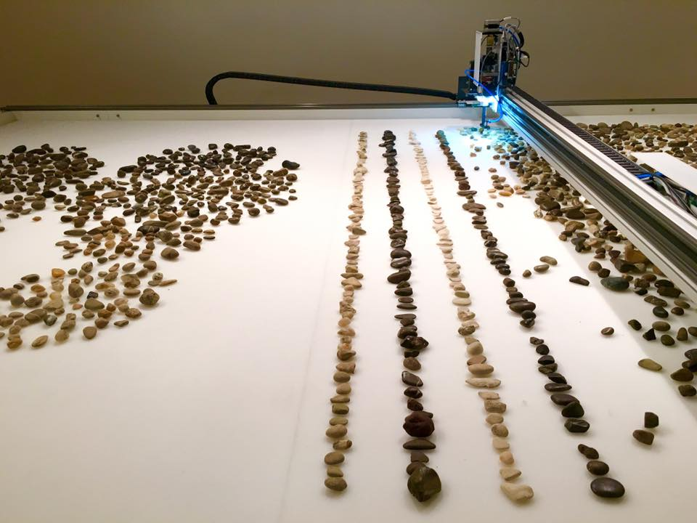
Form
1，工業自動化技術，計算機視覺識別系統配合，相机拍摄随机分类岩石的照片，并用它来绘制每块石头的位置。
2，歷史地質學，通過對每一種石頭對應的年齡特點，例如主色、線條、圖層、圖案、紋理，進行識別數據，再分配到預定類別中。
3，工業真空夾吸起石頭，再放入計算機預設坐標區域。

Slide 8

Prokop Bartoníček(巴托尼切克)
1983年1月出生于布拉格。2003年，在中学毕业之前，他被接纳为教授雕塑工作室。Beranek在布拉格艺术建筑与设计学院（UPRUM）。在2007-2008之间，Bartonicek是教授的学生。目前，他在柏林和布拉格生活和工作。在2008-2015年，Bartonicek组织了定期的艺术展览，以便在布拉格的22个展厅展示柏林的实验场景。此外，他还建立了一个文化中心Ex Post，位于布拉格市中心的前邮局。Bartonicek是Pebe Interactive sro公司的所有者兼董事，负责生产技术要求严格的项目。
巴托尼切克并没有脱离人类经验的维度; 他没有走进虚拟现实的人造领域。相反，他的工作重点是经过仔细考虑（虽然不断尝试）并置电子媒体的迷人完美表达和同样令人着迷的“真实”的人性和自然世界。在这两个领域之间的对话中，Bartoníček主要关注揭示人类思想，自然界和宇宙中发生的过程。

Slide 9
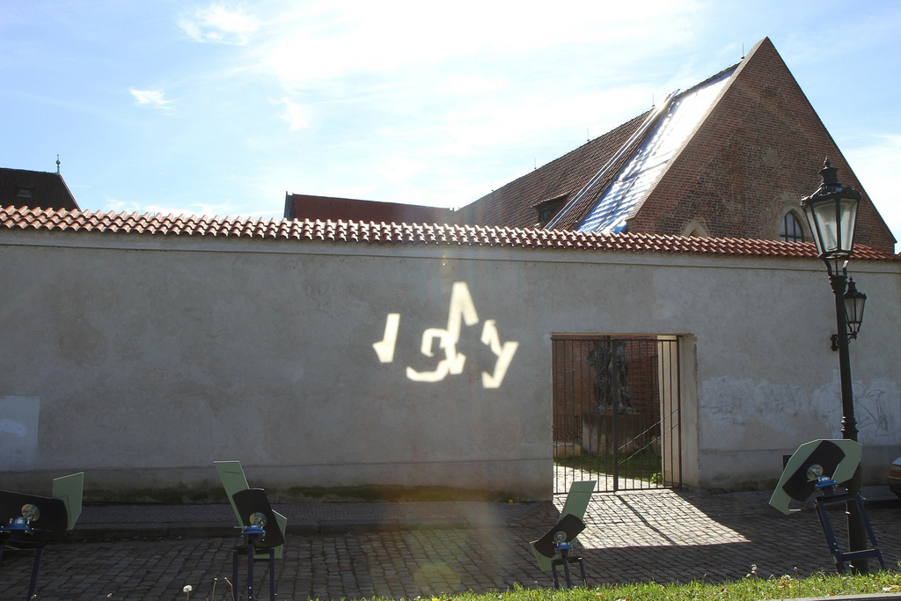

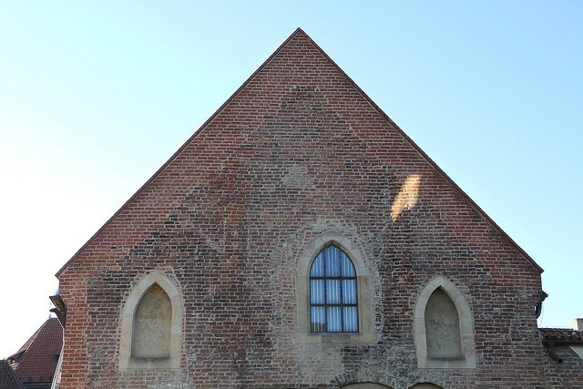
现在
https://vimeo.com/50501685
在城市场景中，我们可以看到几何形状的太阳反射。由太阳描述的抽象构图从上方接近地面。几个小时后，形状重叠，从而形成一个强大的光簇，在互锁铭文中变化非常快。在遭遇的单个光碎片呈现“现在”这个词，准确地捕捉到瞬间的瞬间。
如今，高效设计和照明技术，绘图和生成艺术的可用性往往忽略了光，时间和空间的基本规则。我决定创建一个令人印象深刻的公共空间灯装置，它将在基本原理范围内工作。
Mirrsaic作为一个过程和工具，使用最先进的科技和技术进行编程，生成和制造，这些科技和技术并不是观众直接看到的。最复杂的项目工具是隐藏的; 它只是一堵墙，一盏日光和几个精确形状的镜子，确切时间的确切位置。

Slide 10
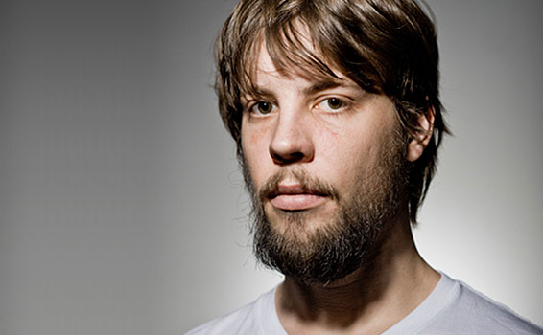
Benjamin Maus（本杰明·毛斯）
出生于1984年。在他生命的早期，他开始拆除设备并使用BASIC作为生成图形的工具。他于2005年在Schwäbisch-Gmünd应用科学大学开始学习。2008年，他搬到柏林，继续在柏林艺术大学学习，在那里他属于Digitale Klasse。直到2007年，他曾经是金属乐队Sepcys的贝斯手。
他喜欢从事设计和艺术项目，使用代码和技术作为工具和媒体。尽管他具有非常技术性的背景，但他认为对现有技术和新兴技术的范式和先入之见不是应该被接受和遵循的事情而不是质疑它们。事实上，他们应该尽可能地被滥用和重新利用; 如果没有合适的概念工具，您应该创建自己的工具。只有这样，才能就不可避免地影响我们世界的事物进行公开对话。对他而言，艺术与设计之间没有界限; 设计是实用艺术。

Slide 11
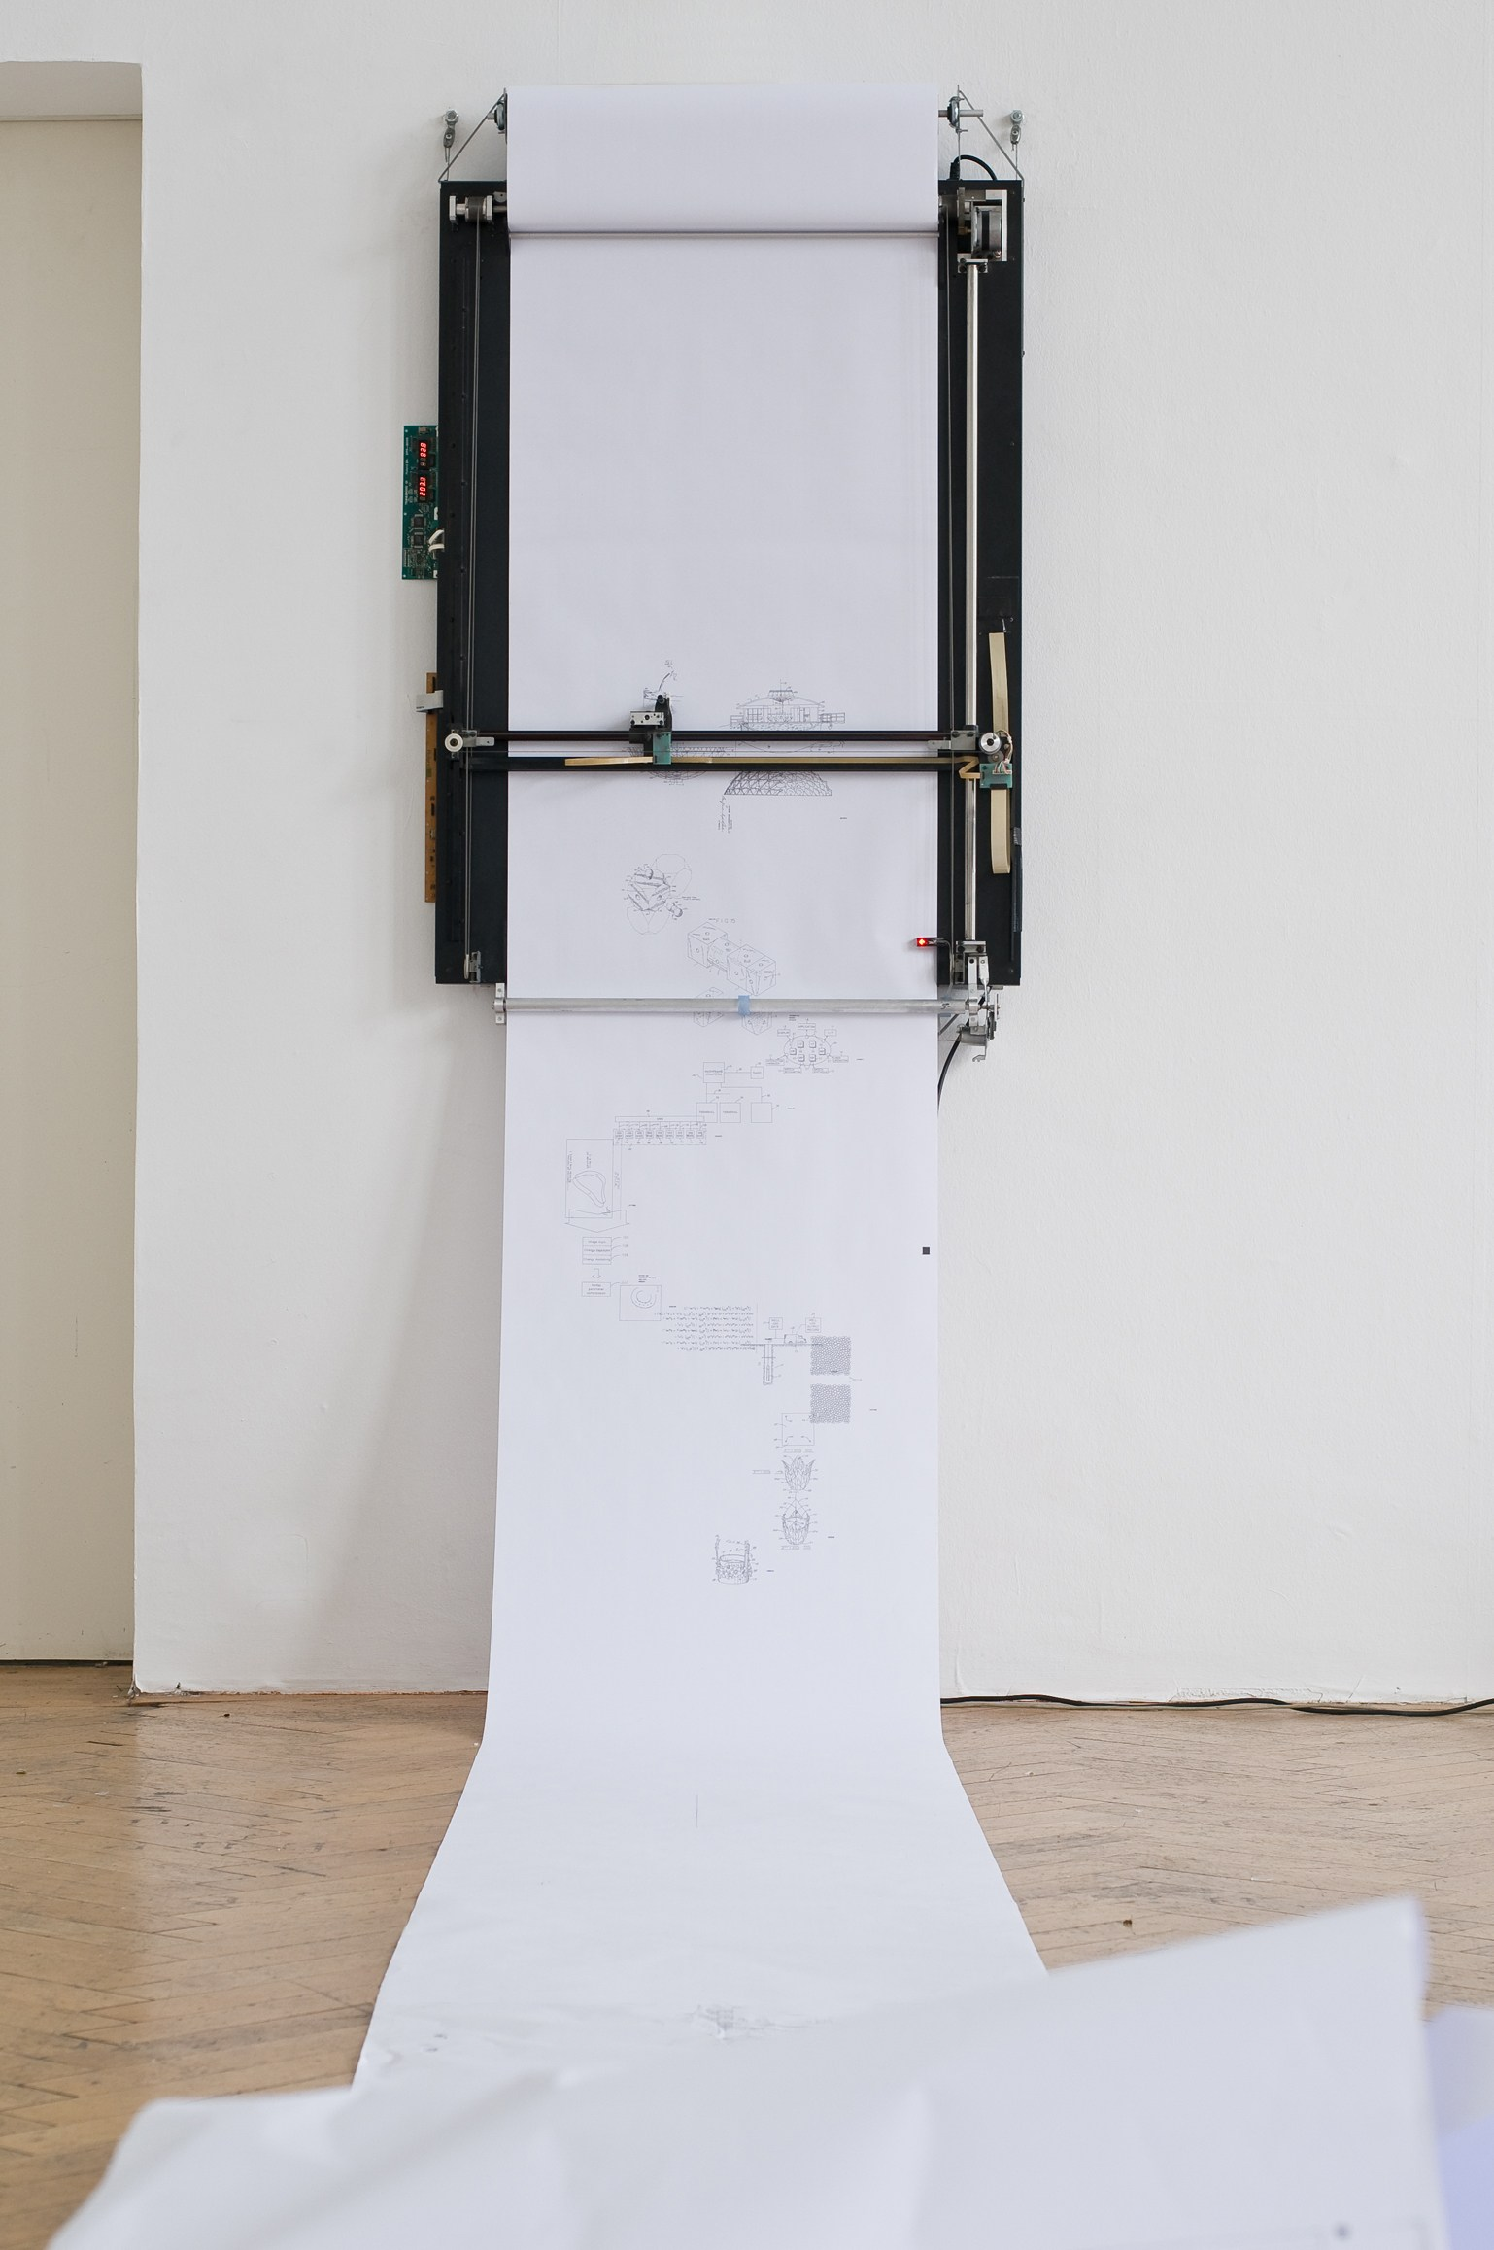
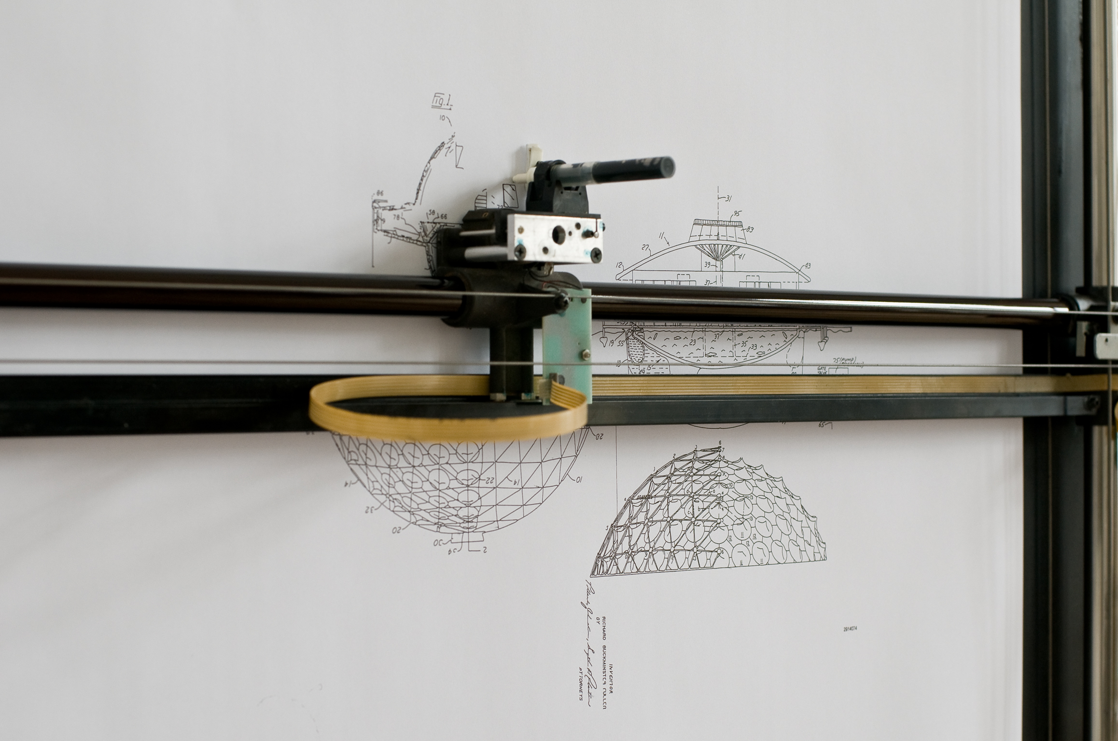
艺术家使用计算语言BASIC作为生成图形的工具，将一组数据转换为活动的艺术作品。

Slide 12
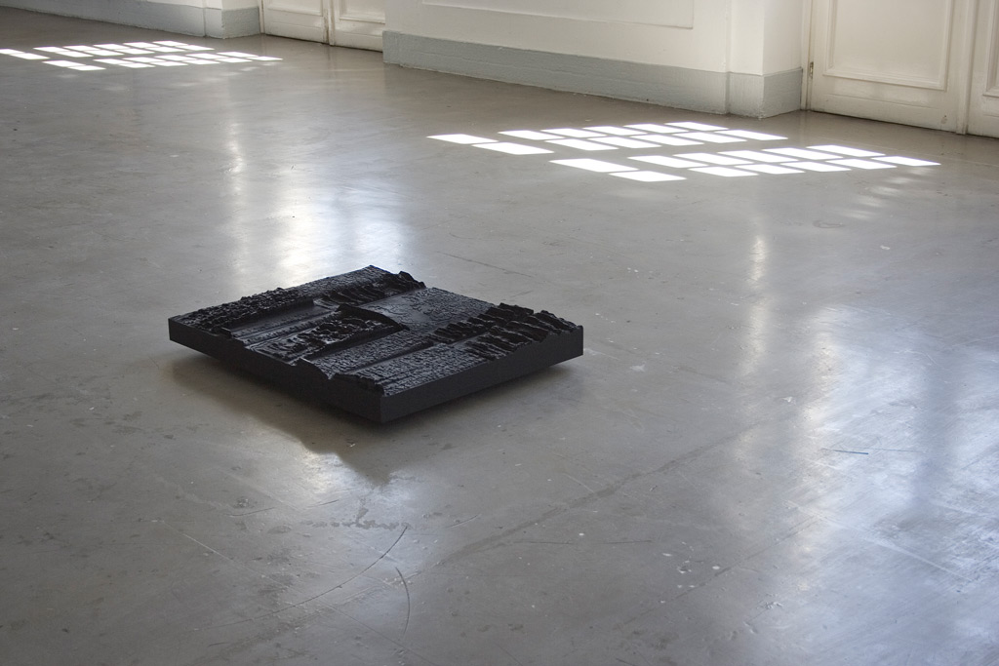
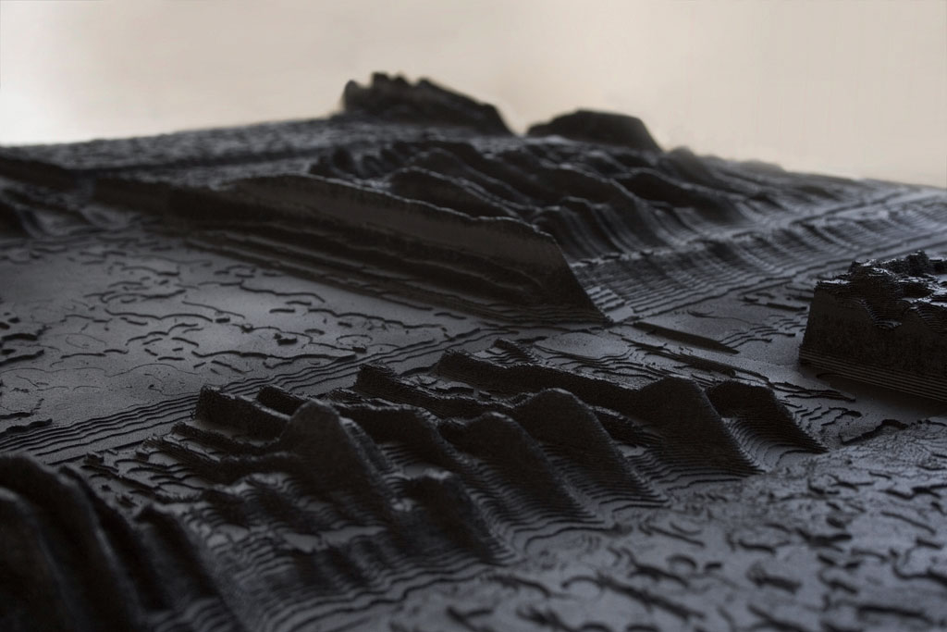
反射是一种声音数据雕塑，源自Frans de Waard同名的音乐作品。受阿姆斯特丹5天节日的委托，参加“冷冻”展览。
材料：CNC铣削MDF，尺寸：900mm x 720mm x 120mm。

Slide 13
謝謝!
民國107年9月26日于清華大學清齋宿舍

